Slide 1
The Postmodern Contribution
Big Sky Worldview Forum
Glenn Sunshine
www.esquareinch.org

Slide 2
The Role of Language
Major Theme in Postmodernism
Relationship of Language to External World
Relationship of Language to Thought
Relationship of Language to Culture
Relationship of Language to Power

Slide 3
Language and Thought
Linguistic Relativity
“Sapir-Whorf Hypothesis”
Linguistic Determinism (“Strong Form”)
Linguistic Influence (“Weak Form”)
Ludwig Wittgenstein (1889-1951)
Philosophical Investigations (1946/1953)
Language-Games
Key Point: Words only have Meaning in Context

Slide 4
Structuralism and Post-Structuralism
Structuralism
Society as Interlocking Network of Structures
Binary Opposition
Fundamental to Definitions, Identity
Post Structuralism
Rejects Structuralism/Coherence Theory
Rejects Experience/Correspondence Theory
Knowledge Based on Cultural Assumptions/Rejects “Metanarratives”
Rejects Binary Opposition
Binaries are Culturally Determined

Slide 5
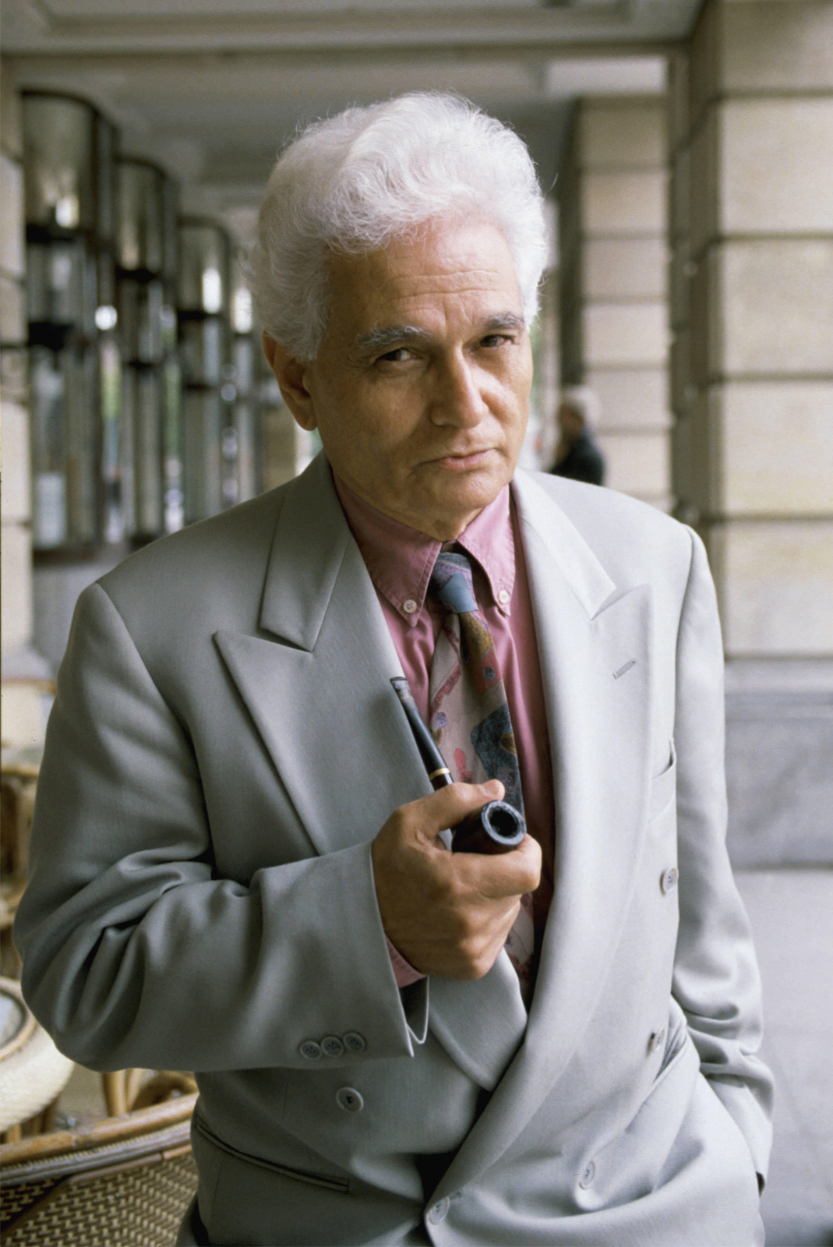
Jacques Derrida (1930-2004)
Starts with Binary Opposition
Adds Hierarchy
Deconstruction
Identify and Question Binaries and Hierarchies
Political Implications: Disrupting Hierarchies
“Texts”
Other Thinkers
Authorial Intent is Only One Possible Meaning
Authorial Intent Inaccessible
Reader-Response Criticism
Postmodern Jargon

Slide 6
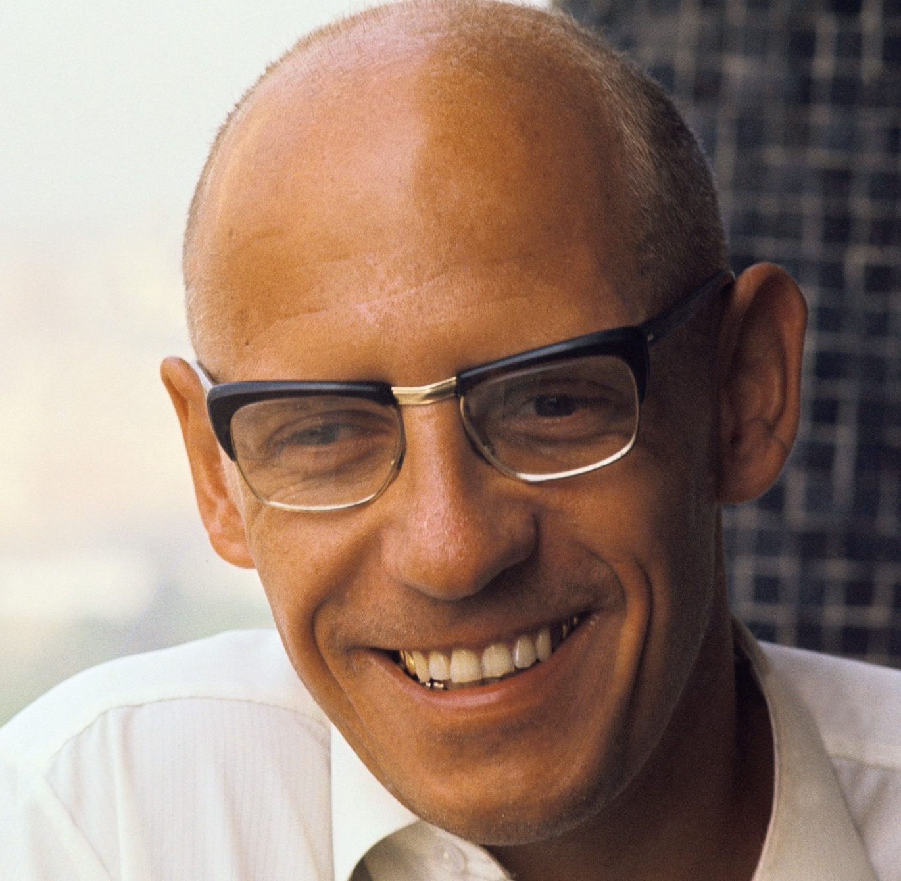
Michel Foucault (1926-1984)
Dissatisfaction with New Left
Power, Knowledge, and Language
Impossibility of Objective Knowledge
Knowledge Determined by Those with Cultural Power (Gramsci’s Hegemony)
Language Encodes Existing Power Structures
Sex and Sexuality as Social Constructs
Tied to Power
Used to Delegitimize LGBT People

Slide 7
Modern Critical Theory
Cultural Marxism plus Postmodernism
Gramsci’s Hegemony and Call for Counter-Hegemony
New Left’s Oppressed Classes and Identity Politics
Derrida’s Challenge of Hierarchies
Foucault’s Concept of Power Dynamics of Language
Despite His Criticism of the New Left!
Focus on Language
Tool of Hegemony and Therefore of Counter-Hegemony
Language Shapes Thought
Therefore, Political Correctness

Slide 8
Intersectionality
Start with Approved Categories of Oppression
Race
Sex
Then LGB
Then T
How Do the Various Categories of Oppression Intersect?
Oppression of Blacks
Oppression of Women
Oppression of Black Women

Slide 9
Intersectionality and Identity
Reject Universals about Humanity
No Metanarratives
Rejects Individual
Identity a Product of Approved Intersectional Categories
You and Everything about You Comes from you Intersectional Categories

Slide 10
Standpoint Theory
Knowledge from Intersectional Identity
Lived Experience as Source of Truth
Self-Validating
Self-Interpreting
Ethnic Gnosticism (Voddie Baucham)
Whites only Know their Hegemonic Culture
Minorities Know White Culture plus their own Lived Experiences
Therefore, Minorities have Superior Understanding of the World than Whites

Slide 11
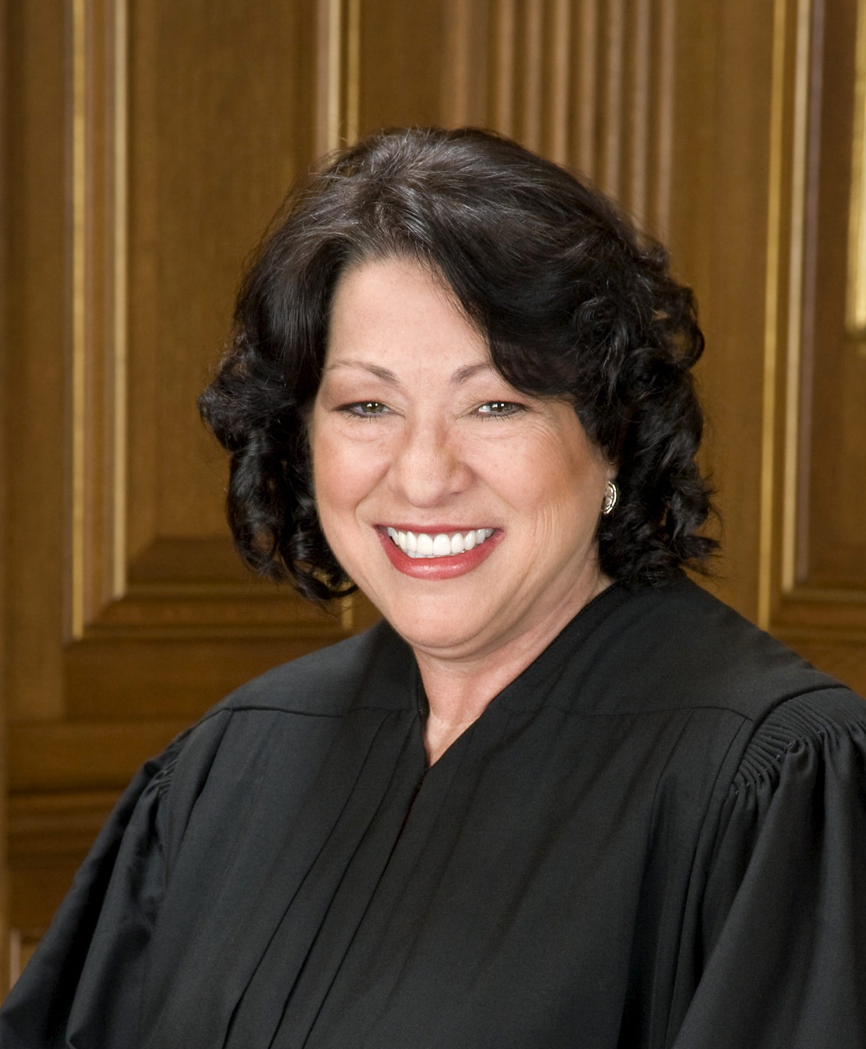
Standpoint Theory
“I would hope that a wise Latina woman with the richness of her experiences would more often than not reach a better conclusion than a white male who hasn't lived that life.”
Sonia Sotomayor, SCOTUS Justice

Slide 12
Implications
Objectivity does not Exist
Everything We Think We Know is Culturally Determined
White Culture Includes
Science
Logic
Insistence on Evidence
Non-White Cultural Experience Trumps These
Applies to All Knowledge Coming from the Hegemony

