Slide 1
The Critical Theory Umbrella
Big Sky Worldview Forum
Glenn Sunshine
www.esquareinch.org

Slide 2
The Zero-Sum Game

Slide 3
Everything is a Zero-Sum Game
Economics
Power
Race
Sex
Class
Etc.
Moral Authority

Slide 4
Identity and Moral Authority
Identity Defined by Intersectional Categories
Lose Moral Authority from Oppressor Categories
Gain Moral Authority from Oppressed Categories
More Oppressed Categories = More Moral Authority
Oppression = Sin
Salvation = Becoming “Woke” or an “Ally”
Not Possible in Some Versions of Critical Theory
Only Oppressors Sin

Slide 5
Creating Communities of Virtuous Victimhood
Women: Victims of Male Oppression
LGBTQ+: Victims of Heteronormative Oppression
People of Color: Victims of White Oppression
Muslims: Victims of Western Oppression
Pagans: Victims of Christian Oppression
Undocumented Workers: Victims of American Oppression
The Poor: Victims of Corporate Oppression
The Planet: Victim of Industrial Oppression

Slide 6
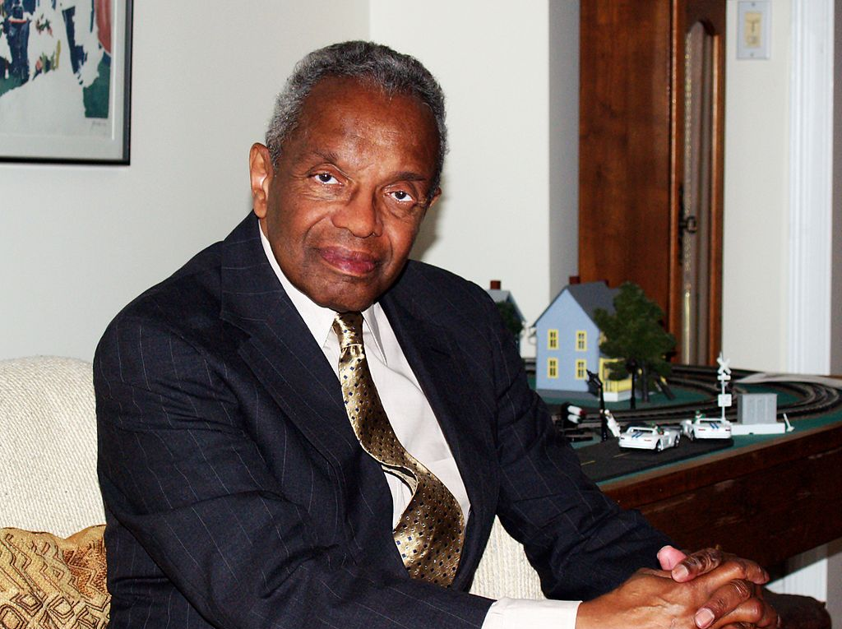
Critical Race Theory (CRT)
Derrick Bell
US Law is White Supremacist
Advances in Civil Rights only if Benefit White Elites
Kimberlé Crenshaw
Intersectionality
Identity
Neither Individual nor Universal
Intersection of Groups

Slide 7
Critical Race Theory
Race as a Social Construct
Changing Definitions
Race and Biology
Definitions of Racism
Old Definition
Newer Definition
Cultural Hegemony
White Supremacy
White Privilege
Newest Definition

Slide 8
White Supremacy Culture*
Perfectionism
A sense of urgency
Defensiveness
Valuing quantity over quality
Worship of the written word
Belief in only one right way
Paternalism
Either/or thinking
Power hoarding
Fear of open conflict
Individualism
Belief that I'm the only one (who can do this 'right’)
Belief that progress is bigger and more
Belief in objectivity
Claiming a right to comfort.
*https://www.dismantlingracism.org/white-supremacy-culture.html

Slide 9
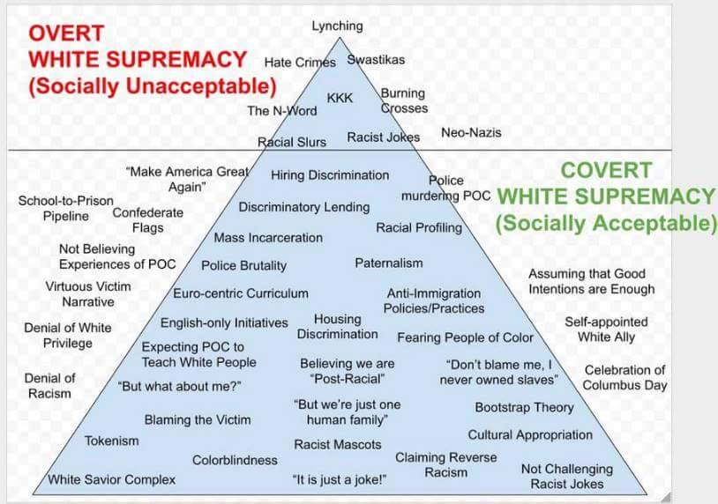
https://radicalcopyeditor.com/2017/04/21/white-supremacy/

Slide 10
“Objectivity” and White Supremacy
Truth as Subjective and Personal
Experience as Criterion for Truth
The Narrative
Statistics as Tool of White Supremacy
No Possibility of Shared Truth
Locked into World of Your Own Experience
Ethnic Gnosticism (Voddie Baucham)
Standpoint Theory
“Knowledge” as Tool of Hegemony (Foucault)

Slide 11
White Privilege*
The ability to speak and write from an unchallenged position of authority (see, for instance, commenters online);
The ability to hold onto wealth during economic crisis (Black and Latino families lost far more wealth during the home foreclosure crisis than did white families);
Protection from experiencing the brunt of negative implications of climate change (economically vulnerable and politically unstable populations, mostly people of color in the global south, are disproportionally affected);
Protection from the lowest wages and most dangerous labor conditions cultivated by the globalization of production;
Being able to deny that racism exists;
Believing in and cultivating sympathy from others for “reverse racism";
Being unconcerned with the racial implications of political candidates one supports;
Believing you worked hard for and earned everything you have without receiving any help or advantages;
Believing that people of color who have achieved success have been given racially motivated advantages;
The ability to adopt a victim status rather than engaging in critical self-reflection when accused of racism;
Believing it is acceptable to be “ironically” racist;
Believing that people need to “get over it” or “move on” when they point out racism; and,
The belief that cultural products and practices that come from communities of color are yours for the taking.
*Cole, Nicki Lisa, Ph.D. "Understanding and Defining White Privilege." ThoughtCo, Feb. 11, 2020, thoughtco.com/white-privilege-definition-3026087.

Slide 12
“Black Lives Matter”
Legitimate Slogan but Problematic Movement (Chris Brooks)
Deeply Rooted in Critical Theory, Intersectionality
Reject “Patriarchal” Nuclear Family
Children raised by “Village” to the degree that Mothers and Children are Comfortable
Fathers?
Strong Support for LGBTQ+
“Black Trans Lives Matter”
Pro-Abortion
Early Anti-Semitic Statements

Slide 13
“Black Lives Matter”
Assume All Cultures, Household Configurations are Equal
Unequal Outcomes must therefore Come from Oppression
Question: Which Black Lives Matter?
Unborn?
Police?
Victims of Crime?
Owners of Looted Businesses?
Those Whose Deaths Support the Narrative?

Slide 14
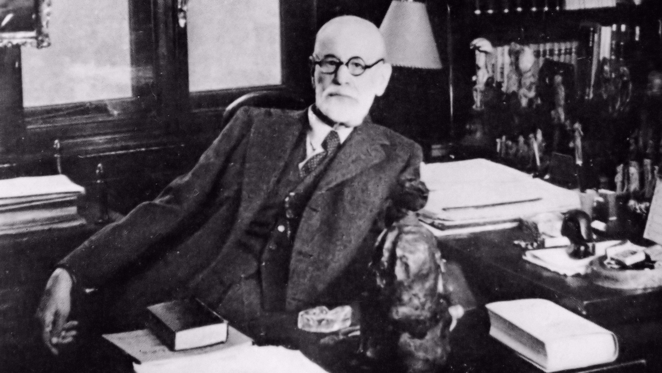
The Sexual Revolution
Sigmund Freud (1856-1939)

Slide 15
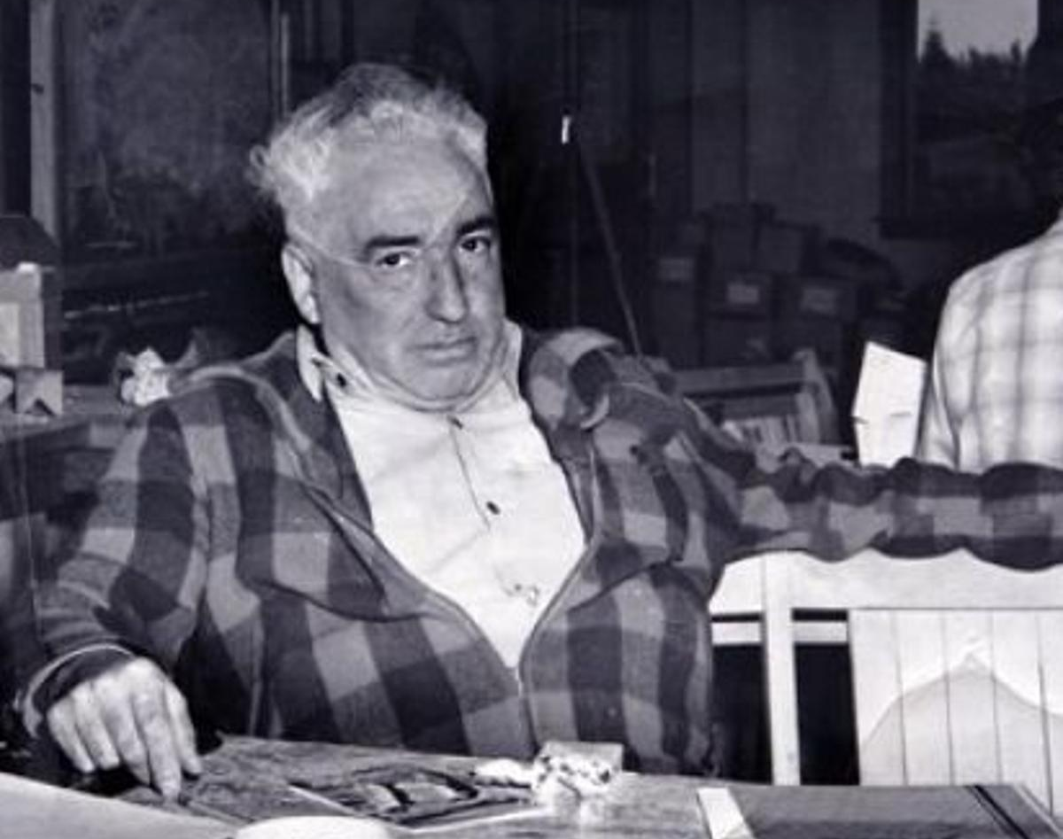
The Sexual Revolution
Wilhelm Reich (1897-1957)
Frankfurt School
Why Marx Failed
Too Radical: Repudiated

Slide 16
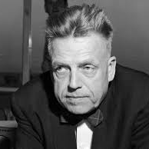
The Sexual Revolution
Alfred Kinsey (1894-1956)
Sexual Behavior in the Human Male (1948)
Sexual Behavior in the Human Female (1953)

Slide 17
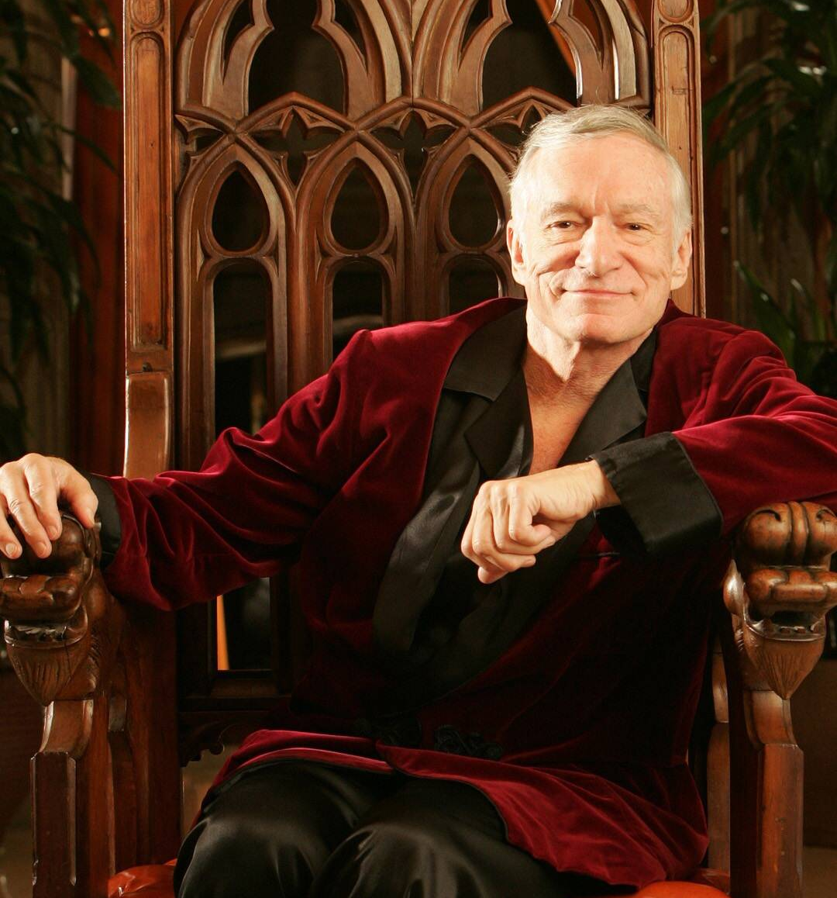
The Sexual Revolution
Hugh Hefner (1926-2017)
Playboy (1953)

Slide 18
The Sexual Revolution
“[Our goal] is to be ready as educators and parents to help young people obtain sex satisfaction before marriage. By sanctioning sex before marriage we will prevent fear and guilt … we must be ready to provide young boys and girls with the best contraception measures available so they will have the necessary means to achieve sexual satisfaction without having to risk possible pregnancy.” --Lena Levine, Planned Parenthood, 1953

Slide 19
From Sexual Liberation to Sexual Minorities
Foucault on Sexuality
Key Question: Identity (Gender, Sexual)
The Problem: Judgmentalism
Metaphysics: Transcendentalism (Neo-Gnosticism)
Epistemology: Subjectivism (Intuitive)
Ethics: Libertine

