Slide 1
Responding to Critical Theory
Big Sky Worldview Forum
Glenn Sunshine
www.esquareinch.org

Slide 2
Why Do We Need a Response?
Critical Theory is Being Institutionalized
Law, Education, Media, etc.
Indoctrination in Schools
The Further from the Truth You Go
The More Lives are Broken
The Faster the System Collapses
But It Won’t Go Down without a Fight
E.g. Cannot Question Critical Theory’s Assumptions

Slide 3
A Biblical Perspective on Truth
Objective Truth Exists
Revelation and Reason
Experience not the Final Word
Truth Matters in Practical Ways
Reject Cultural Relativism: e.g. Aztecs
Reject Moral Relativism: e.g. Pol Pot
Reject Equality of All Family Structures

Slide 4
The Image of God
Source of Human Worth
Gen. 9:6
Cx. The World’s Standards
No Room for Discrimination
Race
Sex
Class
Religion
Lifestyle

Slide 5
Biblical Principles: Individual
Image of God
Intersectionality and Idolatry
Spiritual and Moral Equality
Sin and Salvation
Love as Foundation of Ethics
Love as Action, Not Words

Slide 6
Biblical Principles: Corporate
Impact of Sin
Individual
Embedded in ALL Institutions, Cultures
Confession of Corporate Sin
Impact of Redemption: Diversity in Service of Unity
Individuals in Churches
Churches in Cultures
Cultures Refracting Image of God in Different Ways

Slide 7
LGBTQ+: The Immediate Challenge
Implications of the Equality Act
Bob Jones University v. United States (1983)
Churches
Christian Colleges and Institutions
Probable Responses

Slide 8
Responding to the Sexual Revolution
What Should We Do?
Intentional Communities
Values are Formed in Community
Work with the Willing
Support for Those on Front Lines
Education in Families and Churches
“Why?” not just “What?” of Sexual Behavior
Speak the Truth in Love

Slide 9
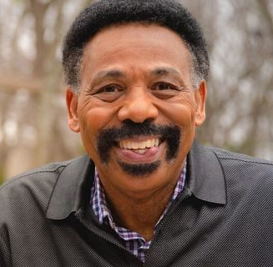
Racial Issues
“If it wasn’t for the failure of the church, and particularly the Evangelical church that supported practically and theologically a division that should not have taken place, we would not have these problems. So since the church helped cause it, the church has to be in front fixing it.”
—Dr. Tony Evans

Slide 10
Rethinking Race
Not “Objective” Biological Reality
Not Biblical
Image of God as Source of Human Value
CRT is Correct: Race is a Social Construct
Still a Cultural Reality
Therefore Must Focus on Cultural Change Informed by Scripture
Can’t get to Biblical Solutions using non-Biblical Categories
Racial Differences on a Spectrum

Slide 11
Systemic Racism?
Systemic Racism
Differing Definitions
Implications of “Hard” Meaning
Institutional Racism
Sin Embeds in Institutions
Criminal Justice
Employment
Redlining
E.g. Driving while Black

Slide 12
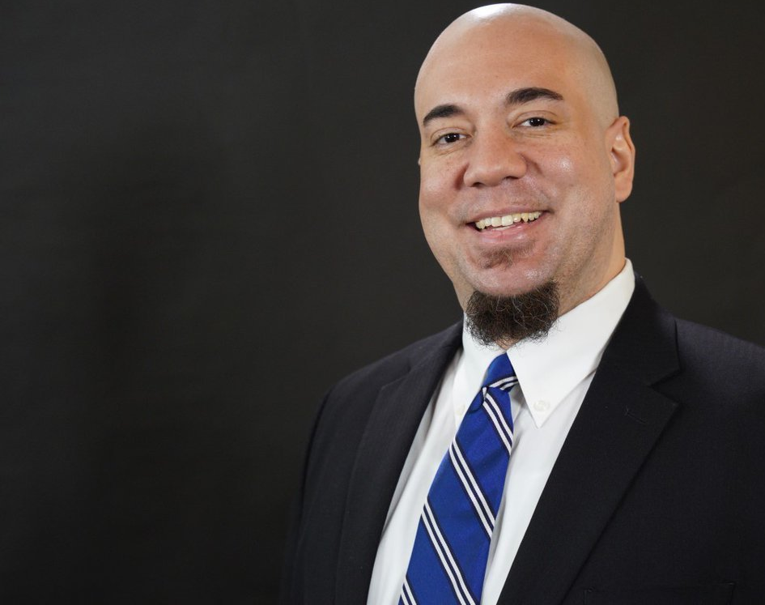
Rethinking Racism
Tweet: “3 reasons modern problems in Black communities can't automatically be blamed on ‘racism’ - as vs. the welfare state, etc: (1) many didn't exist when racism was much worse (fatherlessness), (2) few exist for Black IMMIGRANTS, and (3) all exist to ~ the same extent for poor whites.”
—Prof. Wilfred Reilly, Political Science Professor, Kentucky State University

Slide 13
Rethinking White Privilege
Race isn’t a Biblical Category, but Class is
Malia Obama vs. 21 y.o. White Laborer
Culture is a Biblical Category
Highest Earning Ethnicity: Indian-Americans
Asian-Americans: POC or White?
Alternative: African-American Disadvantage

Slide 14
Dealing with White Privilege
Two Ways of Eliminating Privilege
Take It Away
Spread It
Examples
Driving while Black
Ending Segregation (MLK)
Assumption: The Way Whites are Treated Should be the Norm
A.k.a. the Golden Rule

Slide 15
Toward Racial Reconciliation
DO NOT
DO
Engage in Drive By Ministry
Simply Quote Statistics or Explain away Racism
Present Yourself as the Great White Hope
Build Relationships
Listen and Learn with Humility
Weep with those who weep
Build Ministry Partnerships with the Community
Let the Community Guide You

