Slide 1
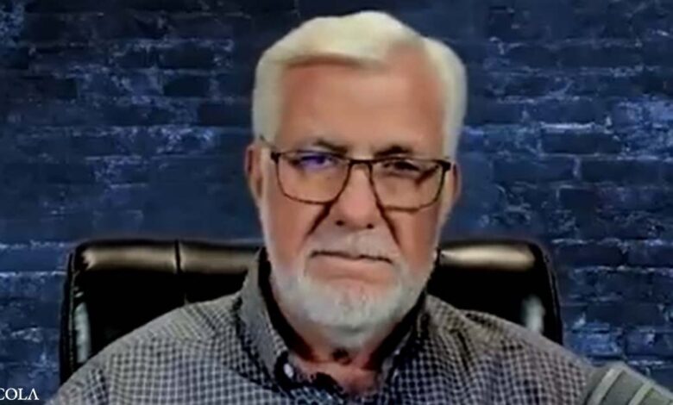
“America is being methodically and purposely conquered by an unseen enemy. Our shields are down. Our people are asleep. Our weapons are almost non-existent. The war has been waged in stealth, so the enemy has not yet been identified... until now!”
Patrick Wood December 18, 2015

Slide 2
1980
November
2022
2015
2018
patrickwood.substack.com

Slide 4
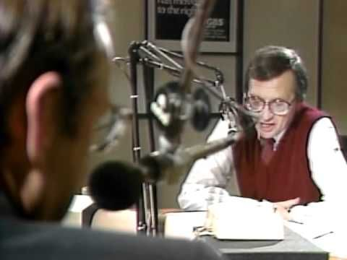

Slide 6
^{The dark horse of the} ^{New World Order is not} Communism, Socialism or Fascism. ^{It is Technocracy.}

Slide 7
“A scientist, my dear friends, is a man who foresees; it is because science provides the means to predict that it is useful, and the scientists are superior to all other men.”
Henri de Saint-Simon (1760-1825)

Slide 8
Hamilton Hall, Columbia University

Slide 9
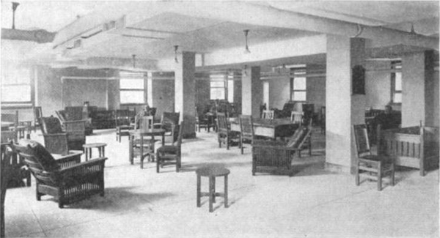

Slide 10
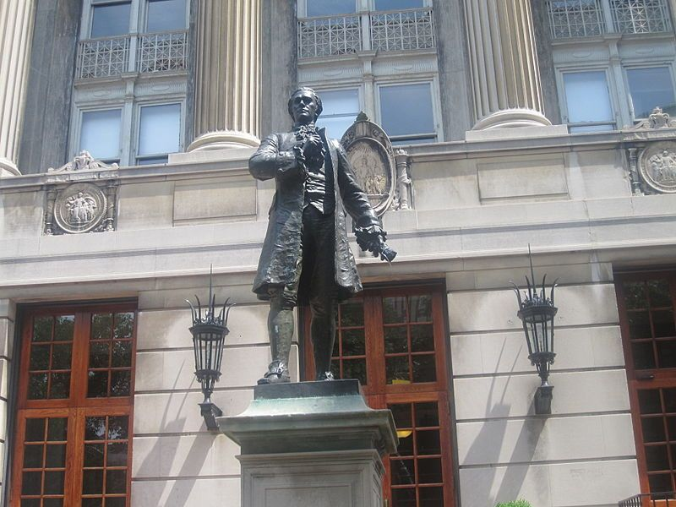

Slide 11
Technocracy is the science of social engineering, the scientific operation of the entire social mechanism to produce and distribute goods and services to the entire population...
– The Technocrat, 1937

Slide 12
There will be no place for Politics, Politicians, Finance or Financiers, Rackets or Racketeers… Technocracy will distribute by means of a certificate of distribution available to every citizen from birth to death.
– The Technocrat, 1937

Slide 13
M. King Hubbert (1903-1989)

Slide 14
“Technocracy is dealing with social phenomena in the widest sense of the word; this includes not only actions of human beings, but also everything which directly or indirectly affects their actions. Consequently, the studies of technocracy embrace practically the whole field of science and industry. Biology, climate, natural resources, and industrial equipment all enter into the social picture.” – Technocracy Study Course

Slide 15
Register on a continuous 24 hour-per-day basis the total net conversion of energy.
By means of the registration of energy converted and consumed, make possible a balanced load.
Provide a continuous inventory of all production and consumption.
Provide a specific registration of the type, kind, etc., of all goods and services, where produced and where used.
Provide specific registration of the consumption of each individual, plus a record and description of the individual.
Allow the citizen the widest latitude of choice in consuming his individual share of continental physical wealth.
Distribute goods and services to every member of the population.

Slide 16
Register on a continuous 24 hour-per-day basis the total net conversion of energy.
By means of the registration of energy converted and consumed, make possible a balanced load.
Provide a continuous inventory of all production and consumption.
Provide a specific registration of the type, kind, etc., of all goods and services, where produced and where used.
Provide specific registration of the consumption of each individual, plus a record and description of the individual.
Allow the citizen the widest latitude of choice in consuming his individual share of continental physical wealth.
Distribute goods and services to every member of the population.

Slide 17
Register on a continuous 24 hour-per-day basis the total net conversion of energy.
By means of the registration of energy converted and consumed, make possible a balanced load.
Provide a continuous inventory of all production and consumption.
Provide a specific registration of the type, kind, etc., of all goods and services, where produced and where used.
Provide specific registration of the consumption of each individual, plus a record and description of the individual.
Allow the citizen the widest latitude of choice in consuming his individual share of continental physical wealth.
Distribute goods and services to every member of the population.

Slide 18
Register on a continuous 24 hour-per-day basis the total net conversion of energy.
By means of the registration of energy converted and consumed, make possible a balanced load.
Provide a continuous inventory of all production and consumption.
Provide a specific registration of the type, kind, etc., of all goods and services, where produced and where used.
Provide specific registration of the consumption of each individual, plus a record and description of the individual.
Allow the citizen the widest latitude of choice in consuming his individual share of continental physical wealth.
Distribute goods and services to every member of the population.

Slide 19
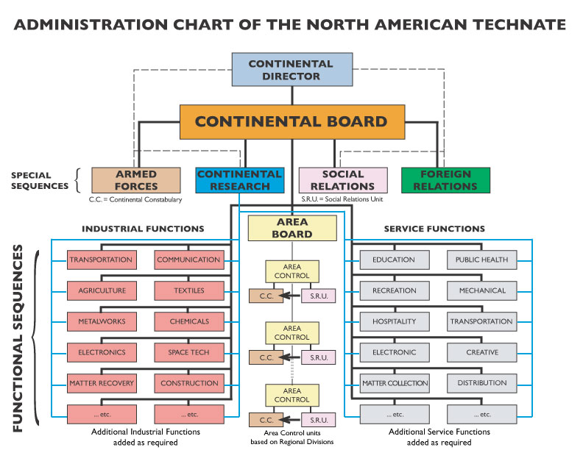

Slide 20
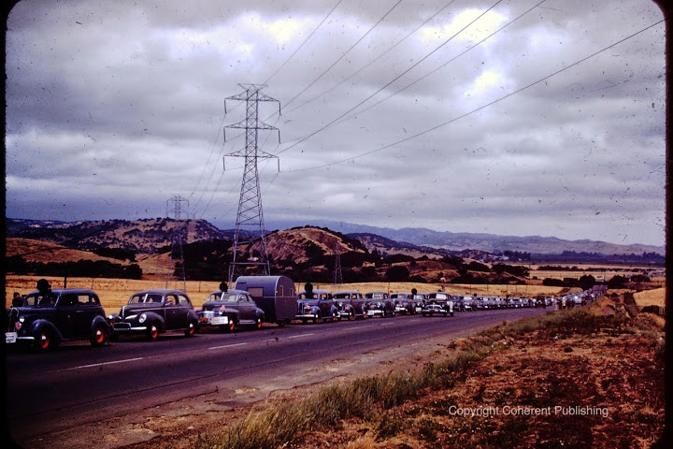

Slide 21
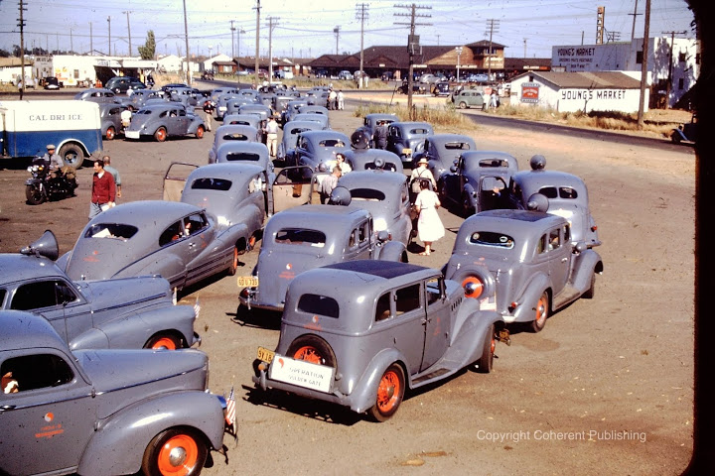

Slide 22
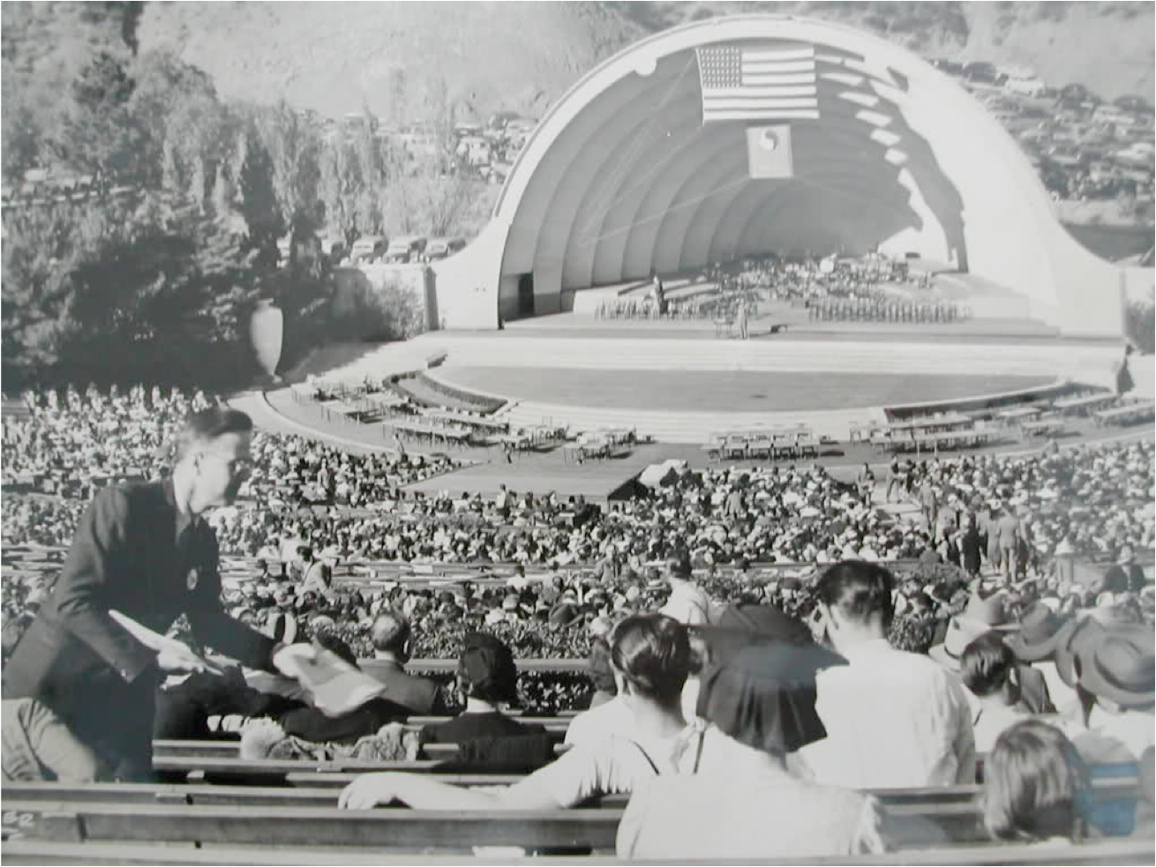

Slide 23
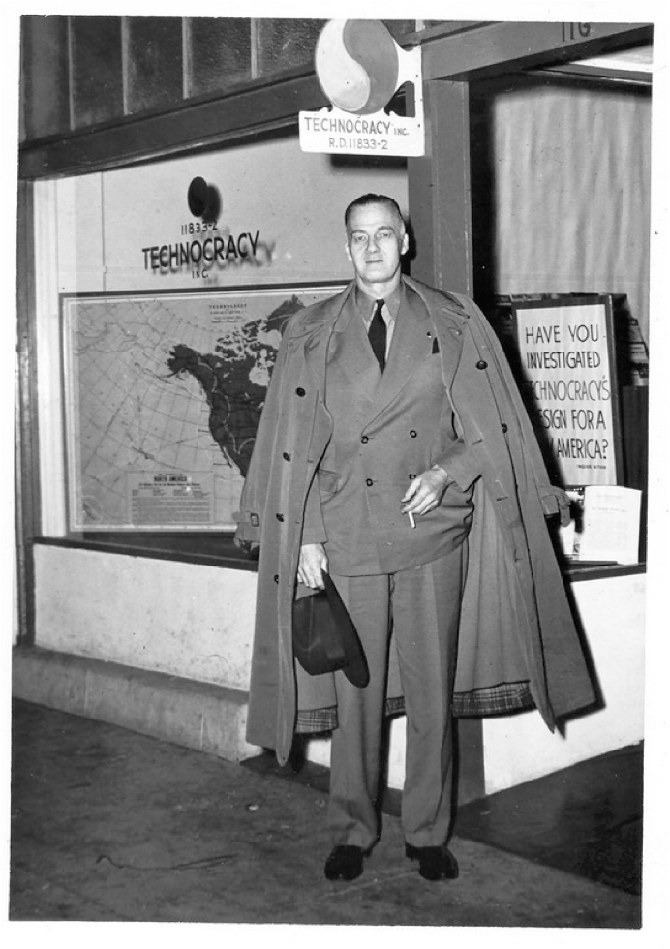
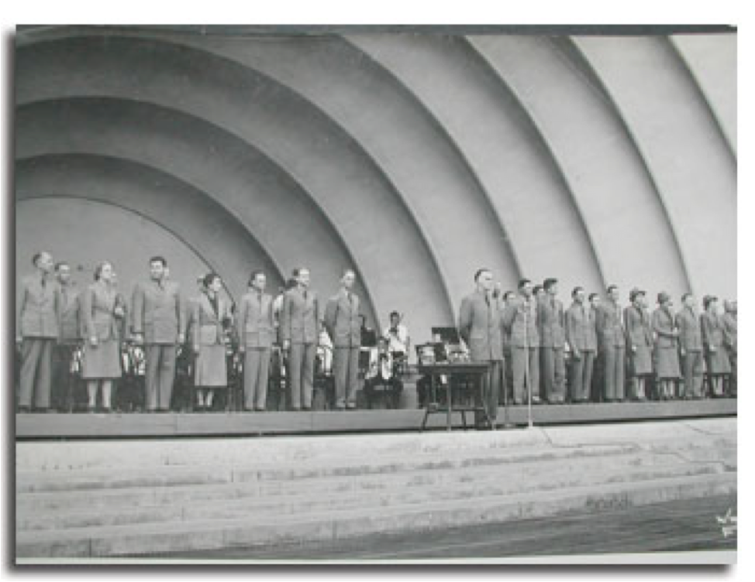

Slide 24
Technocracy is the ONLY alternative economic system in the history of the world.

Slide 25
The book that set the course

Slide 27
Bilderberg Hotel, Netherlands - 1972

Slide 28
Co-founded in 1973 by
David Rockefeller and Zbigniew Brzezinski

Slide 29
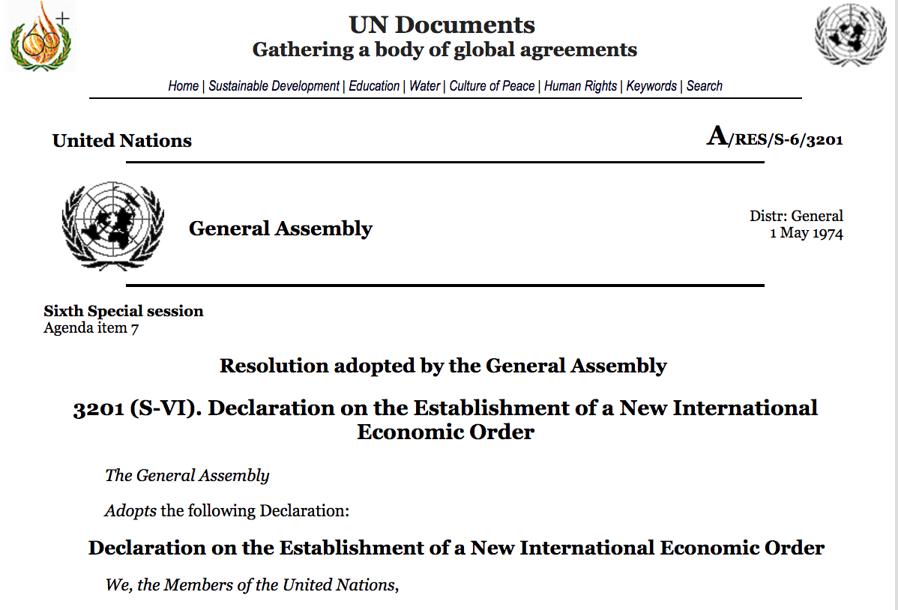

Slide 30
Zbigniew Brzezinski - 1970
“The nation-state as a fundamental unit of man’s organized life has ceased to be the principal creative force: International banks and multi­national corporations are acting and planning in terms that are far in advance of the political concepts of the nation-state.” - Between Two Ages

Slide 31
Richard Gardner - 1974
“The ‘house of world order’ will have to be built from the bottom up rather than from the top down. It will look like a great ‘booming, buzzing confusion,’ to use William James' famous description of reality, but an end run around national sovereignty, eroding it piece by piece, will accomplish much more than the old-fashioned frontal assault.” – The Hard Road To World Order

Slide 32
Bringing China onto the world stage
Brzezinski (L) and Chairman Deng (R) - 1979

Slide 33
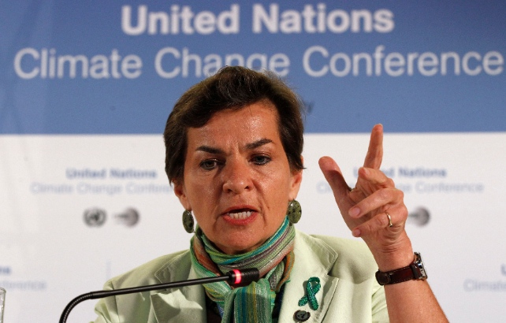
Christiana Figueres
Executive Secretary of the UN Framework Convention on Climate Change

Slide 34
“This is probably the most difficult task we have ever given ourselves, which is to intentionally transform the economic development model, for the first time in human history. This is the first time in the history of mankind that we are setting ourselves the task of intentionally, within a defined period of time to change the economic model that has been reigning for at least 150 years, since the industrial revolution.” - Figueres

Slide 35
Technocracy’s Asymmetric Strategy
Global Pandemic Panic of 2020
Global Propaganda Campaign
Global Biological Attack
Global Economic Destruction
Global Energy Crisis
Global Food Crisis
Global Financial Crisis

Slide 36
“It is the inventory and control plan for all land, all water, all minerals, all plants, all animals, all construc-tion, all means of pro-duction, all food, all energy, all information and all human beings in the world.” – Rosa Koire on Agenda 21

Slide 37
THANK YOU!
Technocracy.News patrickwood.substack.com

