Slide 1
Trilateral Commission and Technocracy
Patrick Wood, Founder
August Forecast & Review
www.AugustForecast.com

Slide 2
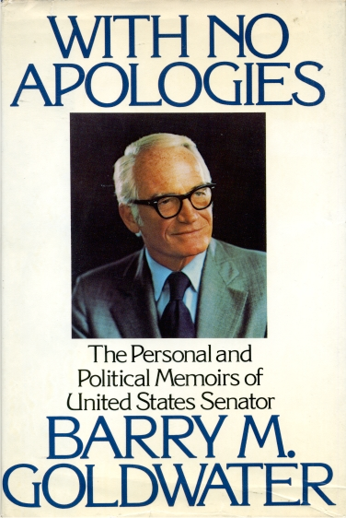
1979
“The Trilateral Commission is international and is intended to be the vehicle for multinational consolidation of the commercial and banking interests by seizing control of the political government of the United States. The Trilateral Commission represents a
skillful, coordinated effort to seize control and consolidate the four centers of power–political, monetary, intellectual and ecclesiastical.”

Slide 3
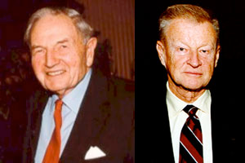
Trilateral Commission The Early Days
Co-founded in 1973 by David Rockefeller and Zbigniew Brzezinski
Floated idea at the 1972 Bilderberg meeting
289 hand-picked members
North America, Europe & Japan
97 from the U.S. - Democrats & Republicans
Bankers, Industrialists; Academics; Politicians; Media,law firms & NGO’s

Slide 4
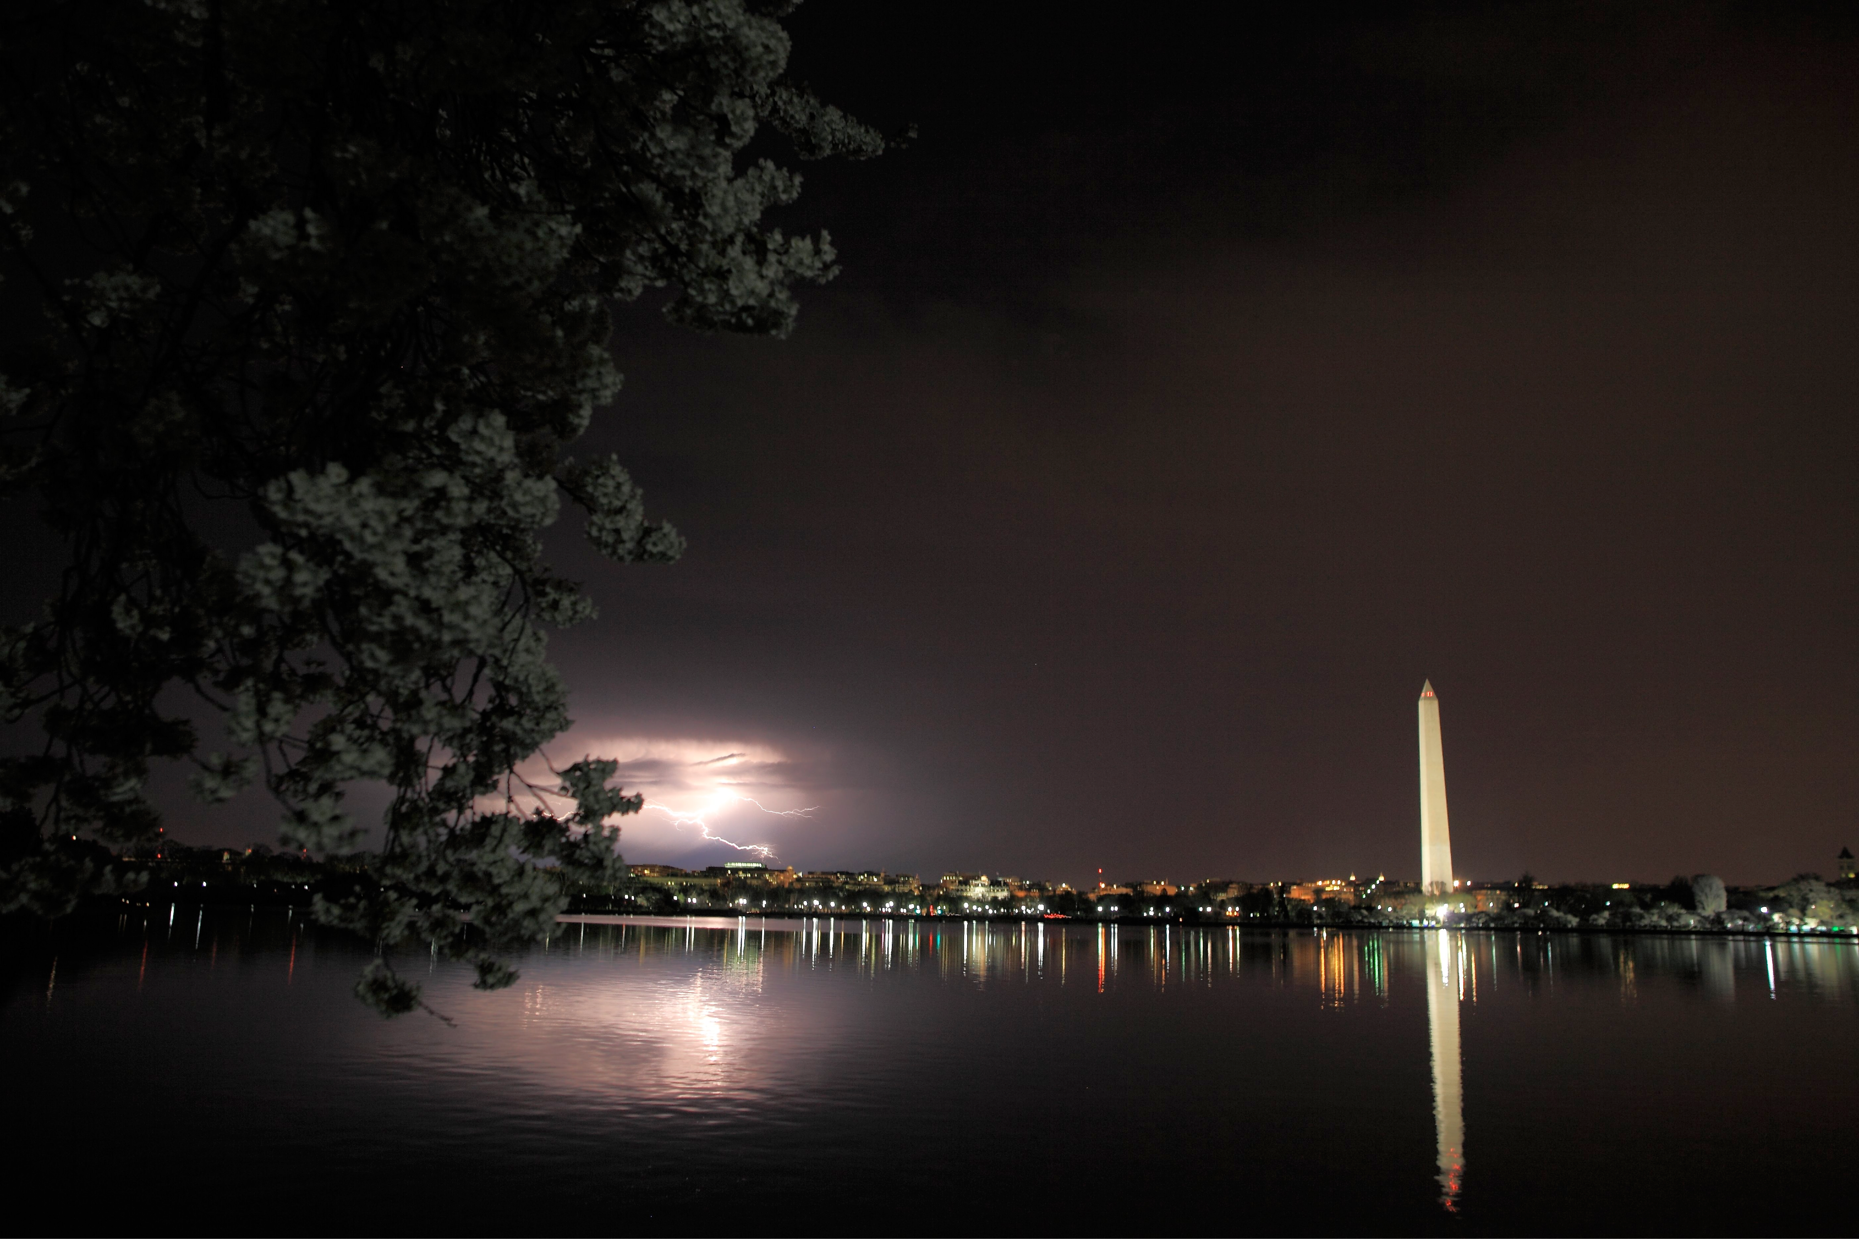
1976: Executive Office Hijacked
Jimmy Carter (& Mondale)- Member of TC, picked by Brzezinski to run for President
Brzezinski immediately appointed to be National Security Advisor.
Carter then appointed almost 1/3 of TC members to top cabinet and Administration posts.

Slide 5
Original Trilateral Policy
Foster a “New International Economic Order”
Promote Interdependence
Promote Free Trade by dismantling tariffs & trade barriers.

Slide 6
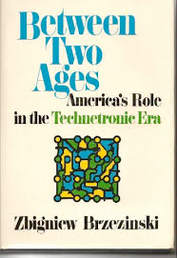
The book that set the course

Slide 7
Brzezinski’s Stages of Societal Development
Religious - Narrow-minded, massive ignorance
Nationalism - Equality before the law
Marxism - “represents a further vital and creative stage in the maturing of man’s universal vision.”
Technetronic - rational humanism on a global scale – the result of American-Communist evolutionary transformations. - (Between Two Ages)

Slide 8
Zbigniew Brzezinski - 1970
“The nation-state as a fundamental unit of man’s organized life has ceased to be the principal creative force: International banks and multi­national corporations are acting and planning in terms that are far in advance of the political concepts of the nation-state.” - Between Two Ages

Slide 9
The question is:
How did they use the Executive Branch to achieve their objectives?

Slide 10
US Trade Representative
9 out of 12!
Robert S. Strauss (1977-1979) | Charlene Barshefsky (1997-2001)
Reubin O'D. Askew (1979-1981) | Robert Zoellick (2001-2005)
William E. Brock III (1981-1985) | Rob Portman (2005-2006)
Clayton K. Yeutter (1985-1989) | Susan Schwab (2006-2009)
Carla A. Hills (1989-1993) | Ron Kirk (2009-2013)
Mickey Kantor (1993-1997) | Michael Froman (2013-2015)

Slide 11
World Bank Presidents
7 out of 10!
Robert McNamara (1968-1981) | James Wolfenson (1995-2005)
A.W. Clausen (1981-1986) | Paul Wolfowitz (2005-2007)
Barber Conable (1986-1991) | Robert Zoellick (2007-2012)
Lewis Preston (1991-1995) | Jim Yong Kim (2009-2012)
David Malpass (2019-2023) | Ajay Banga (2023 -?)

Slide 12
Executive Office
7 out of 12!
James Earl Carter (1977-1981) | Walter Mondale Vice President
Ronald Reagan (1981-1989) | George H.W. Bush Vice President
George H.W. Bush (1989-1993) | Dan Quale Vice President
Bill Clinton (1993-2001) | Al Gore Vice President
George W. Bush 2001-2009 | Dick Cheney Vice President
Barack Obama 2009-Present | Joe Biden Vice President

Slide 13
National Security Advisors
12 out of 22!
Henry Kissinger (1969-1975) | Adm. John Poindexter (1985-1986) | Condeleezza Rice (2001-2005)
Brent Scowcroft (1975-1977) | Frank Carlucci (1986-1987) | Stephen Hadley (2005-2009)
Zbigniew Brzezinski (1977-1981) | Colin Powell (1987-1989) | Gen. James Jones (2009-2010)
Richard Allen (1981-1982) | Brent Scowscroft (1989-1993) | Tom Donilon (2010-2013)
William P. Clark (1982-1983) | Anthony Lake (1993-1997) | Susan Rice (2013-2017)
Robert McFarlane 1983-1985 | Sandy Berger (1997-2001) | Jake Sullivan (2021-?)

Slide 14
Trilaterals In Biden Admin
Tony Blinken, U.S. Secretary of State
Lael Brainard, Member, U.S. Federal Reserve's Board of Governors
Mark Brzezinski, U.S. Ambassador to Poland (brother of broadcaster Mika Brzezinski and son of TC co-founder, Zbigniew Brzezinski)
R. Nicholas Burns, U.S. Ambassador to China
Ken Juster, U.S. Ambassador to India
David Lipton, First Deputy Managing Director, International Monetary Fund
Wendy Sherman, U.S. Deputy Secretary of State
Jake Sullivan, U.S. National Security Advisor
John Podesta – Green New Deal spending tsar
Ajay Banga - President of the World Bank

Slide 15
What is the New International Economic Order?
It is the Technetronic Era!
A controlled society dominated and managed by an elite (Congress is irrelevant and useless)
Global banks and multinational corporations are primary actors and planners of economic life
Continuous surveillance over every citizen
Files containing all personal information for instant retrieval

Slide 16
technocracy - Webster’s
Government by technicians
Management of society by technical experts
Technocracy
Replacement economic system based on energy distribution and consumption and run by engineers, scientists and technicians

Slide 17
Technocracy, Inc.
Originated at Columbia University in 1932
Founded by M. King Hubbert and Howard Scott in 1933
Created Technocracy Study Course in 1934
Hubbert created “Peak Oil Theory” in 1954 to be later hailed as a father of the eco-movement

Slide 18
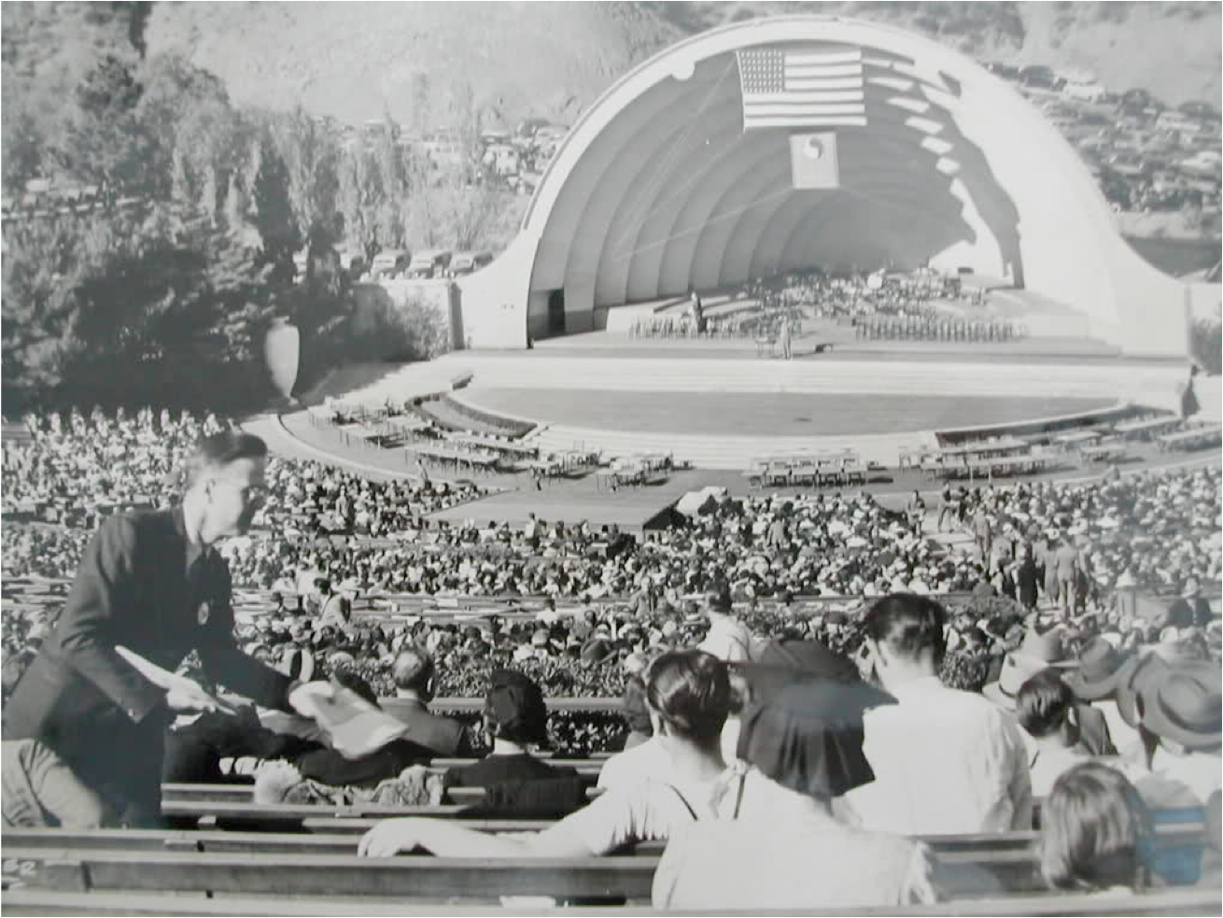
Technocracy

Slide 19
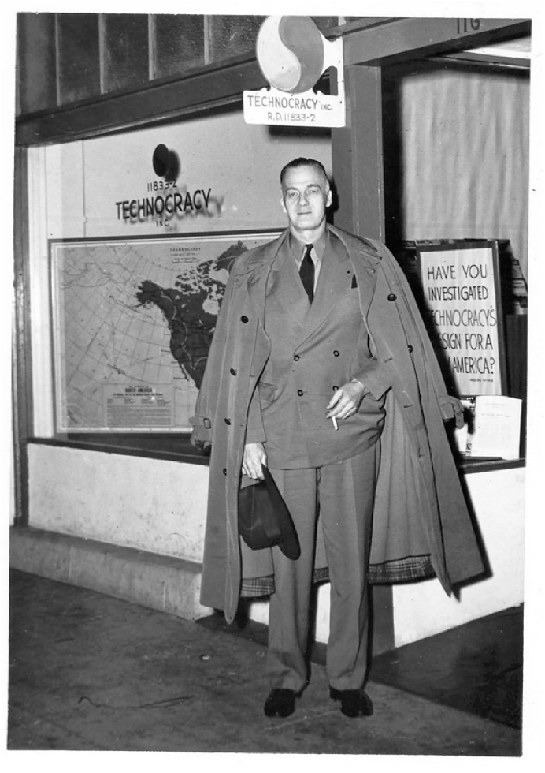
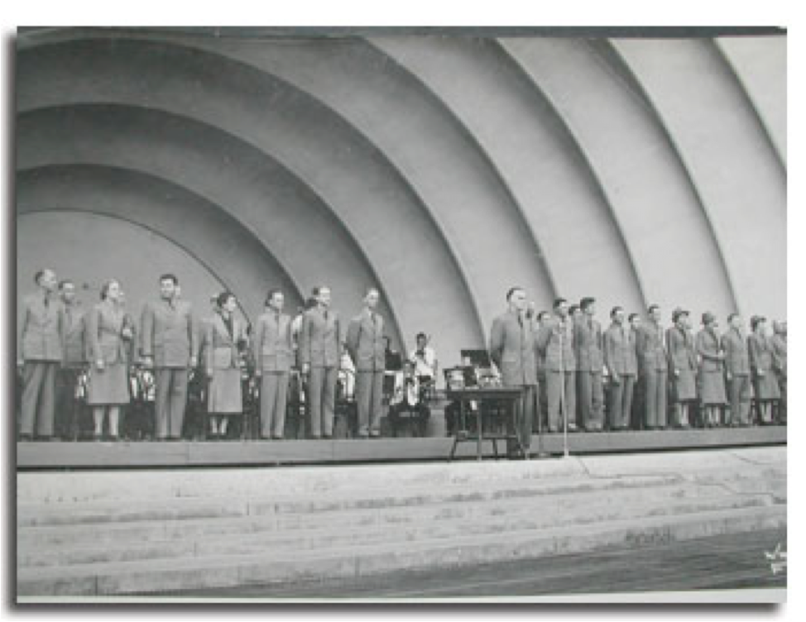
Technocracy

Slide 20
Technocracy Highlights
By nature produces volumes of inviolable regulations that are “science-based”
Creates totalitarian control in the end, but is NOT socialism or communism
Seeks to replace price-based economic system with energy-based system (energy credits)

Slide 21
1932 Technocracy Requirements
"Register on a continuous 24 hour-per-day basis the total net conversion of energy.
"By means of the registration of energy converted and consumed, make possible a balanced load.
"Provide a continuous inventory of all production and consumption [Scott, Howard et al, Technocracy Study Course, p. 232]

Slide 22
1932 Technocracy Requirements
"Provide a specific registration of the type, kind, etc., of all goods and services, where produced and where used
"Provide specific registration of the consumption of each individual, plus a record and description of the individual." [Scott, Howard et al, Technocracy Study Course, p. 232]

Slide 23
SO…
What are some CURRENT examples of the Trilateral/Technocracy action plan?

Slide 24
UN Environmenal Programme
“A green economy implies the decoupling of resource use and environmental impacts from economic growth… These investments, both public and private, provide the mechanism for the reconfiguration of businesses, infrastructure and institutions, and for the adoption of sustainable consumption and production processes.” UNEP

Slide 25
Agenda 21
A Plan to Change the World

Slide 26
Timeline of Events
06/13/92 – UN Conference on Environment and Development
03/03/93 – Clinton/Gore announced National Partnership for Reinventing Government
04/23/93 – Agenda 21 book published
06/29/93 – Clinton signs EO 12852: President’s Council on Sustainable Development
09/11/93 – Clinton signs EO 12862: National Performance Review / Reinventing Government

Slide 27
Smart Grid - Controlling Energy

Slide 28
Global Smart Grid!

Slide 29
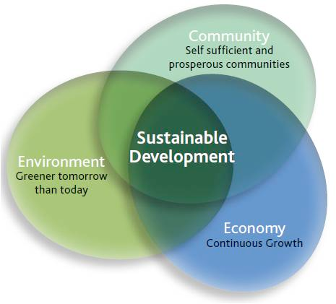
Sustainable Development

Slide 30
Global Warming

Slide 31
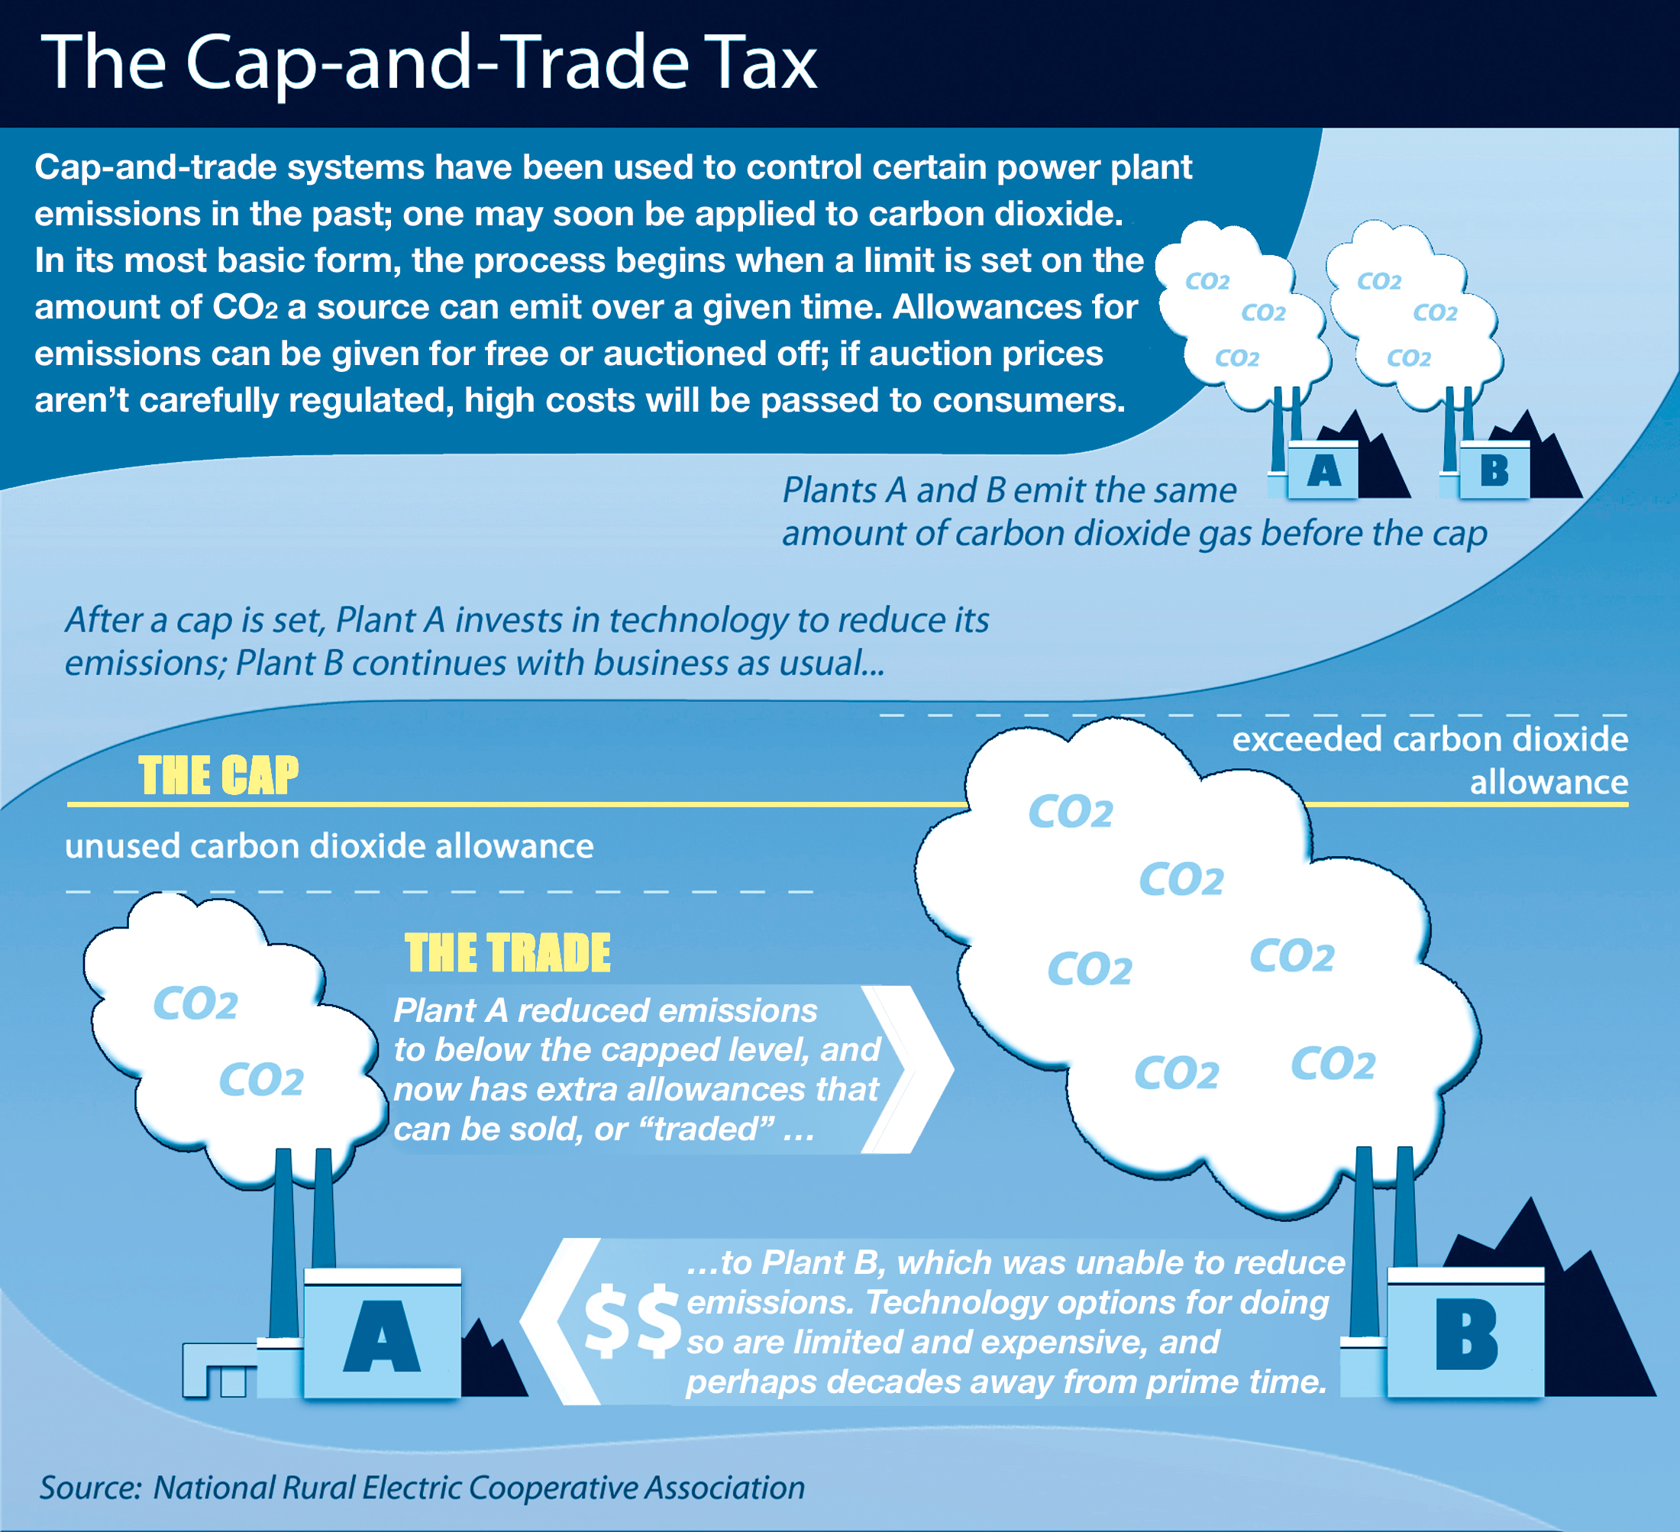
Cap & Trade

Slide 32
Obamacare It’s about your DATA, not your HEALTH

Slide 33
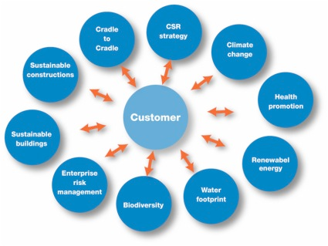
Customer/Consumer Centric

Slide 34
Driven by Economics
Total control over the economic process depends directly upon total information awareness within that economic system!
And now you know why they need…

Slide 35
Total Surveillance Society

Slide 36
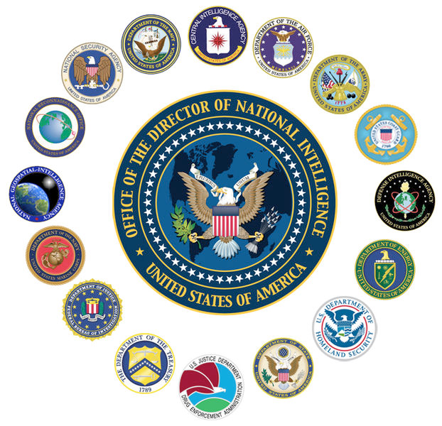

Slide 37
The National Intelligence Agency was created by George Bush on April 21, 2005
The first-ever Director of National Intelligence was John Negroponte – member of the Trilateral Commission!

Slide 38
Obama’s Intelligence Trilaterals
Adm. Dennis Blair - Director of National Intelligence
Susan Rice - National Security Advisor
Thomas Donilon, National Security Advisor and Deputy Security Advisor
Gen. James Jones, National Security Advisor

Slide 39
Trilaterals in Europe
“Back in the early Seventies, the hope for a more united EUROPE was already full-blown — thanks in many ways to the individual energies previously spent by so many of the Trilateral Commission’s earliest members.” (David Rockefeller; In the Beginning; The Trilateral Commission at 25, 1998, p.11)

Slide 40
Conclusions
Technocracy is very close to total omnipotence
It is “old religion” but newly implemented by the Trilateral Commission as the “green economy”
It is the primary sponsor of programs like Agenda 21, Sustainable Development, Smart Grid, Biodiversity, Wildlands Project, etc.
It will result in Scientific Dictatorship ala Brave New World (Huxley, 1932) and Nineteen Eighty Four (Orwell, 1948)

Slide 41
Thank You!

