Slide 1
GENETIC TAKEOVER
Of all DNA on earth, including humans
Patrick Wood
Technocracy News & Trends

Slide 2
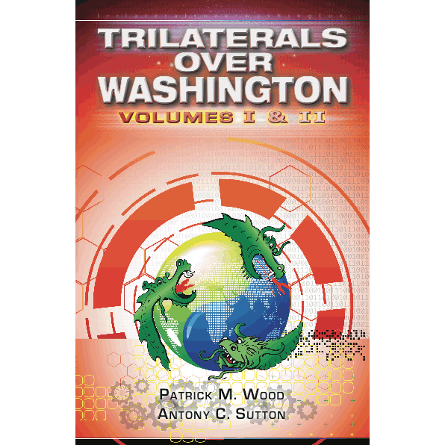
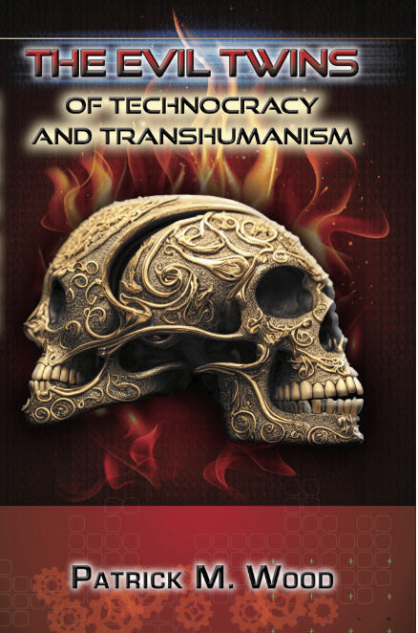
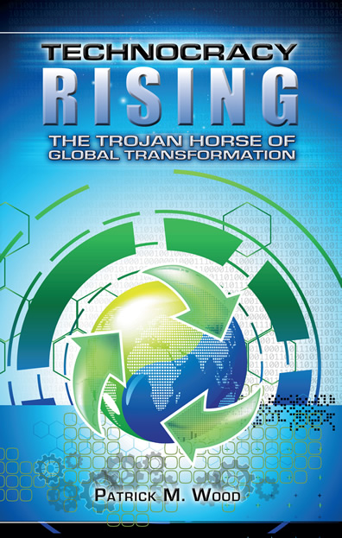
The Evil Twins of
Technocracy and Transhumanism
1980
November
2022
2015
2018
patrickwood.substack.com

Slide 3
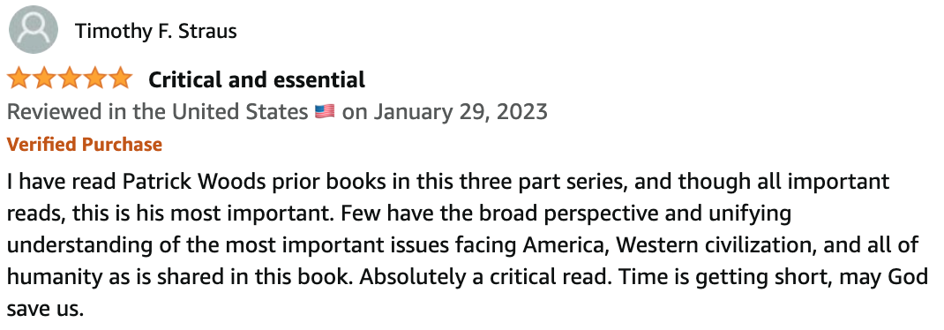

Slide 4
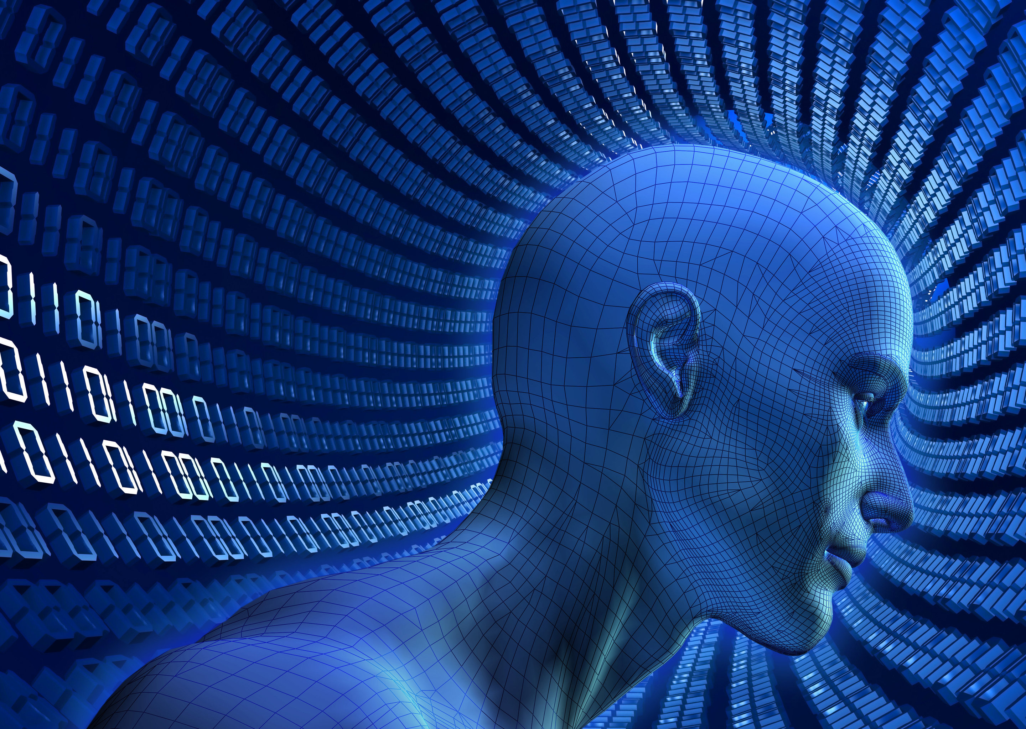

Slide 5
What is Transhumanism?
Transhumanism promotes an interdisciplinary approach (NBIC) to understanding and evaluating the opportunities for enhancing the human condition and the human organism opened up by the advancement of technology. Attention is given to both present technologies, like genetic engineering and information technology, and anticipated future ones, such as molecular nanotechnology and artificial intelligence. - Max More. Founder, modern Transhumanism

Slide 6
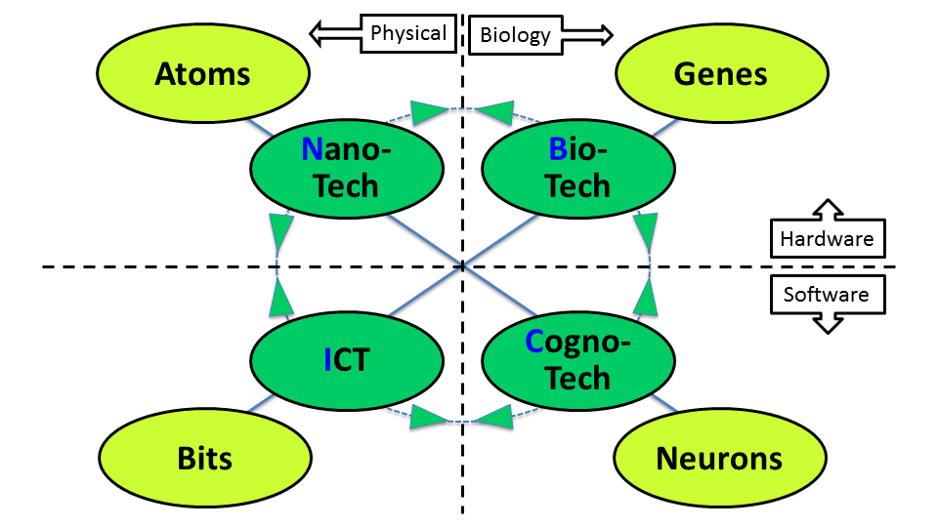
Convergence - NBIC

Slide 7
What is Transhumanism?
The central premise of transhumanism, then, is that biological evolution will eventually be overtaken by advances in genetic, wearable and implantable technologies that artificially expedite the evolutionary process. – World Economic Forum

Slide 8
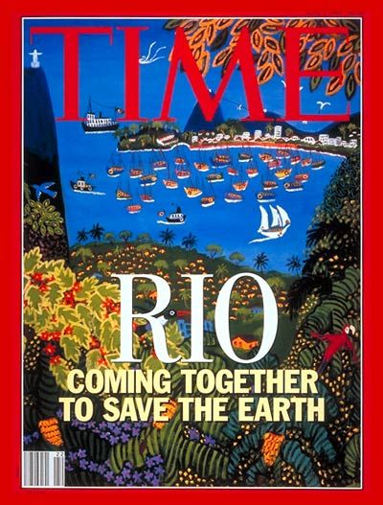
1992

Slide 9
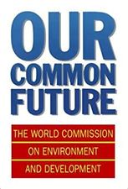
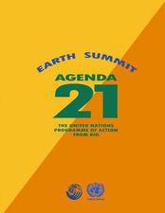
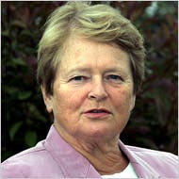
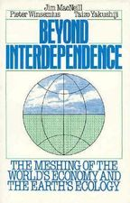
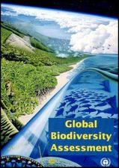
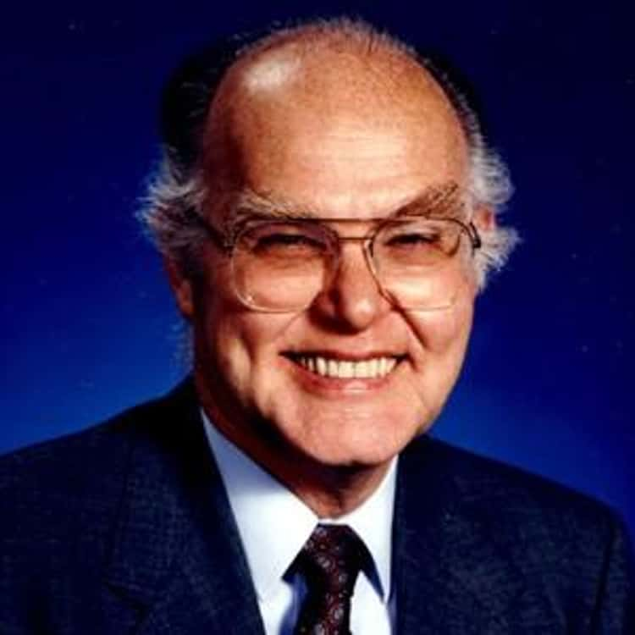
The Earth Summit
Brundtland
MacNeill

Slide 10
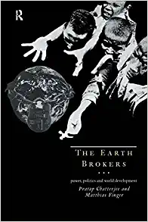

Slide 11
Post-Agenda 21 Analysis
^{The Earth Brokers - 1994}
“We argue that UNCED has boosted precisely the type of industrial development [Technocracy] that is destructive for the environment, the planet, and its inhabitants. We see how, as a result of UNCED, the rich will get richer, the poor poorer, while more and more of the planet is destroyed in the process.”

Slide 12
Biodiversity Convention (Cont.)
^{The Earth Brokers - 1994}
“The Convention implicitly equates the diversity of life - animals and plants – to the diversity of genetic codes. By doing so, diversity becomes something modern science can manipulate. It promotes biotechnology as being ‘essential for the conservation and sustainable use of biodiversity.” – p. 43

Slide 13
The Biodiversity Convention
^{The Earth Brokers - 1994}
“The main stake raised by the biodiversity convention is the issue of ownership and control over biological diversity… the major concern was protecting the pharmaceutical and emerging biotechnology industries.” – p. 42

Slide 14
Moderna CMO Tal Zaks
"We are actually hacking the software of life. We think about it as an operating system. So if you could actually change that, if you could introduce a line of code, or change a line of code, it turns out it has profound implications for everything."

Slide 16
What has been GMO’d
Seeds – Monsanto, Bayer
Insects – Oxitec, mosquitos
Animals – Beef, pigs, chickens, turkeys, chickens
Fish – Salmon, trout, catfish, tilapia, striped bass, flounder
Bacteria, viruses
Humans – mRNA, RNA, DNA

Slide 17
Star Trek Clip clip

Slide 18
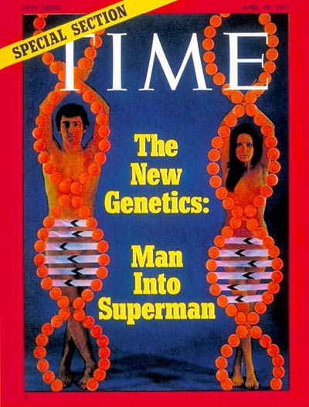
1971

Slide 19
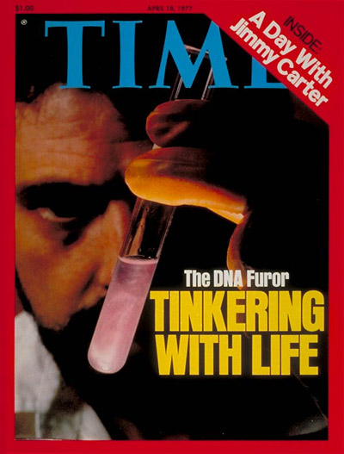
1977

Slide 20
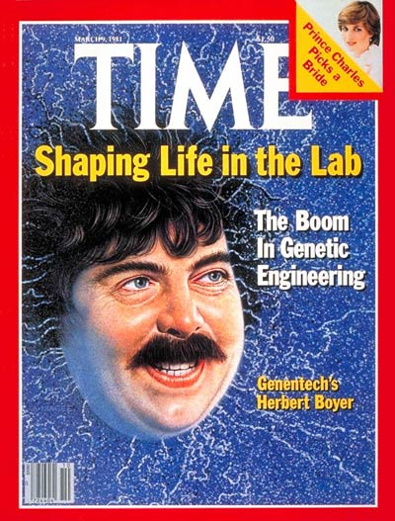
1984

Slide 21
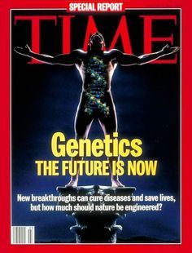
1994

Slide 22
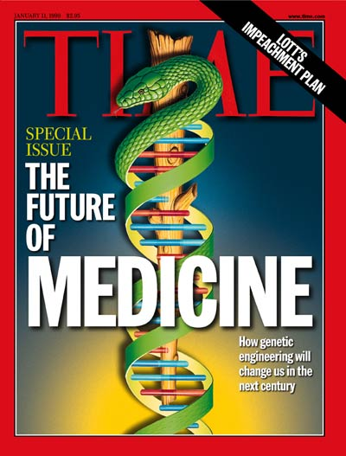
1999

Slide 23
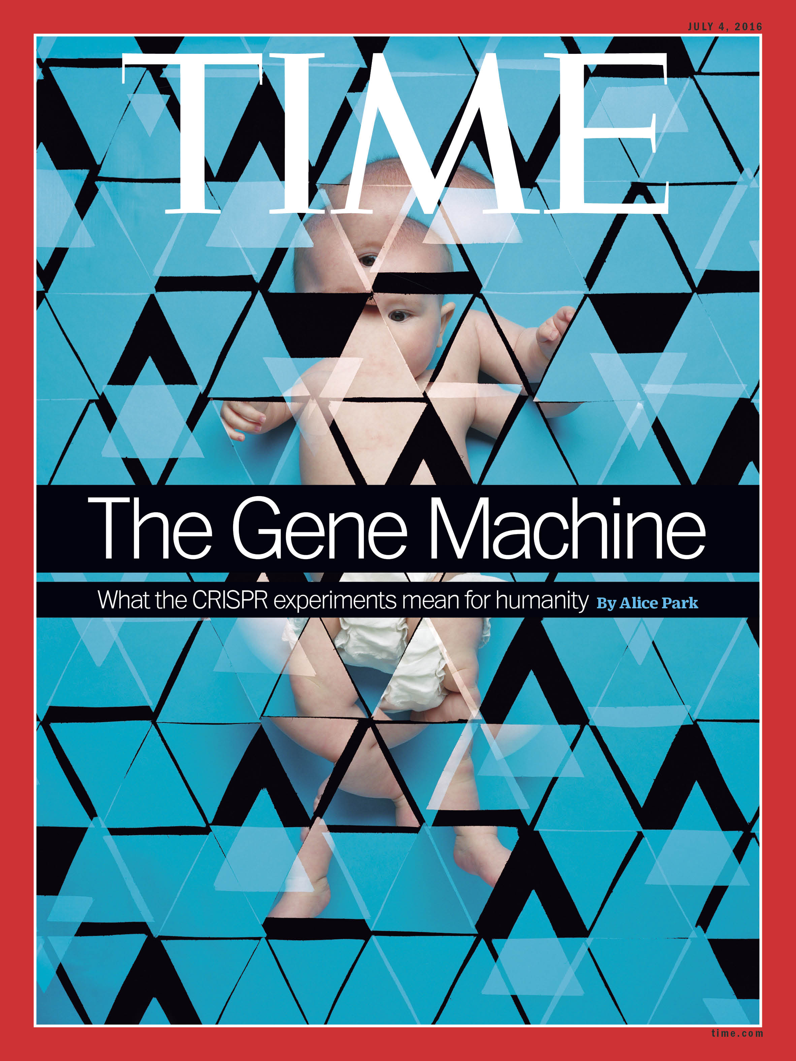
2015

Slide 24
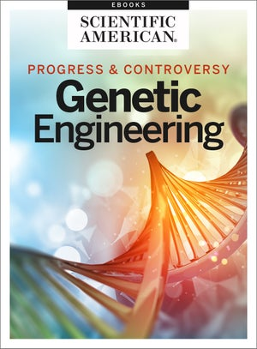
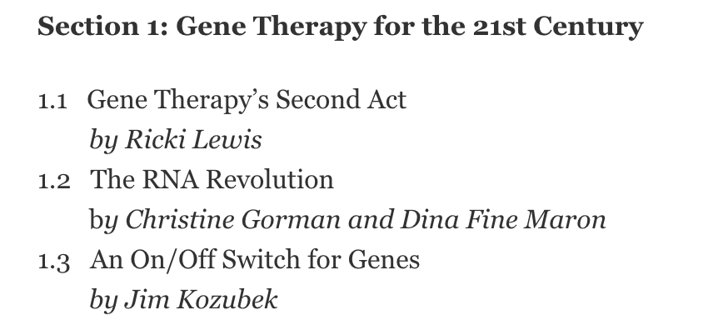
2018

Slide 25
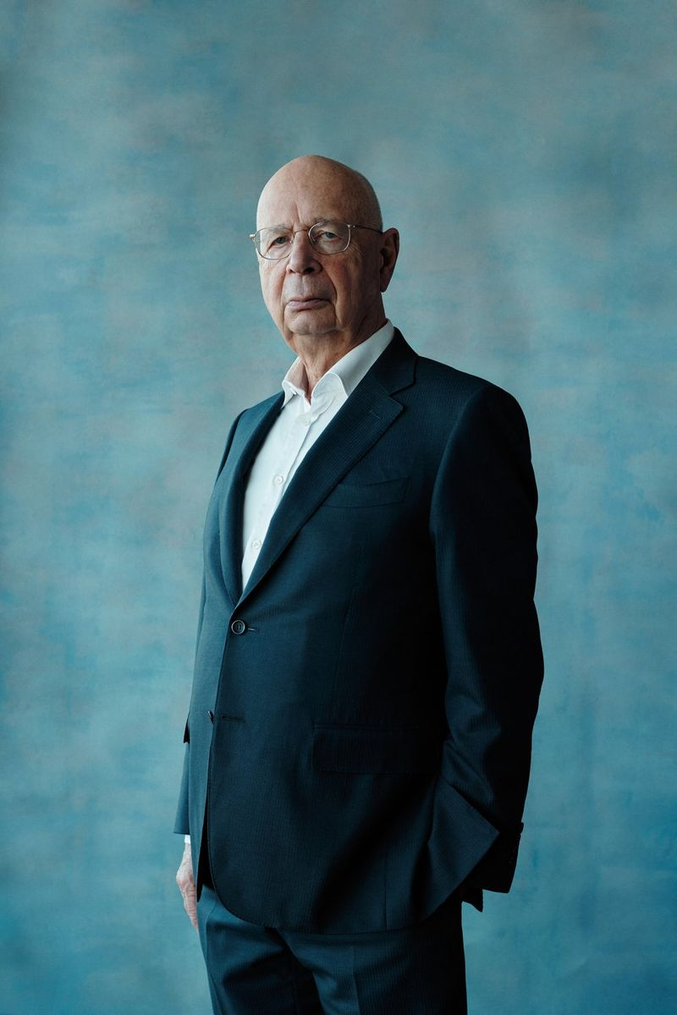
…a posthuman condition: the end of humanity’s reliance on our congenital bodies by transforming “our frail version 1.0 human bodies into their far more durable and capable version 2.0 counterparts”. – World Economic Forum

Slide 26
SCHWAB VIDEO

Slide 27
European video of Pfizer exec

Slide 28
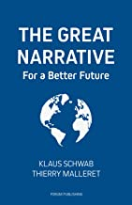
The Great NARRATIVE

Slide 29
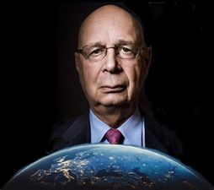
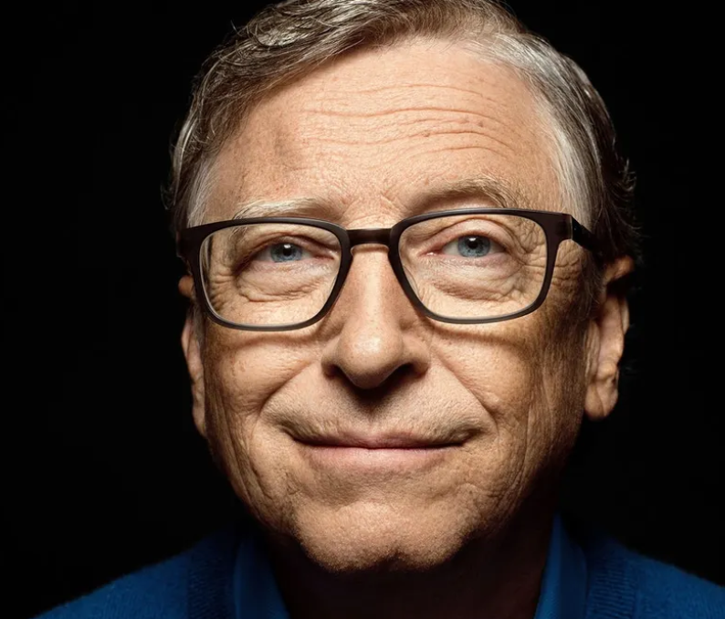
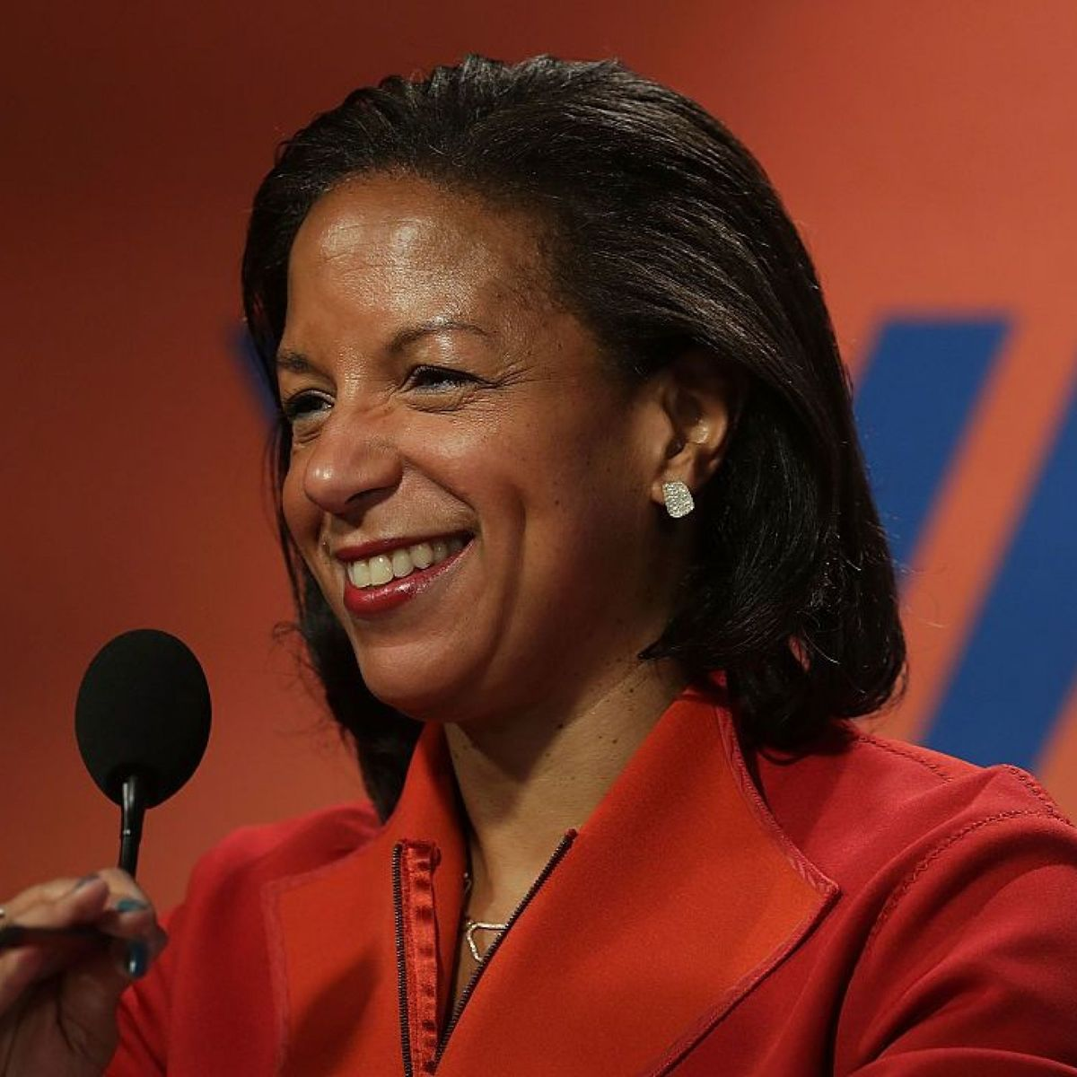
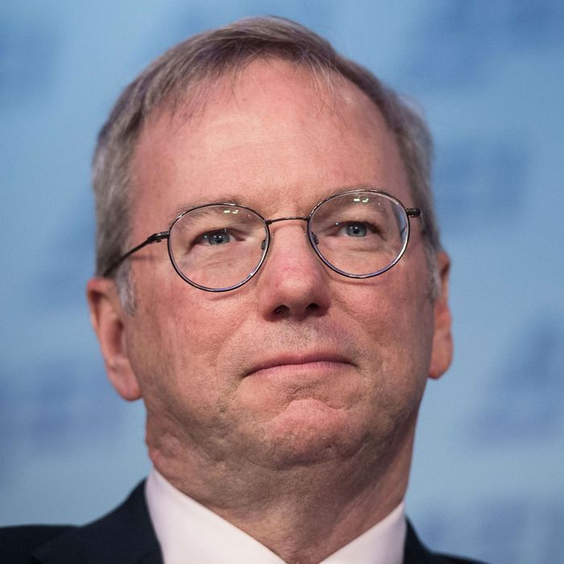
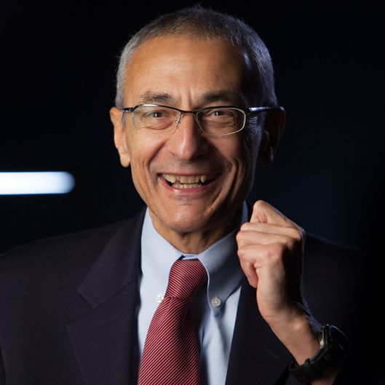
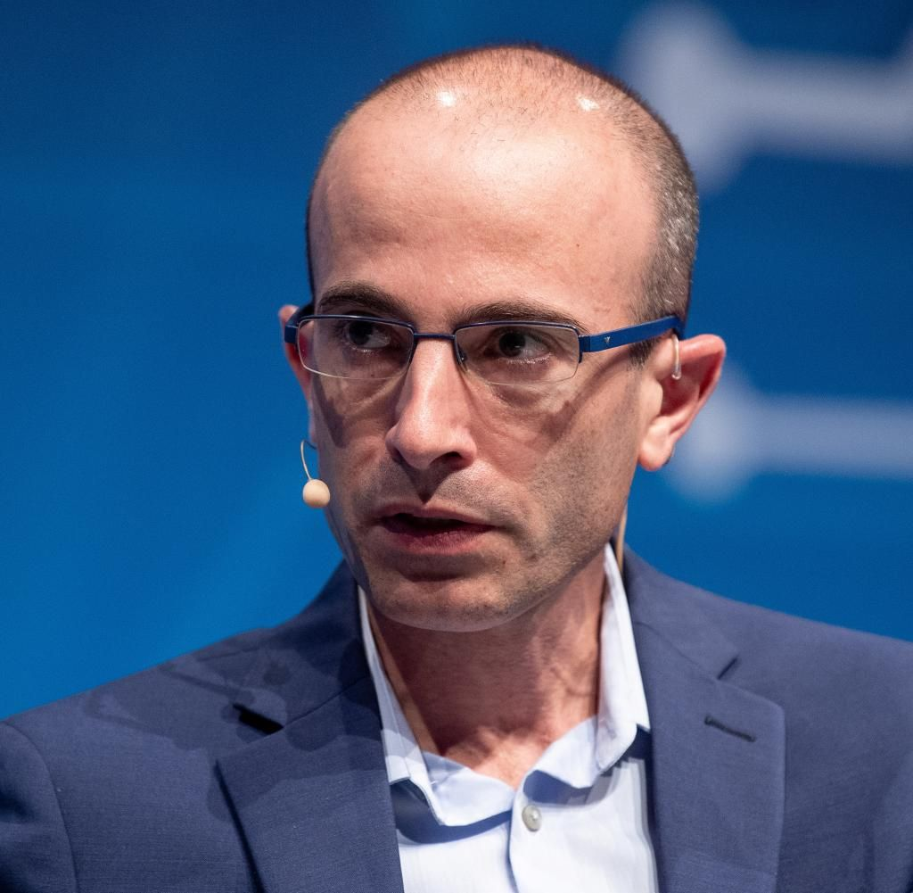
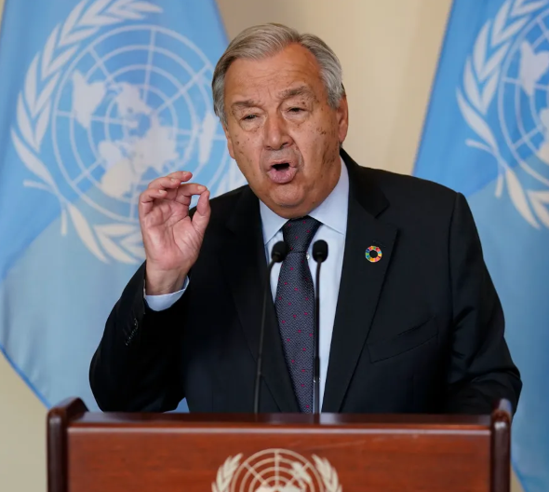
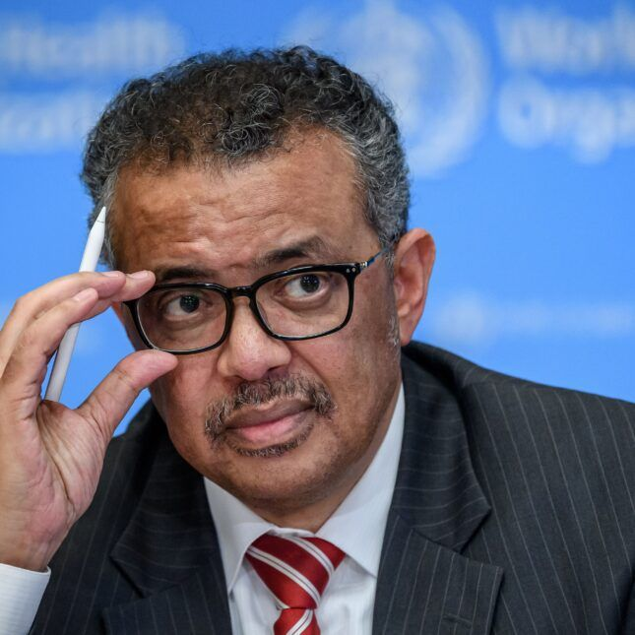
Whoever controls the narrative, controls everything else
(This isn’t all…)

Slide 30
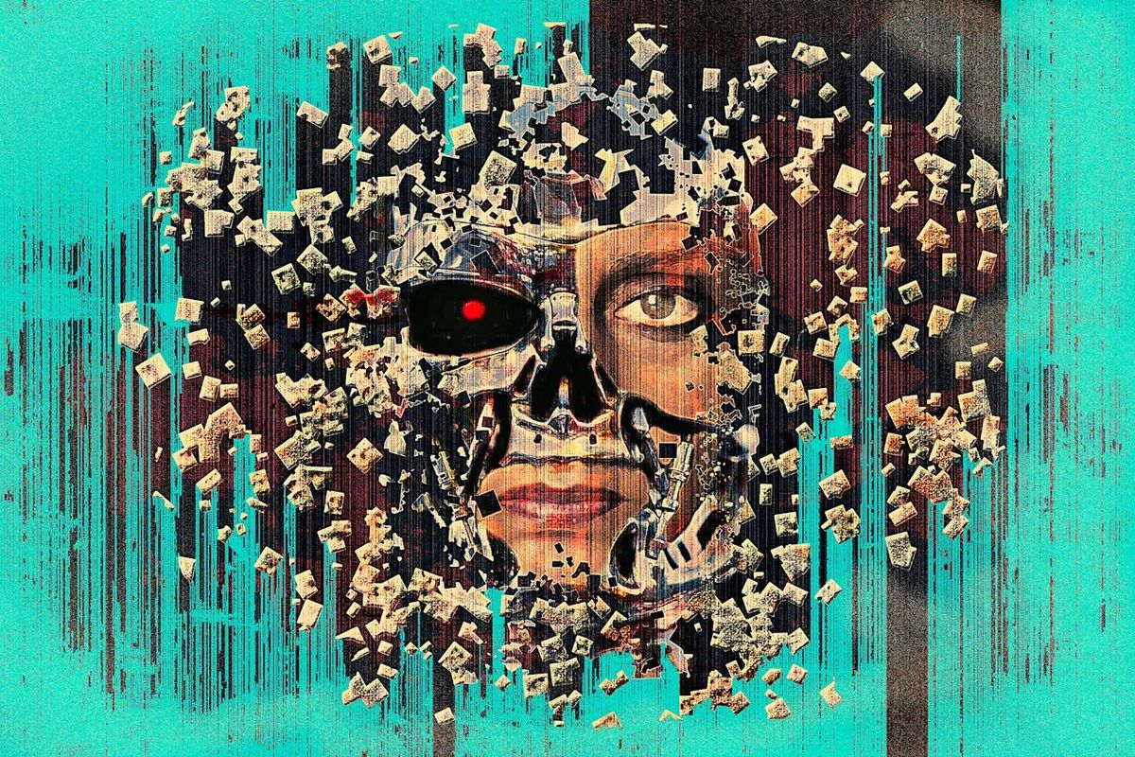
The Great Reset
Technocracy is to societal structure and operation…
As Transhumanism is to
the humans who live there!

Slide 31
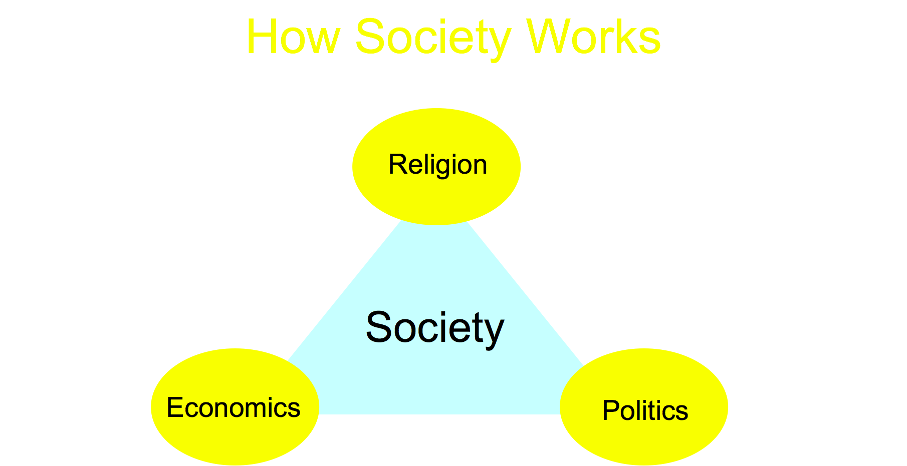

Slide 33
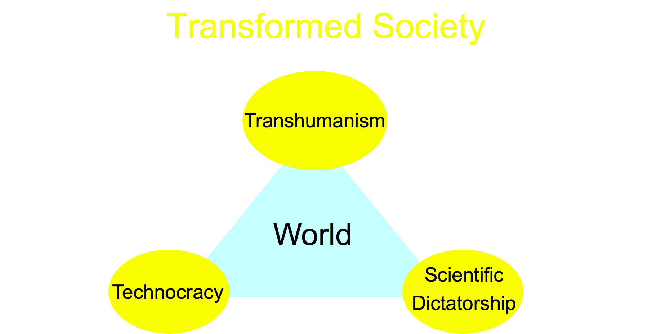

Slide 34
The Great ENDING
The nations were angry; and your wrath has come. The time has come for judg-ing the dead, and for rewarding your servants the prophets and your saints and those who reverence your name, both small and great – and for destroying those who destroy the earth.” Rev. 11:18

Slide 35
THANK YOU!
Technocracy.News

