Slide 1
Ps. 2:1-3 Why do the heathen rage, and the people imagine a vain thing? The kings of the earth set themselves, and the rulers take counsel together, against the Lord, and against his anointed, saying, Let us break their bands asunder, and cast away their cords from us.

Slide 2
Global Cities

Slide 3
Observation #1
Two Meanings of “Babylon”

Slide 4
RELIGIOUS MYSTERY BABYLON
And the ten horns which thou sawest upon the beast, these shall hate the whore, and shall make her desolate and naked, and shall eat her flesh, and burn her with fire. Rev. 17:16

Slide 5
COMMERCIAL BABYLON
Rejoice over her, thou heaven, and ye holy apostles and prophets; for God hath avenged you on her. Rev. 18:20

Slide 6
The Two Babylons of Revelation 17-18
 | Revelation 17 Religious Babylon | Revelation 18 Commercial Babylon
Focus | Babylon as a System | Babylon as a Global City
Timing | Falls before Abomination of Desolation (Midway) | Falls at the end of 7 years
Destroyer | The Ten Kings | Jesus Christ
Result | No Mourning | Great Mourning

Slide 7
The Two Babylons of Revelation 17-18
 | Revelation 17 Religious Babylon | Revelation 18 Commercial Babylon
Focus | Babylon as a System | Babylon as a Global City
Timing | Falls before Abomination of Desolation (Midway) | Falls at the end of 7 years
Destroyer | The Ten Kings | Jesus Christ
Result | No Mourning | Great Mourning

Slide 8
The Two Babylons of Revelation 17-18
 | Revelation 17 Religious Babylon | Revelation 18 Commercial Babylon
Focus | Babylon as a System | Babylon as a Global City
Timing | Falls before Abomination of Desolation (Midway) | Falls at the end of 7 years
Destroyer | The Ten Kings | Jesus Christ
Result | No Mourning | Great Mourning

Slide 9
The Two Babylons of Revelation 17-18
 | Revelation 17 Religious Babylon | Revelation 18 Commercial Babylon
Focus | Babylon as a System | Babylon as a Global City
Timing | Falls before Abomination of Desolation (Midway) | Falls at the end of 7 years
Destroyer | The Ten Kings | Jesus Christ
Result | No Mourning | Great Mourning

Slide 10
Observation #2
Two Meanings of “World”
1. The world (cosmos) is the order of things, the “kingdoms of the world” is ruled by the god of this world. (2 Cor. 4:4)
2. The earth, the creation, is the property of God (cf. Haggai 2:8)

Slide 11
Them that destroy the earth… Rev 11:18
Shutting down energy
Shutting down CO2
Shutting down Nitrogen fertilizers
Shutting down food/agriculture
Dimming the sun (geo-engineering)
Genetic engineering
Taking over ”intelligent design”

Slide 12
Parag Khanna
MS, MA, Georgetown
PhD, London School of Economics
Professor, Yew School of Public Policy
Esquire: “75 Most Influential People of the 2st Century”

Slide 13
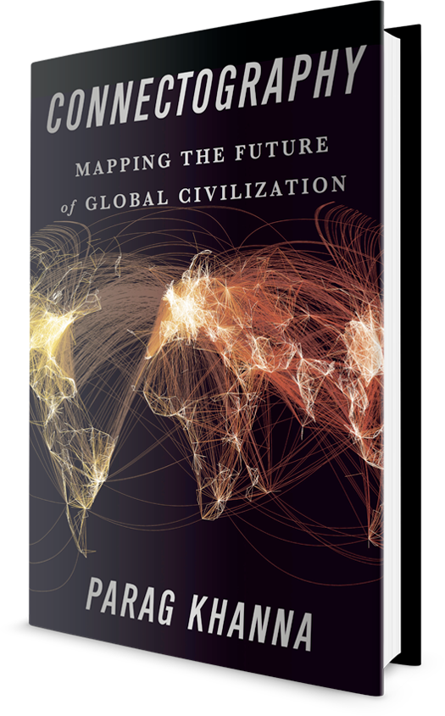

Slide 14
”We are building this global society without a global leader. Global order is no longer something that can be dictated or controlled from the top down. Globalization is itself the order.” Dr. Parag Khanna

Slide 15
+

Slide 16
Left over thoughts…
AI – ChatGPT
War in Ukraine – WWIII?
5G – 6G - Connectivity
What you can do…

Slide 17
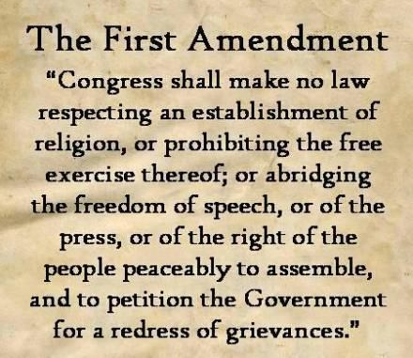
Saving Free Speech
www.CitizensForFreeSpeech.org

Slide 18
CFFS Mission
CFFS promotes successful local activism by showing its members how to effectively communicate and exercise their First Amendment rights in every public or private situation. We mobilize our members to achieve success in their local communities by giving them tools, strategies, training and encouragement to restore civility in the civic arena and to teach others to do the same.

Slide 19
Where you can find me
www.Technocracy.news
www.CitizensForFreeSpeech.org
PatrickWood.substack.com
www.WorldViewWeekend.org
/Live (4:00pm Central Daily)
/profile/patrick-wood (archive)
www.RevelationGate.com

