Slide 1
God’s Truth on Gender Confusion
glenn t. stanton
director, family formation studies

Slide 2
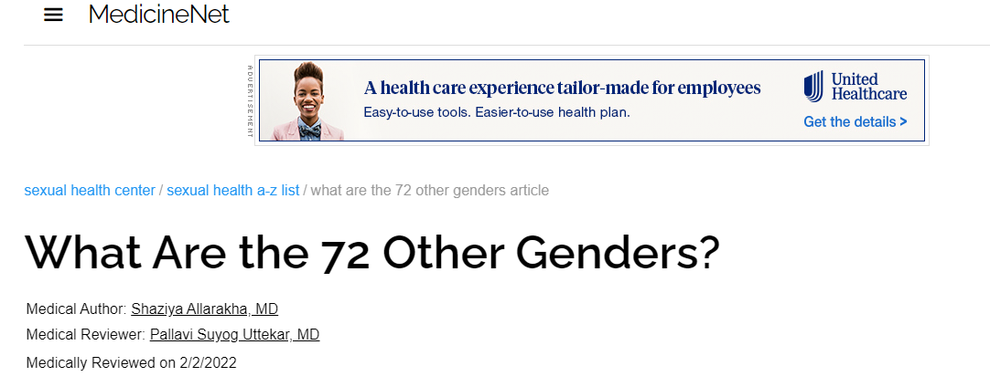
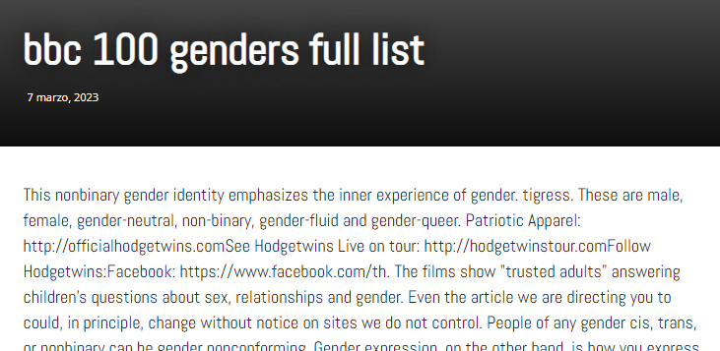
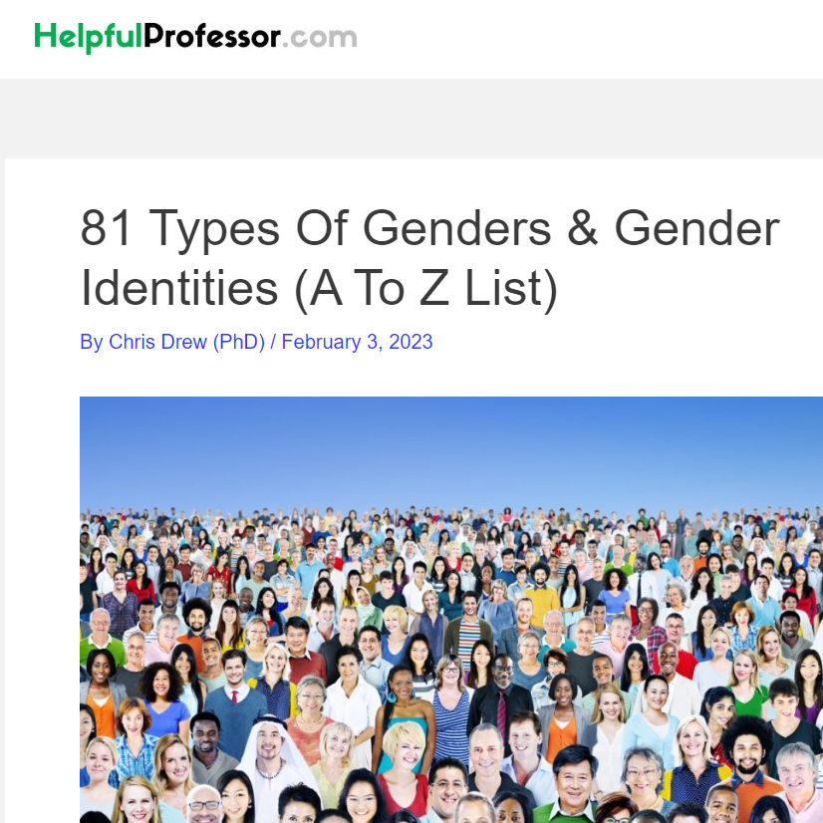
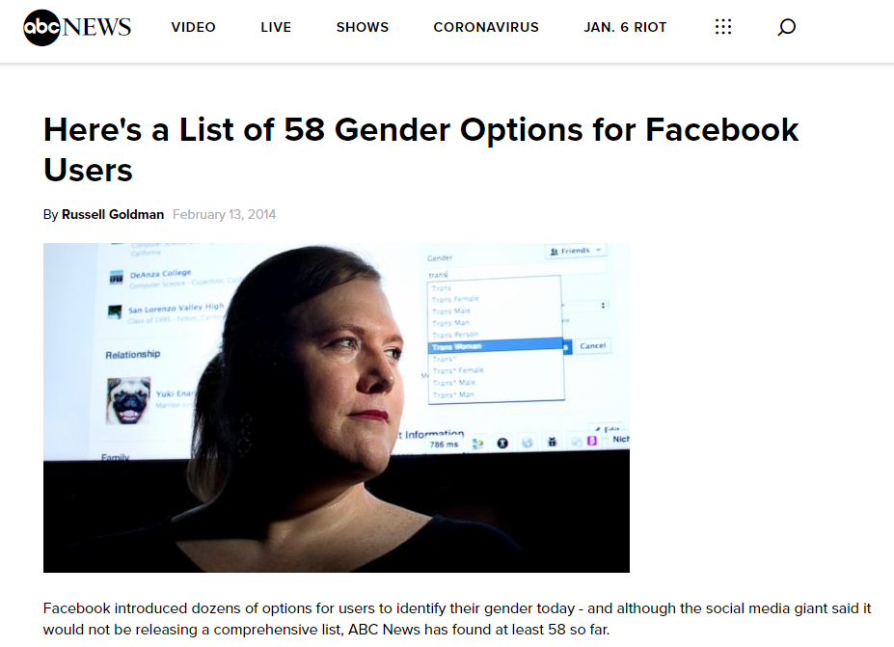

Slide 3
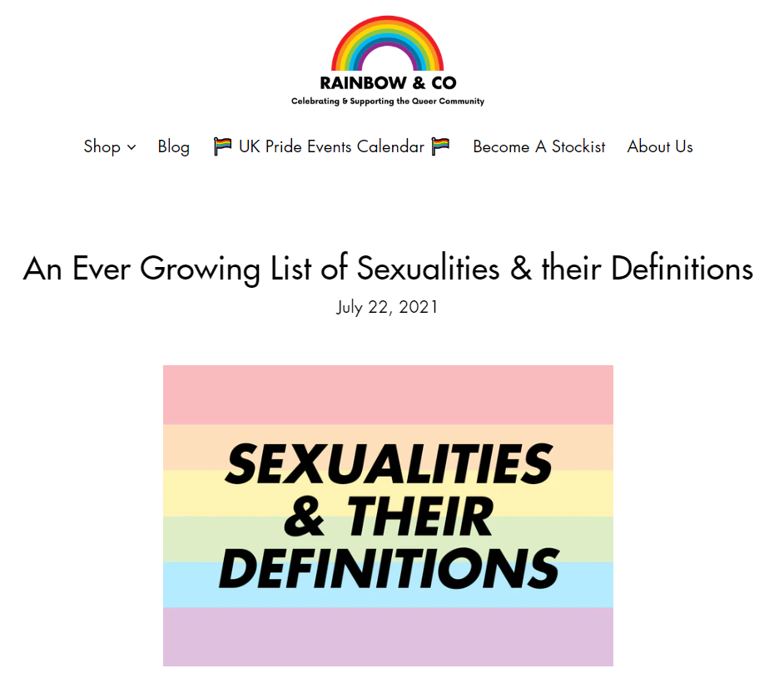

Slide 5
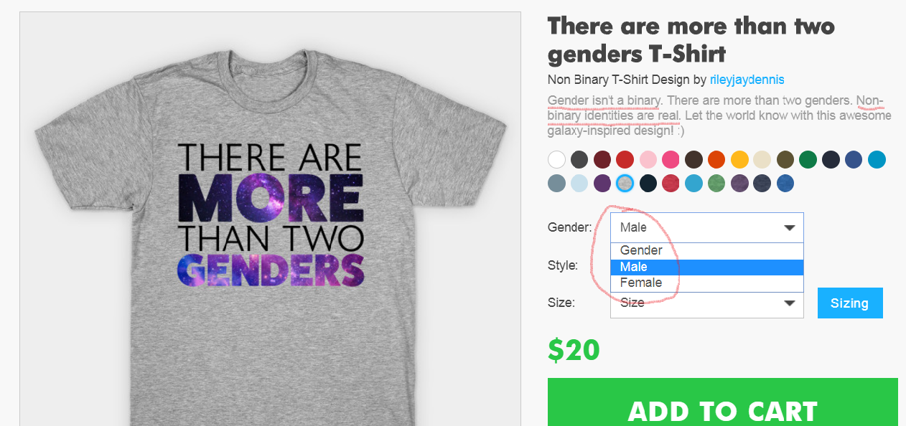

Slide 6
Binary is Bad…
But L,G,B,T, Require It

Slide 7
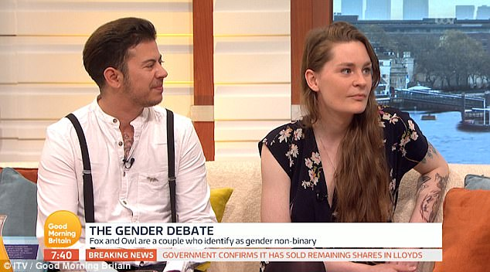

Slide 8
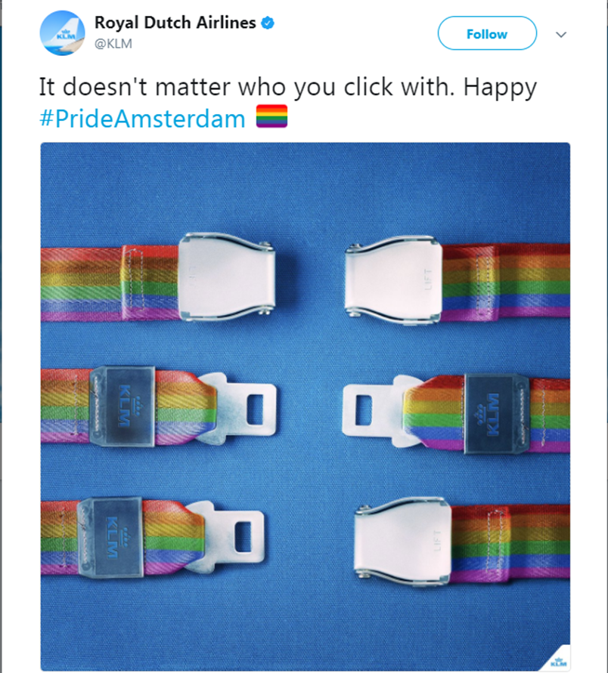

Slide 9
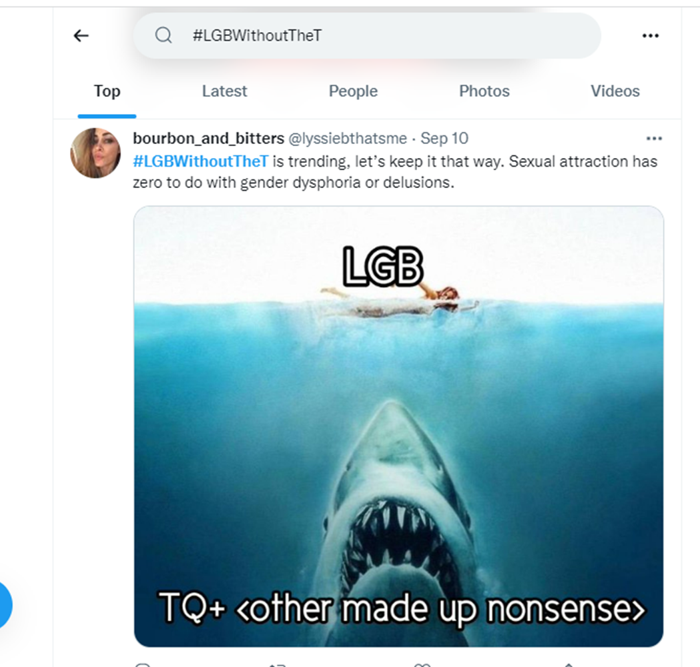

Slide 10
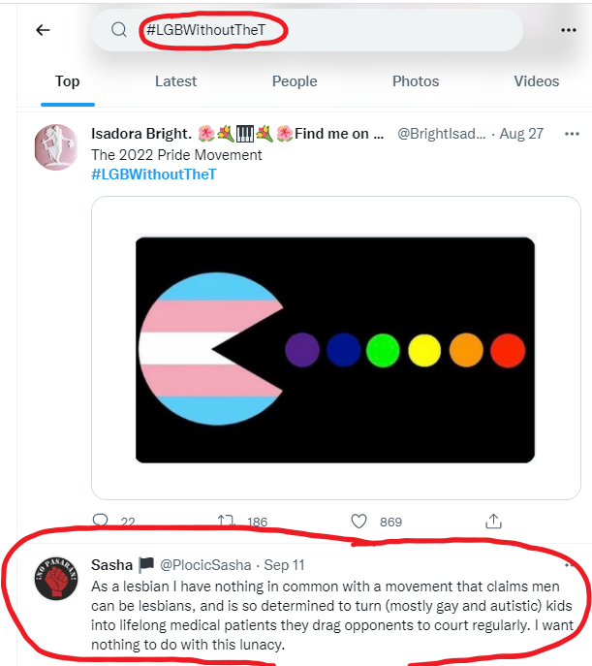

Slide 11
    How did we get here?

Slide 12
The proposition of
the same-sex family
challenged the fundamental truth
of reality of male and female

Slide 13
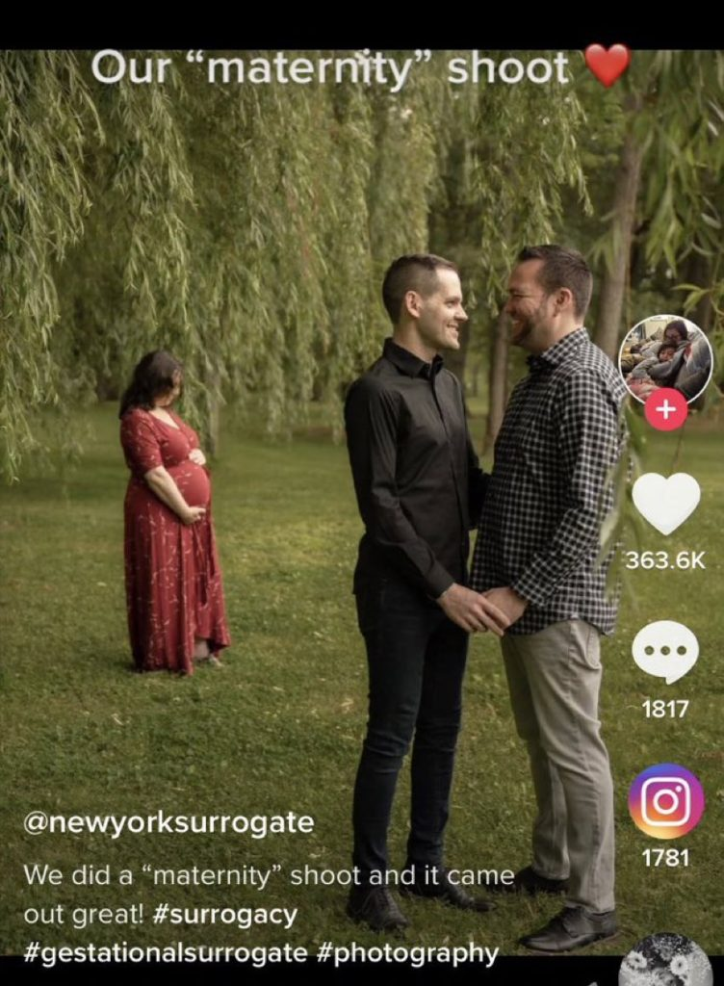

Slide 14
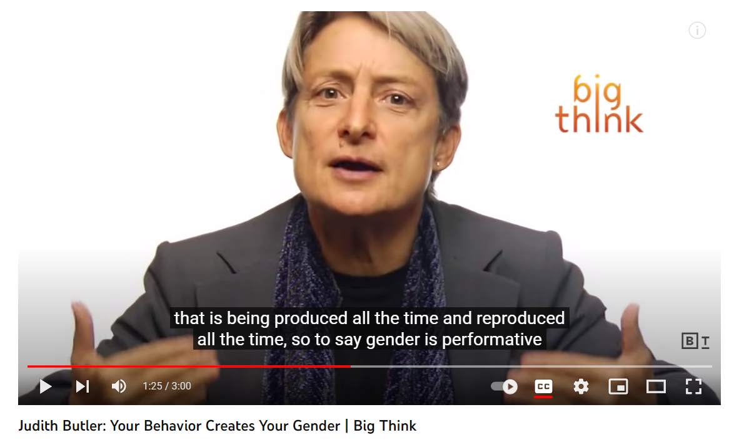

Slide 15
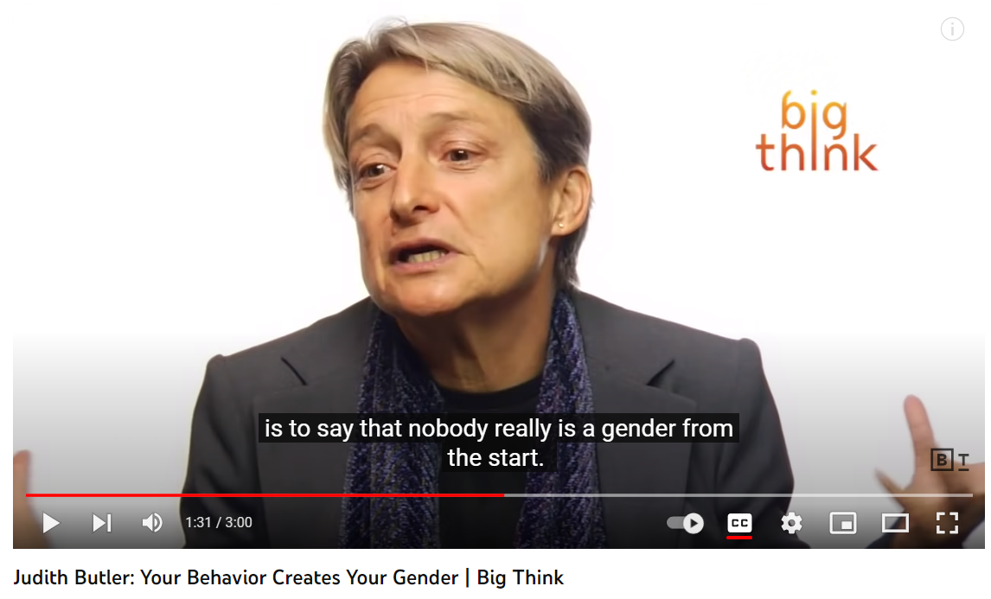

Slide 16
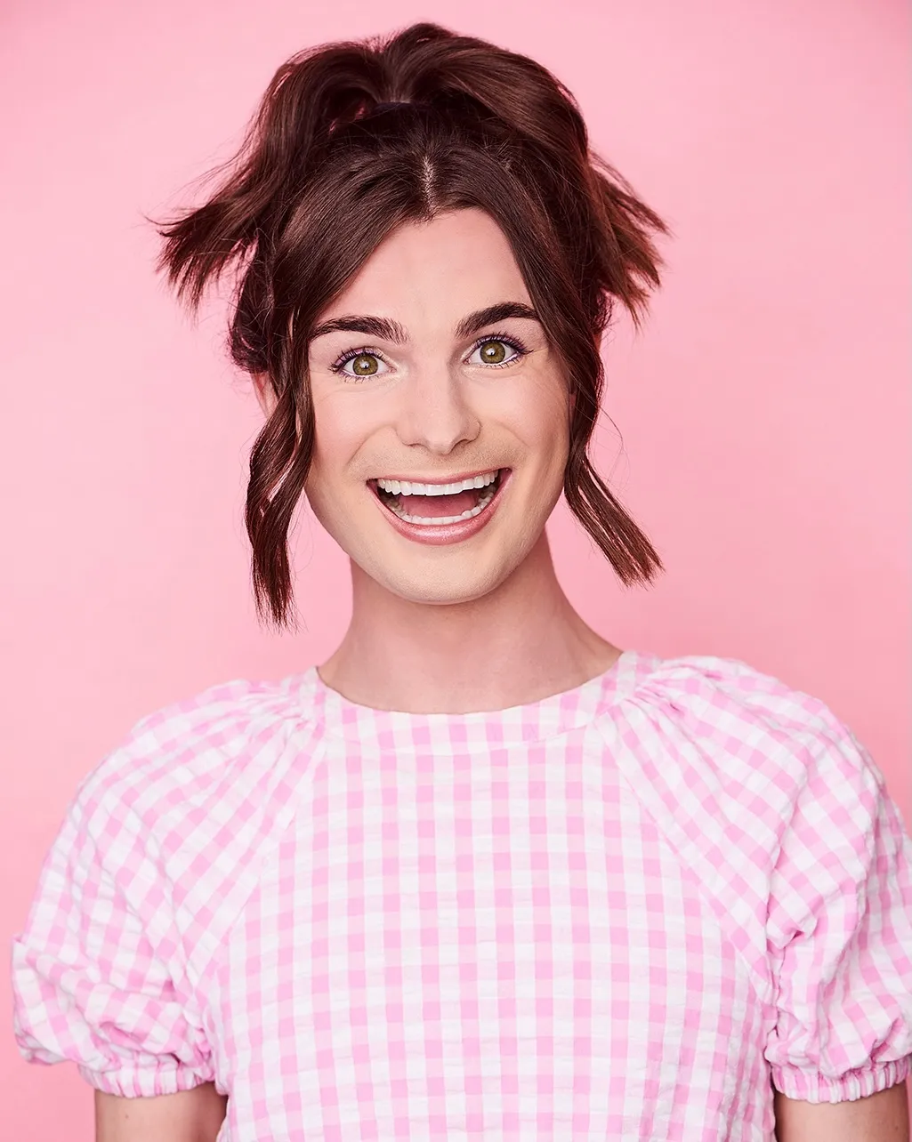
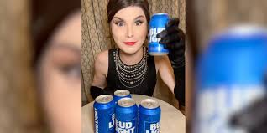

Slide 17
Male/Female Are Cultural Constructs…
Unless You’re Trans

Slide 18


Slide 19
But get this…

Slide 20
We are told our genitals don’t define gender …
But you must agree so-called ‘gender affirming’ surgery to change genitals is essential life-saving medicine!

Slide 21
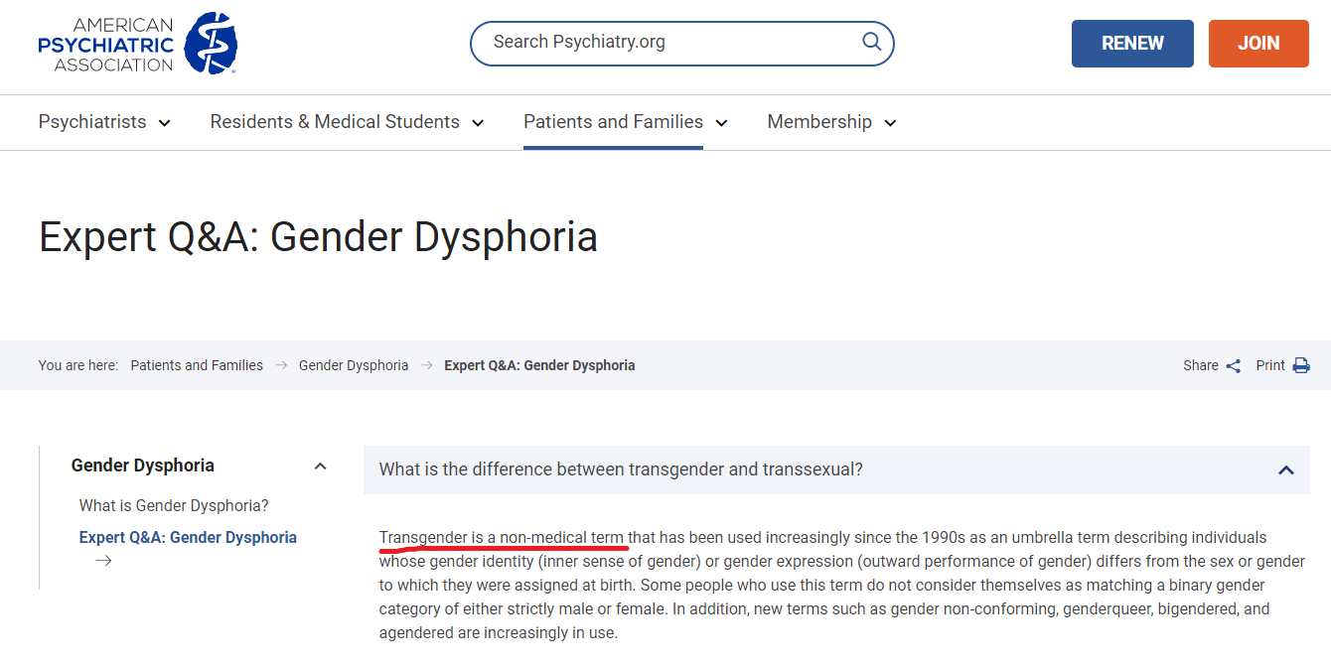

Slide 22
    We must ask ...
    Where is truth found?

Slide 23
    We must ask ...
    Where is truth found?
    In God or in Nature?

Slide 24
    We must ask ...
    What does it mean
    to be human?

Slide 25


“One is born a girl or boy, one becomes woman or man.
The human species is divided into two, and in two only…
In other words, every individual who is not man is woman.
There is no third possibility.
…That is, humankind does not
exist outside this double form,
masculine and feminine.

Slide 26
    ‘Non-binary’ is not a thing

Slide 27
    ‘Non-binary’ is not a thing
    There are not many genders

Slide 28
    Non-binary is not a thing
    There are not many genders
    ‘Gender identity’ is not real

Slide 29
    Non-binary is not a thing
    There are not many genders
    Gender identity is not real
    ‘Trans’ is not a thing

Slide 30
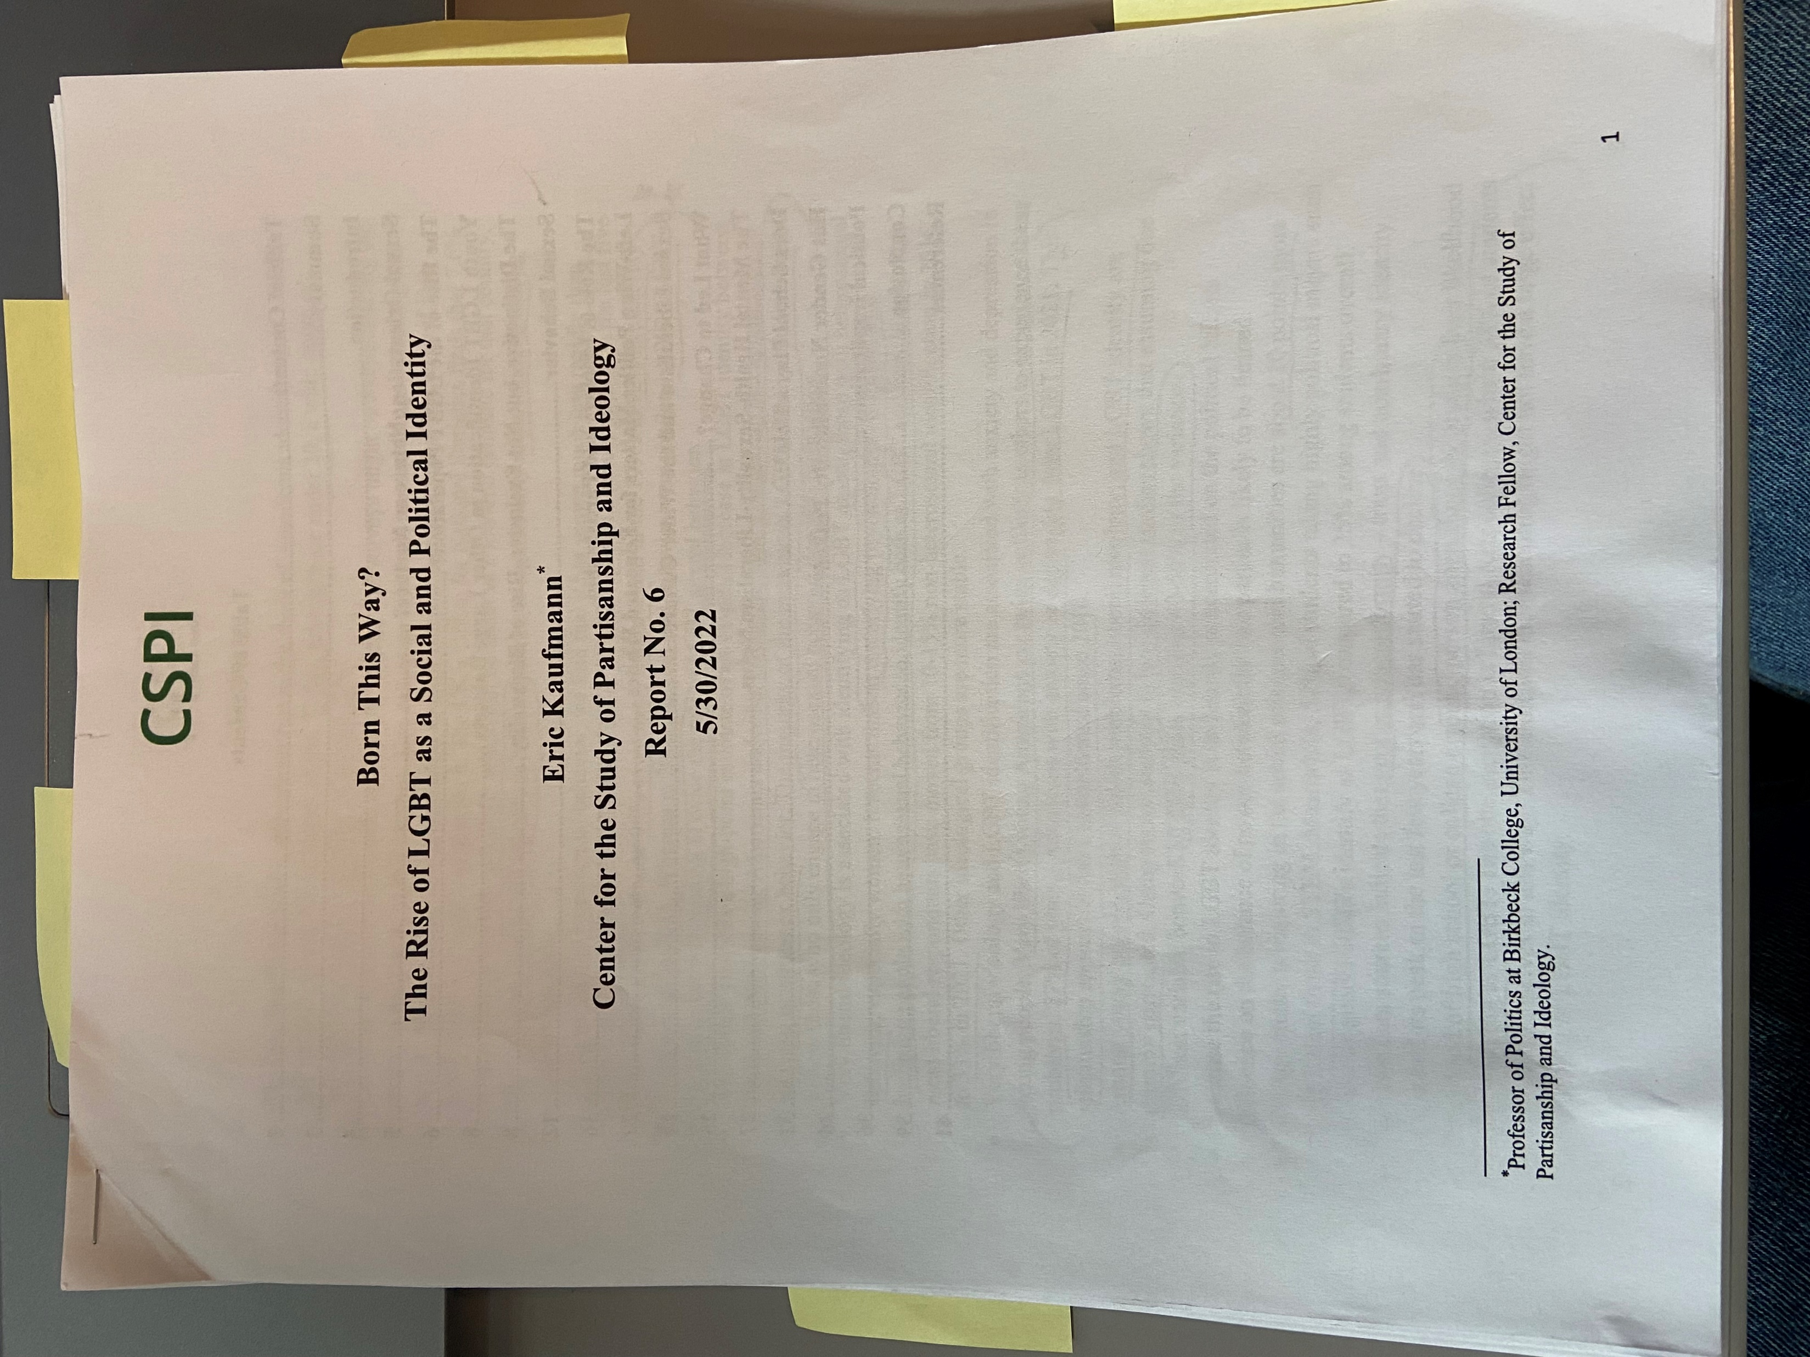
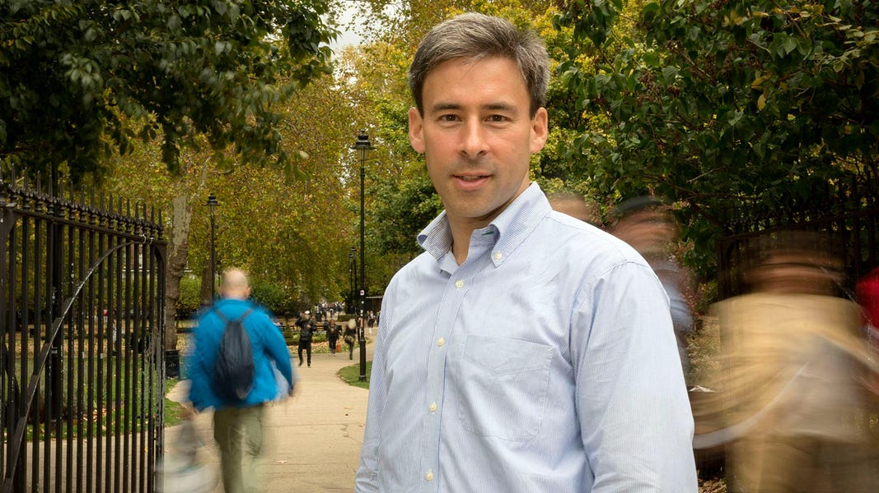
    Er Eric Kaufmann,
    University of London

Slide 31
    “When we look at homosexual behavior, we find that it has grown much less rapidly than LGBT identification.
    By 2021, LGBT identification was running twice the rate of LGBT sexual behavior.”

Slide 32
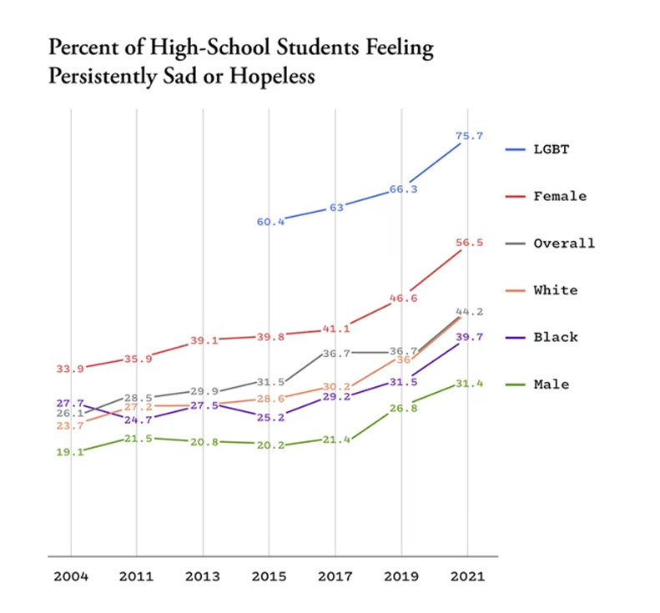
“Why American Teens Are So Sad”
The Atlantic, April 11, 2022

Slide 33
    If “LGBT” is anything, it is this…
      A wholly subjective self-declaration that I, the autonomous individual, am set on challenging universal sexual norms in dramatic ways…

Slide 34
    This revolution operates on… intimidation,
    confusion,
    and the
    exploitation of false compassion.

Slide 35
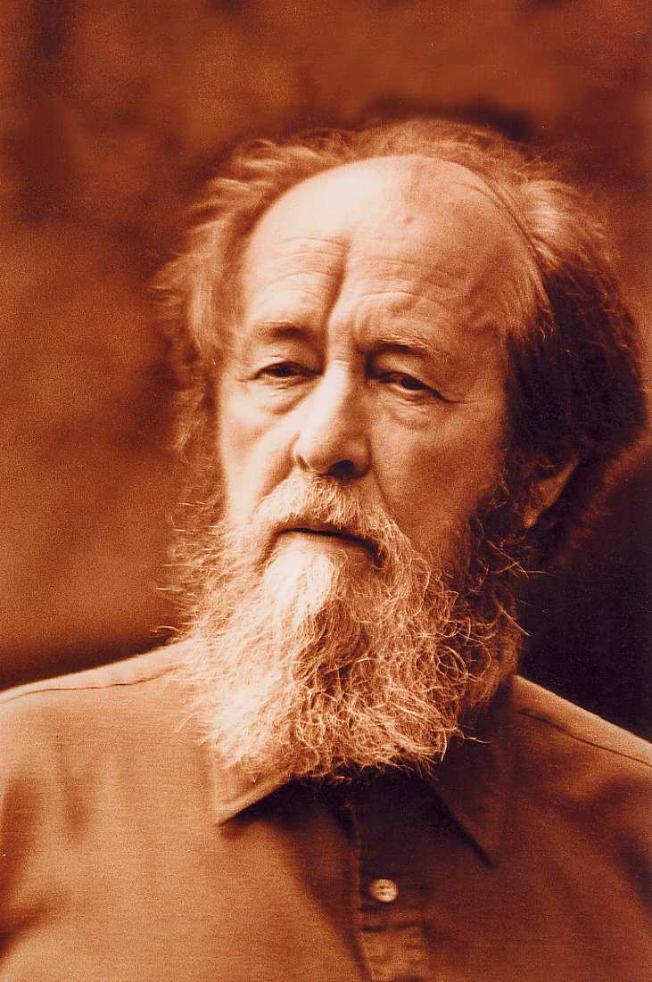
    Follow the bold wisdom of
    famed Soviet dissident…
    Alexandr Solzhenitsyn

Slide 36
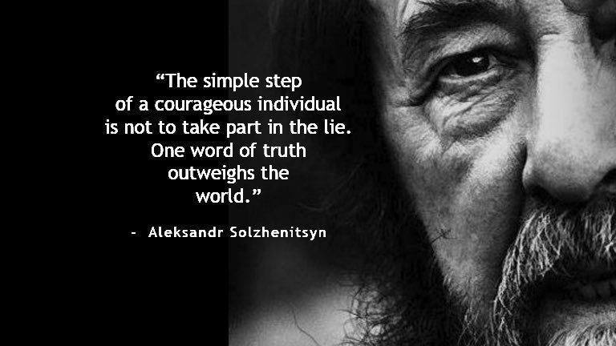

Slide 37
    Break

Slide 38
Sexuality/Gender
    Are Undeniable
    Gospel Issues

Slide 39
    We must ask ...
    What does it mean
    to be male and female?

Slide 40
Jesus, when asked about divorce…
    “Have you not read that He who created them from the beginning made them male and female…”
    - Matthew 19:4

Slide 41
    Then God said, “Let us make [humanity] in our image, after our likeness…
      So God created man in his own image,
      in the image of God he created him;
      male and female he created them.
                -Genesis 1:26-27 ESV

Slide 42
    What is the first thing scripture
    tells us about
    male and female?

Slide 43
    Image.
    Likeness.
    Of God!

Slide 44
Image / Hebrew: tselem (male)
    Idol, representative figure
    2. semblance, reflection, shadow, photo

Slide 45
Likeness / Hebrew: demuth (feminine)
    Resemble, similarity
    2. Tangible reproduction, model

Slide 46
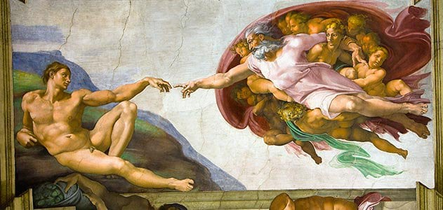

Slide 47
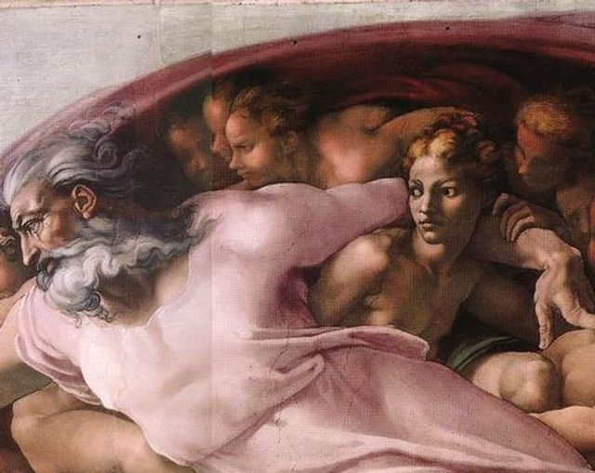

Slide 48
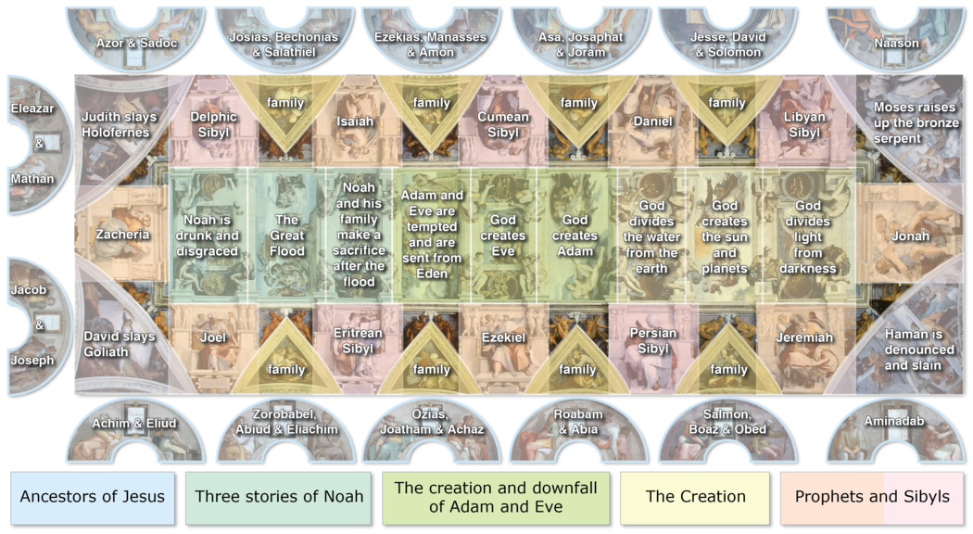





Slide 49
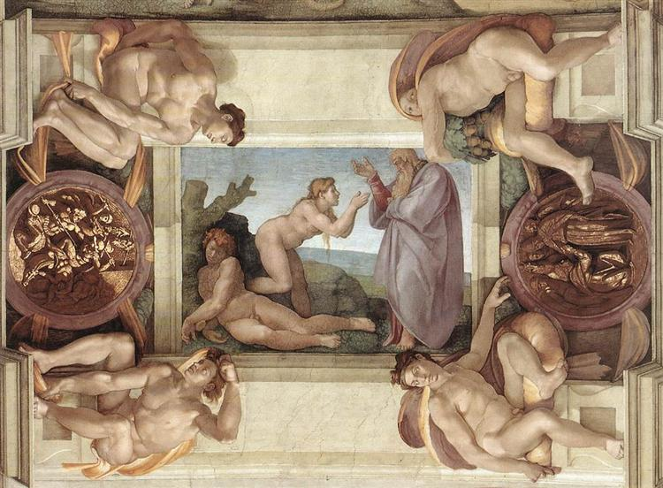

Slide 50
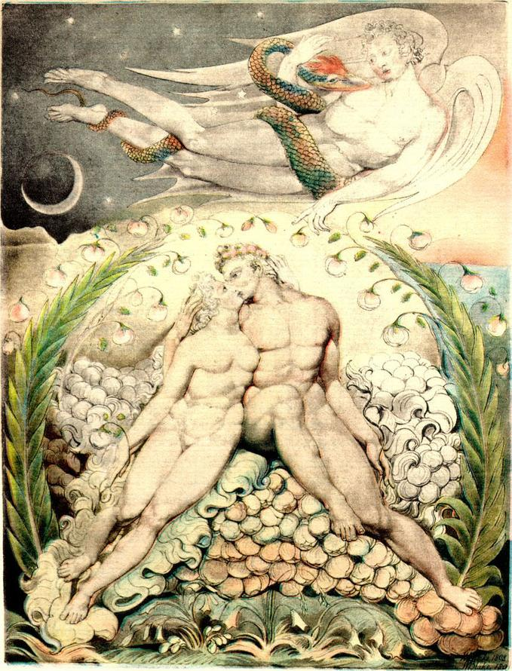

Slide 51
    Therefore,
    attacks on male and female
    are attacks on ????

Slide 52
    This is why sex and gender
    are absolutely
    Gospel issues!

Slide 53
    Sex vs Gender
    Different Things?

Slide 54

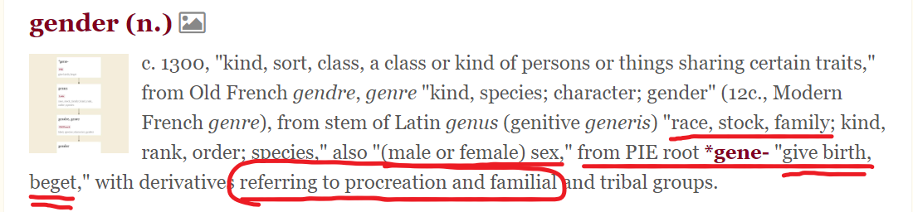

Slide 55
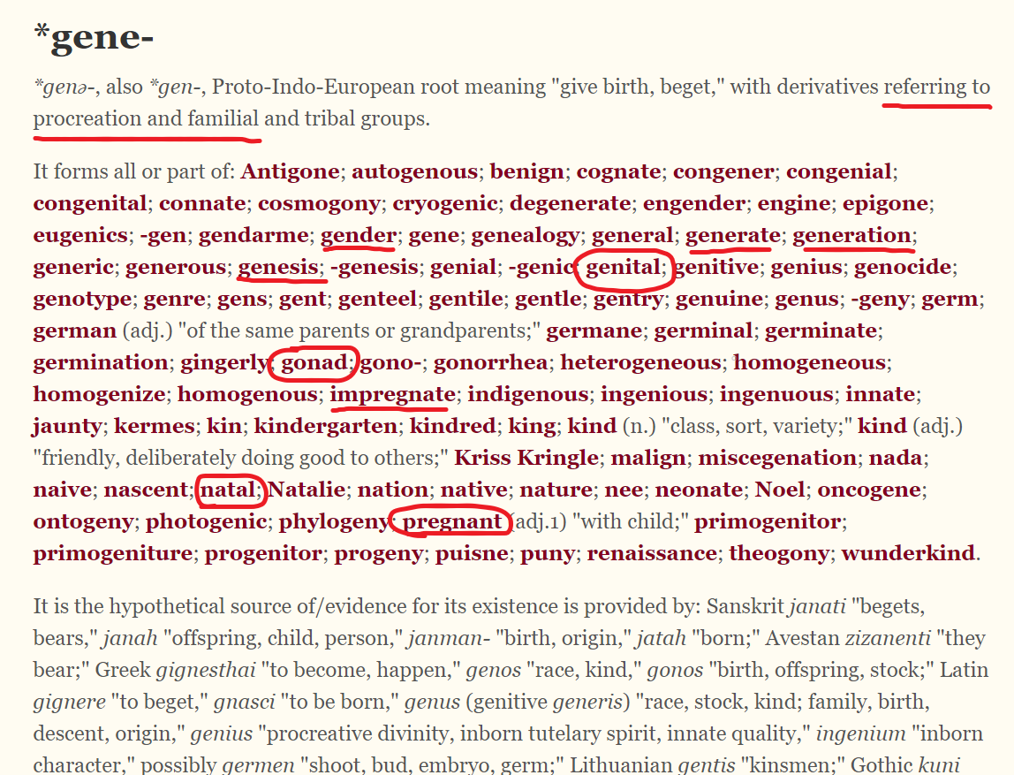

Slide 56
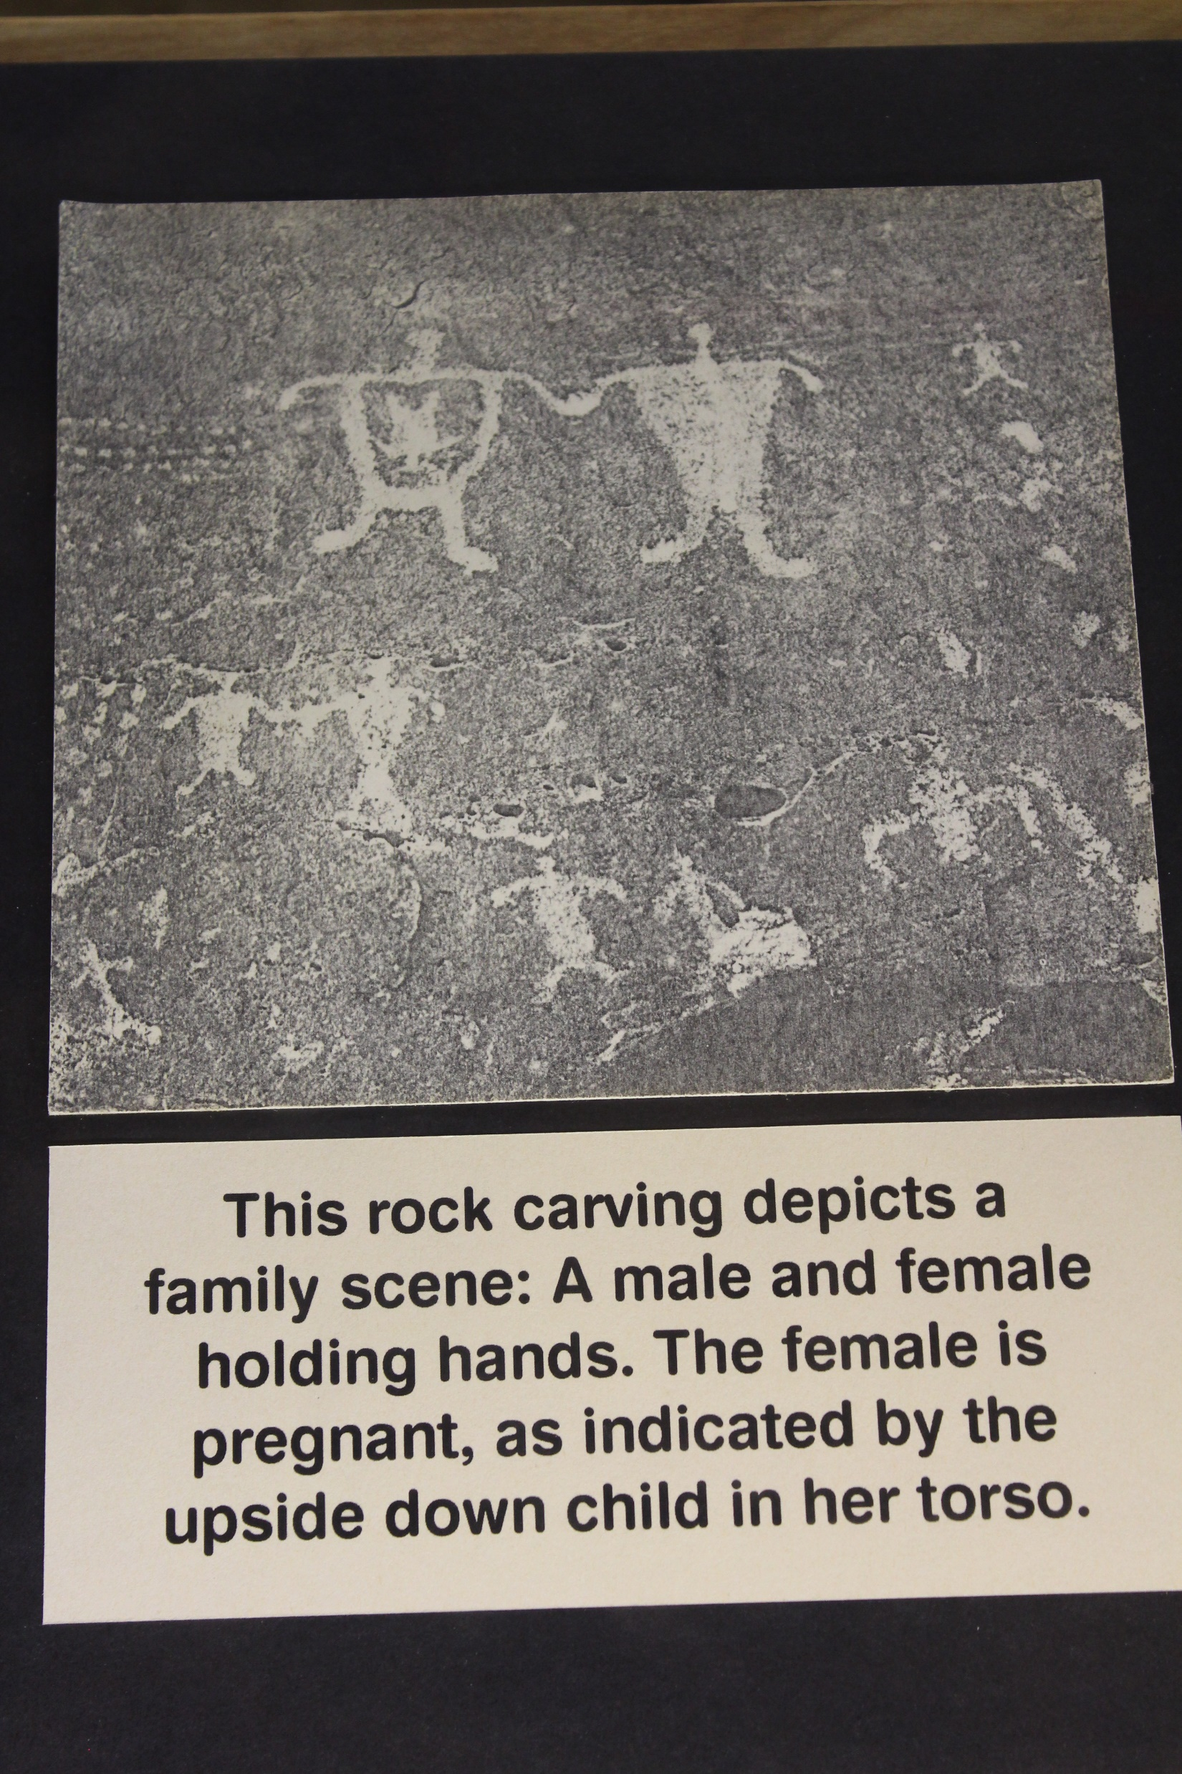
    The beauty and power
    of
    Male and Female

Slide 57
    Q & A

