Slide 1
How Common Core Bankrupted American Kids
And why it will happen again unless we do something smart.

Slide 2
Two Main Types of Education
Classical Liberal Arts
Progressive Propaganda
Focused on great books
Affirms and draws out a fixed human nature
Aim of cultivating virtue
Content-strong science instruction
Morality, civics, and duty-driven
Controlled by parents and communities
Focused on random, contemporary books with no enduring value
Relativist human manipulation
Aim of cultivating political correctness
Sciences politicized and watered down
Therapeutic and consumer-driven
Bureaucratic and centrally controlled

Slide 3
Timeline of American Education

Slide 4
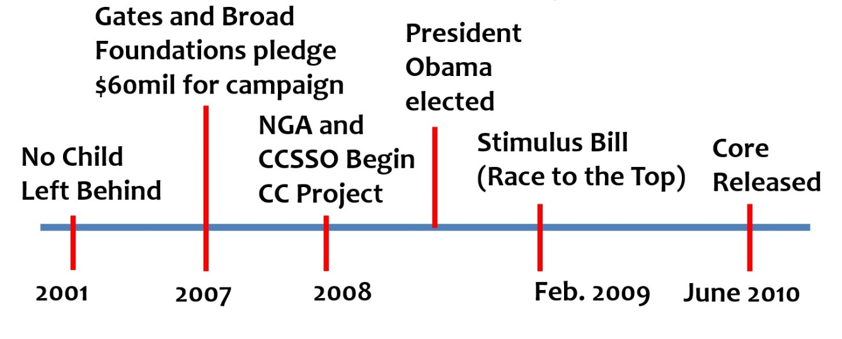
Early Timeline of Common Core

Slide 5
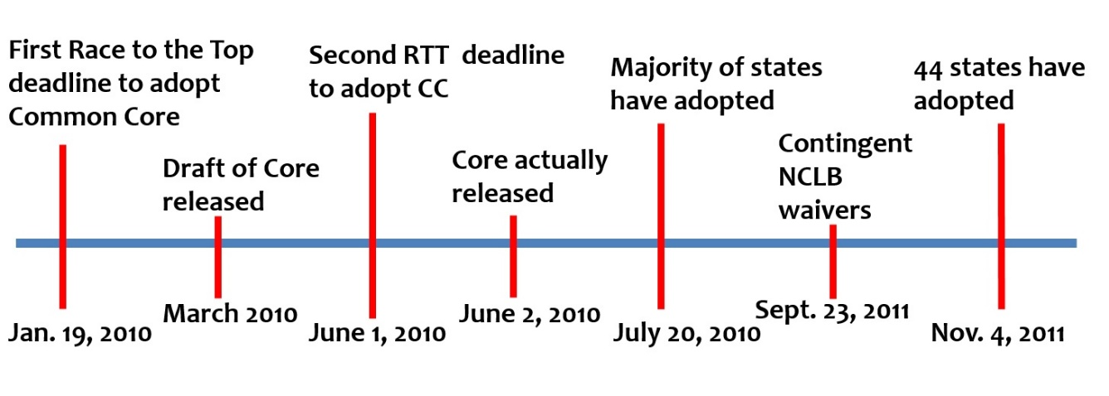
Later Timeline of Common Core

Slide 6
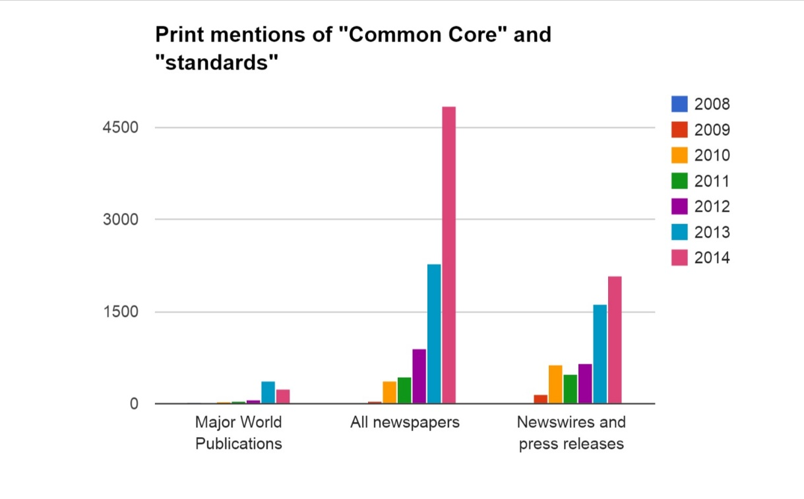
Media mentions of Common Core

Slide 7
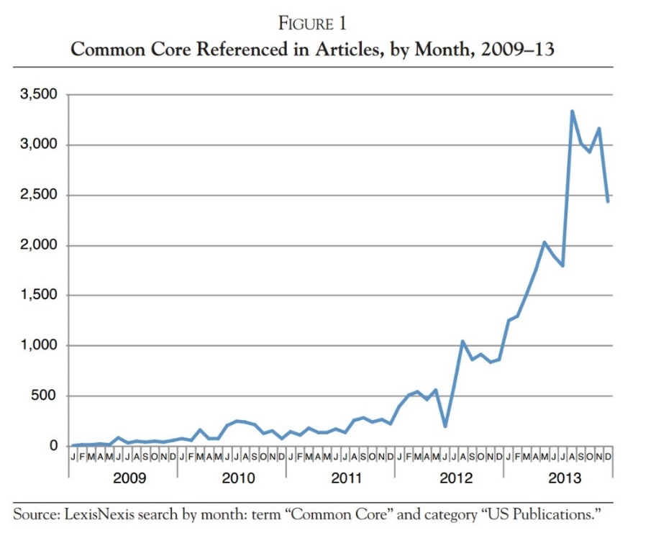

Slide 8
Americans Were Promised Academic Improvements
And we got the opposite.

Slide 9
“To compete with the rest of the world…we have to make sure that the skills they are learning are aligned with what employers and colleges expect high-school graduates to know…the Common Core State Standards, set an ambitious and voluntary goal line.”
—Jeb Bush

Slide 10
“We will end what has become a race to the bottom in our schools and instead spur a race to the top by encouraging better standards and assessments,”
—President Barack Obama, 2009

Slide 11
“It would be great if our education stuff worked, but that we won’t know for probably a decade.”
—Bill Gates

Slide 12
Ten Years Later
All the promises have been proven to be lies

Slide 13
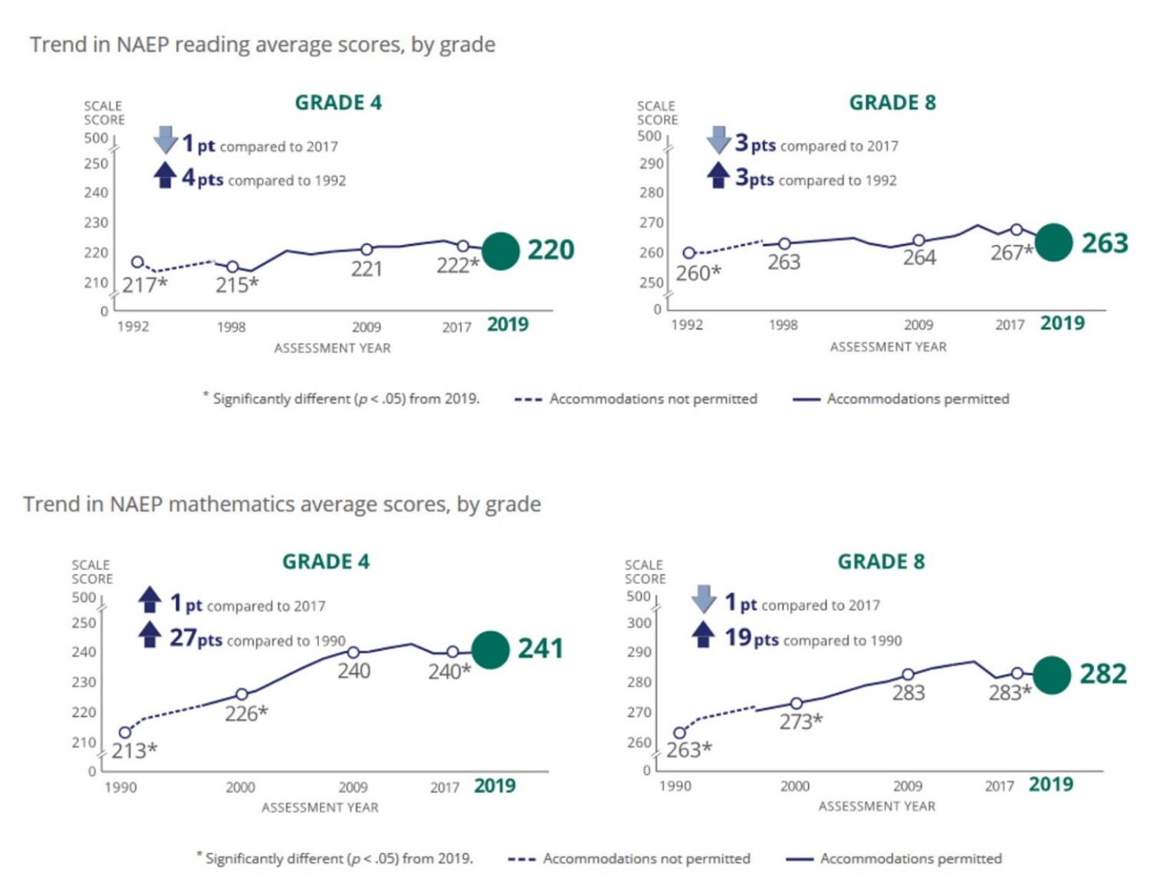
NAEP 2019

Slide 14
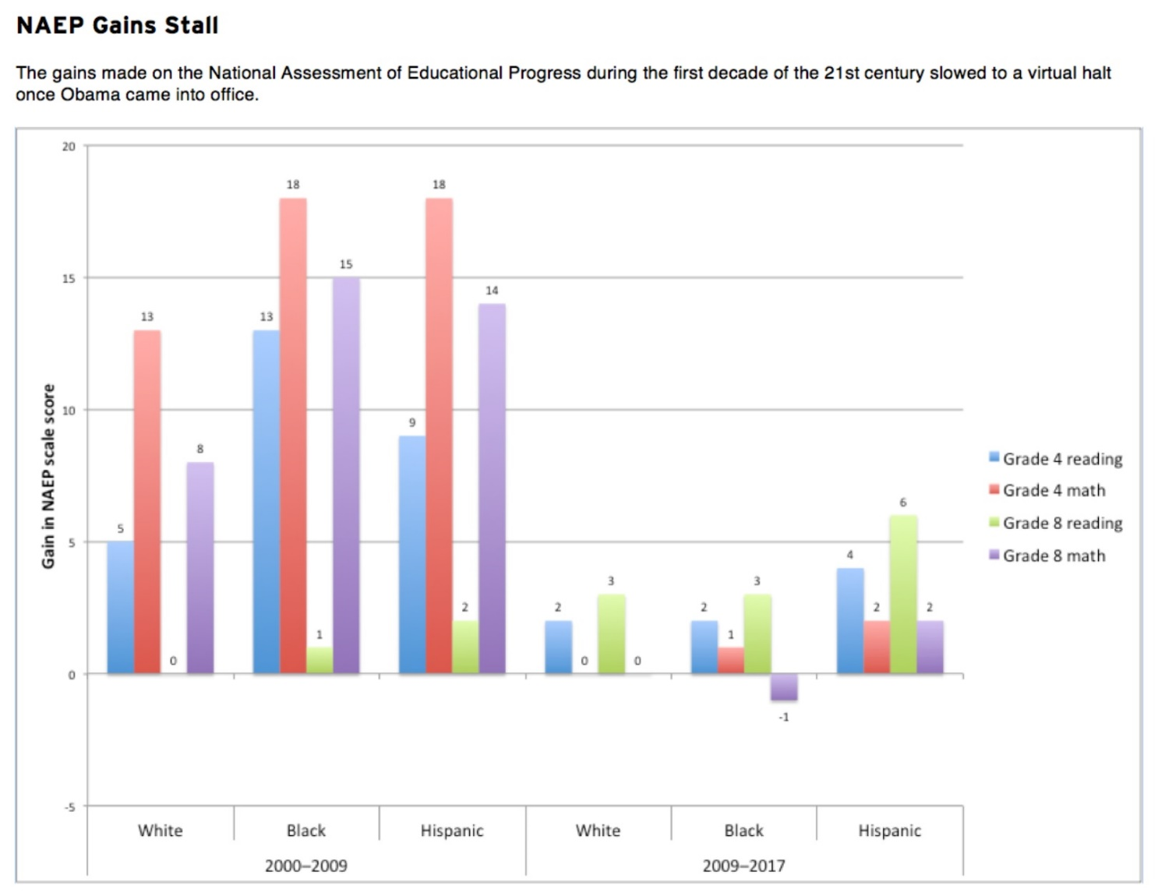
NAEP Gains Stall and REverse

Slide 15
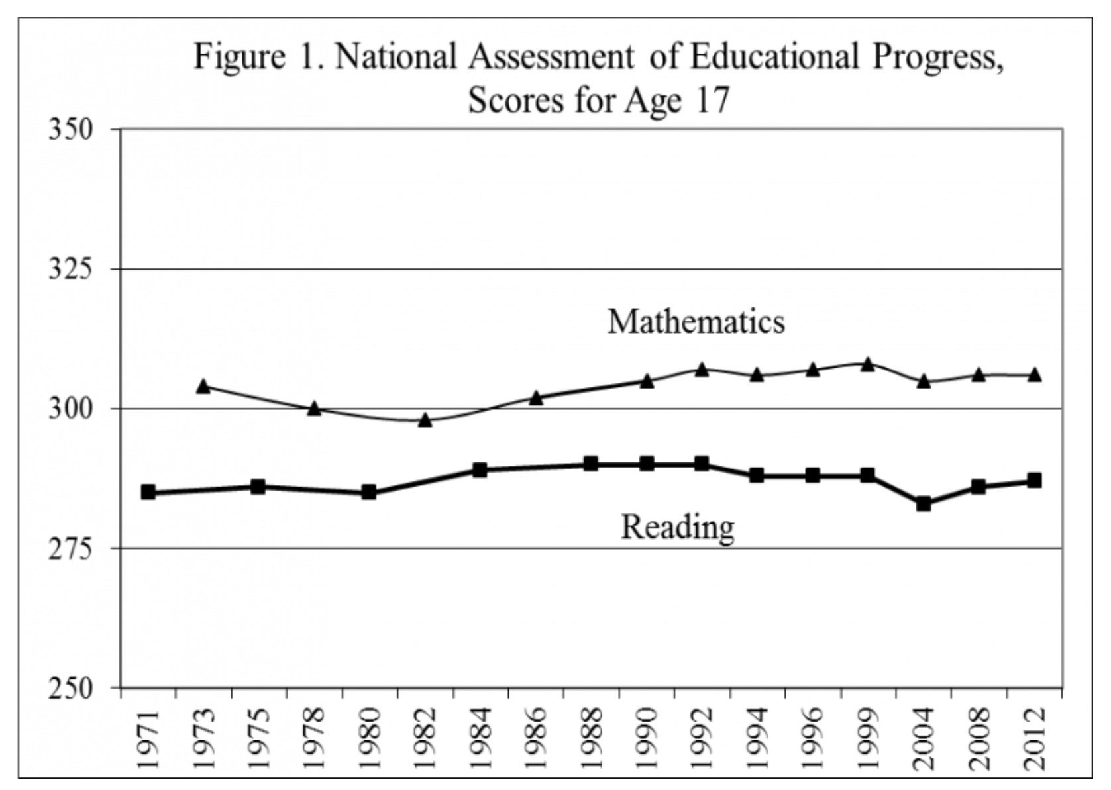
No Change in High School Grads on NAEP since 1970s

Slide 16
Fed Researchers Find Common Core Damaged Achievement

Slide 17
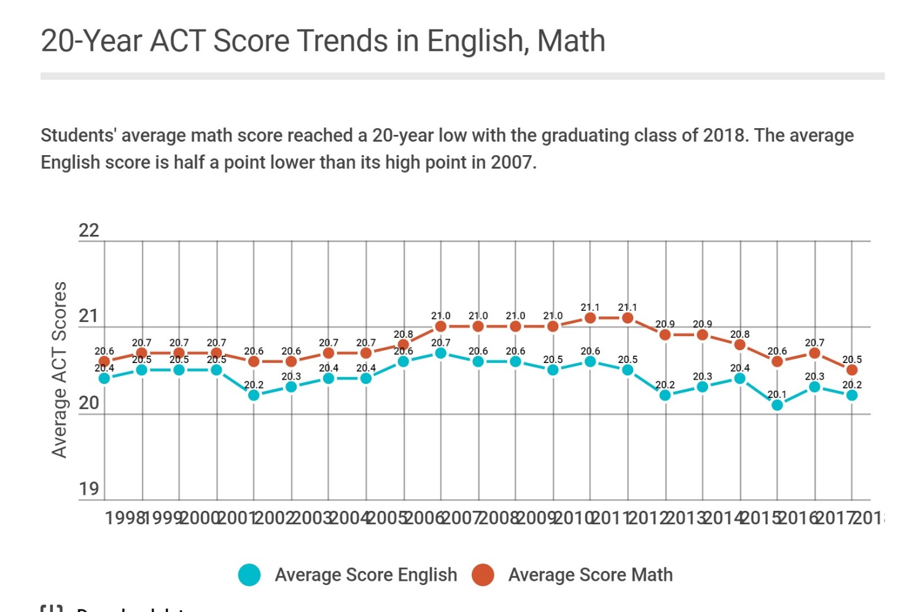
ACT Scores at 20-year Low

Slide 18
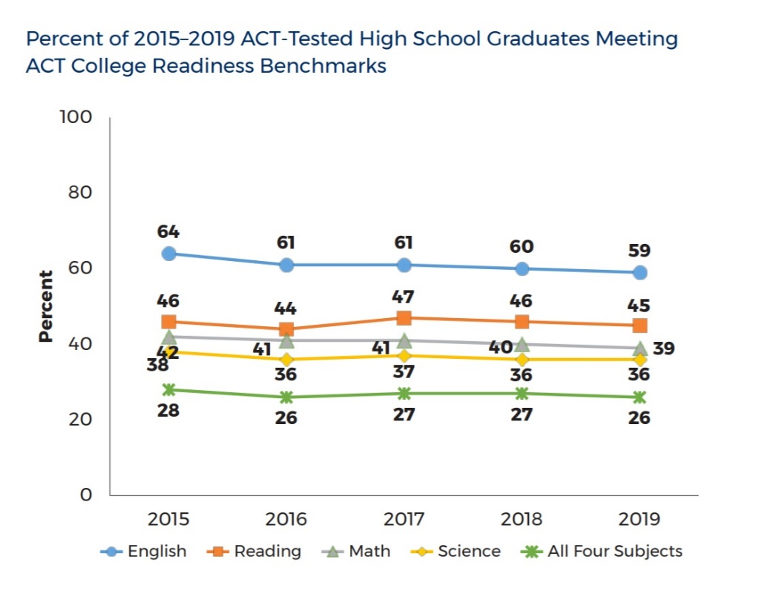
High School Grads Worst Prepared for college in 15 years

Slide 19
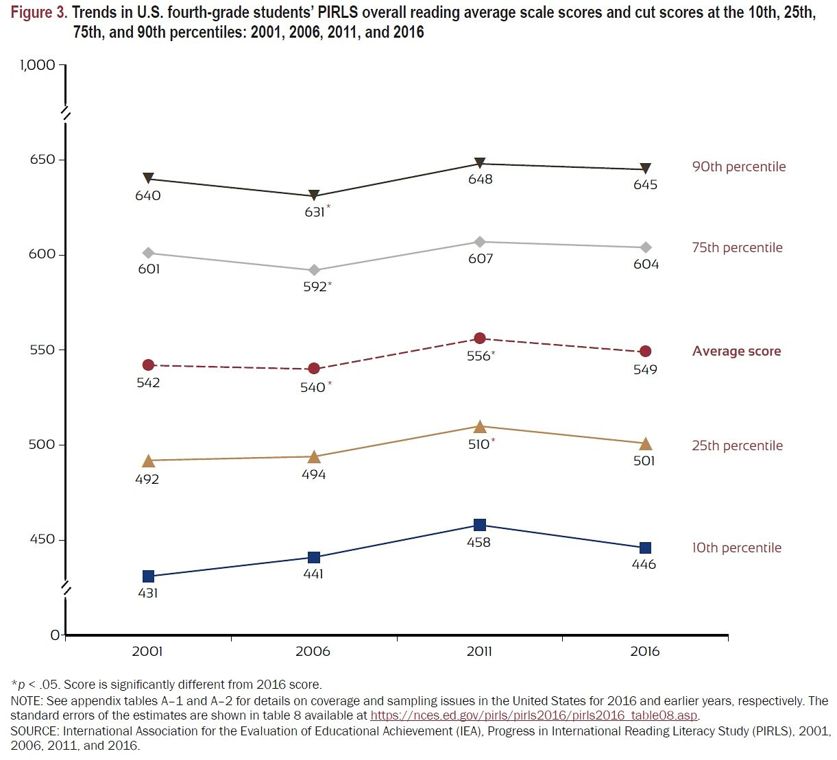
Declines on International Comparisons

Slide 20
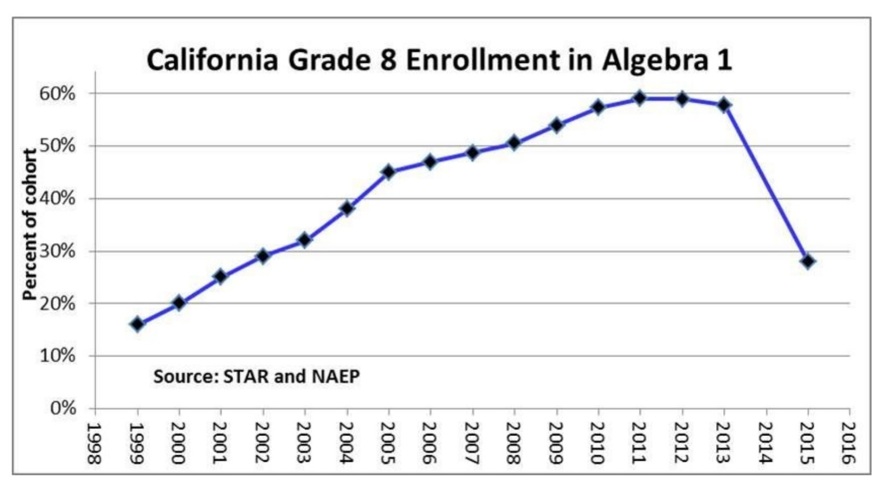
Eighth Grade Algebra Drop

Slide 21
Drop in Advanced Math Achievement

Slide 22
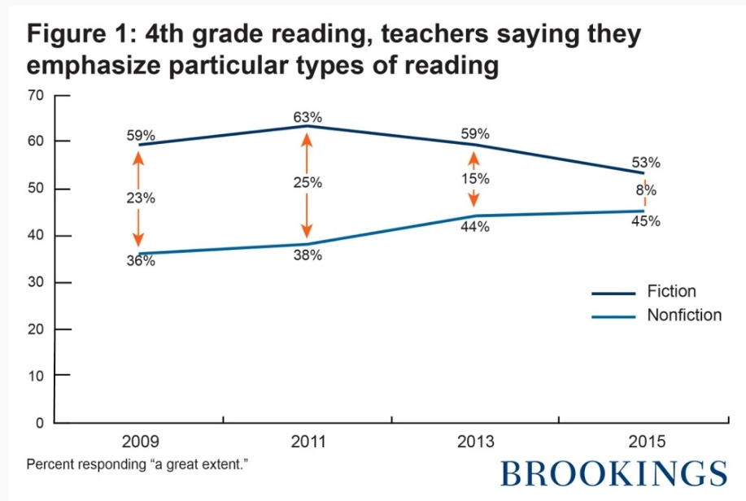
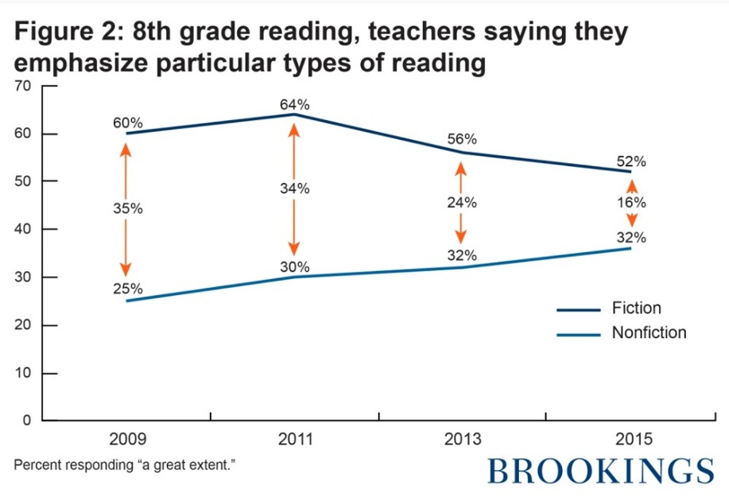
Research Also Finds Teachers Did What Common Core Demands

Slide 23
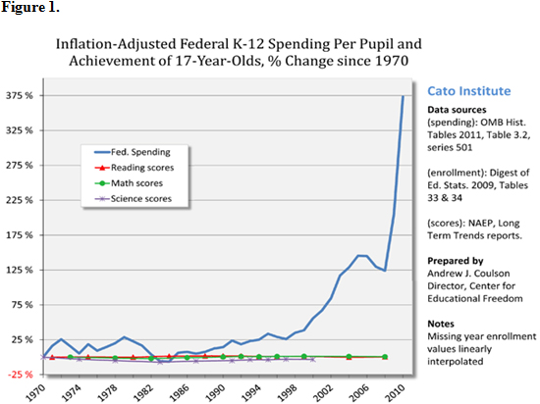
Common Core: Same Results, Billions Spent, Another Generation Gone

Slide 24
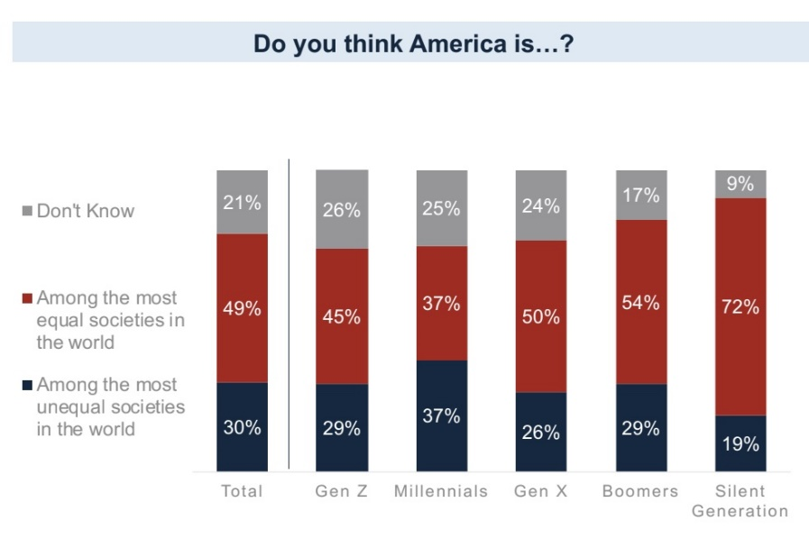
Negative Views of America

Slide 25
FLAG/YouGov Poll 2019
Half of those surveyed believe the United States is sexist (50%) and racist (49%);
American exceptionalism is on the decline. 46% of younger Americans do not agree that “America is the greatest country in the world”;
38% of younger Americans do not agree that “America has a history that we should be proud of”;
One in eight (14%) of Millennials agree that “America was never a great country and it never will be”;
46% of younger Americans agree that “America is more racist than other countries”;
84% of Americans do not know the specific rights enumerated in the First Amendment;

Slide 26
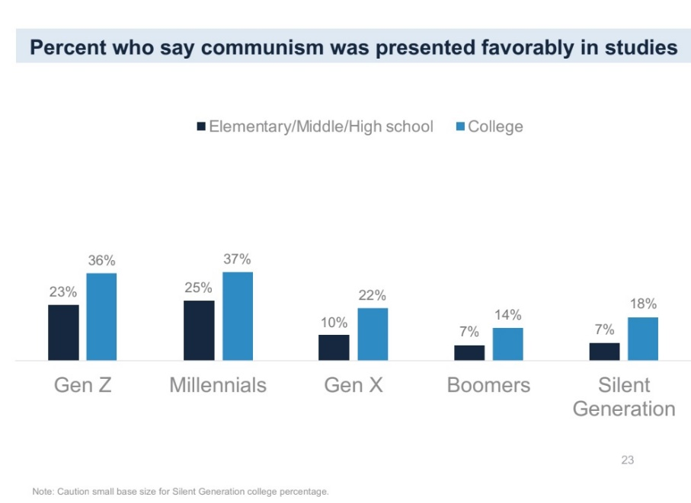
Communism Presented Favorably in school

Slide 27
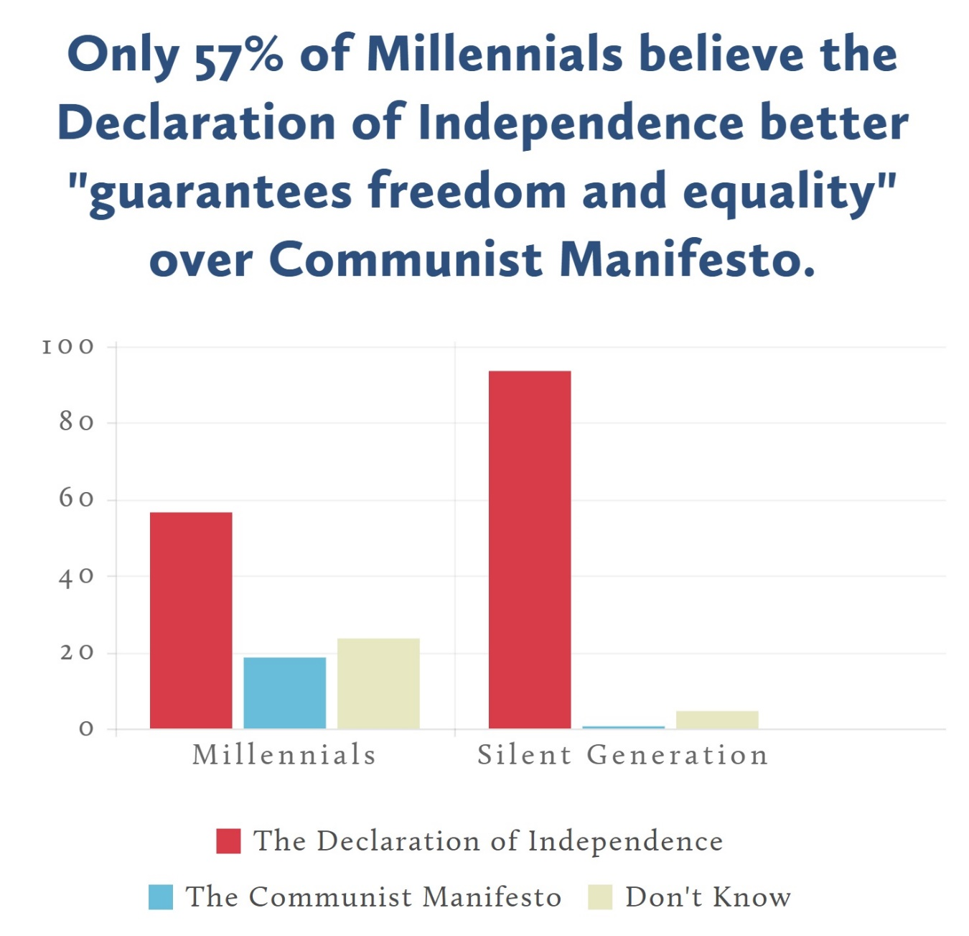

Slide 28
