Slide 1
How to Fix Our Anti-Family Economy
What hurts men hurts women, and vice versa. And when men and women suffer, so do children.

Slide 2
A look at the current trends
On work, marriage, and children

Slide 3
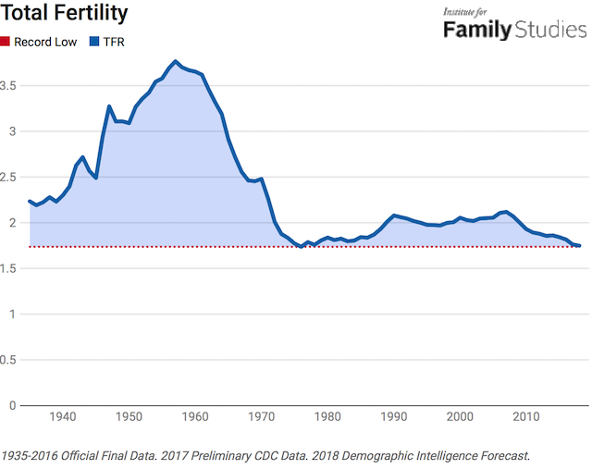
Record low birth rate…during an economic boom

Slide 4
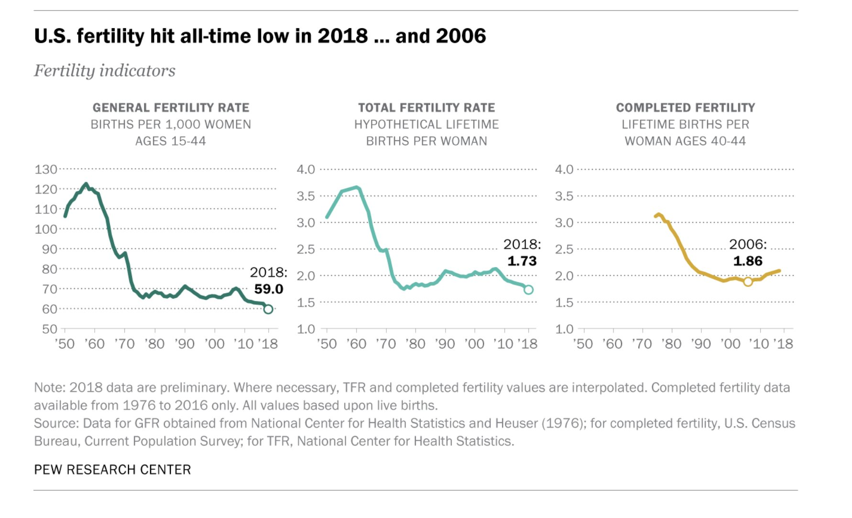

Slide 5
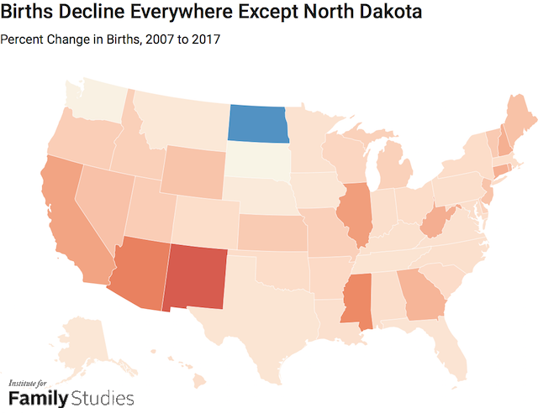
Highest lost births in blue states

Slide 6
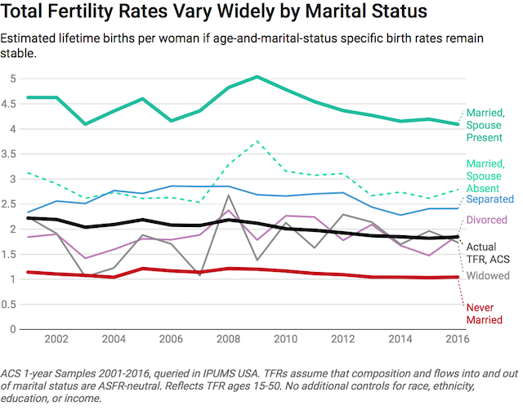
Family breakdown kills fertility

Slide 7
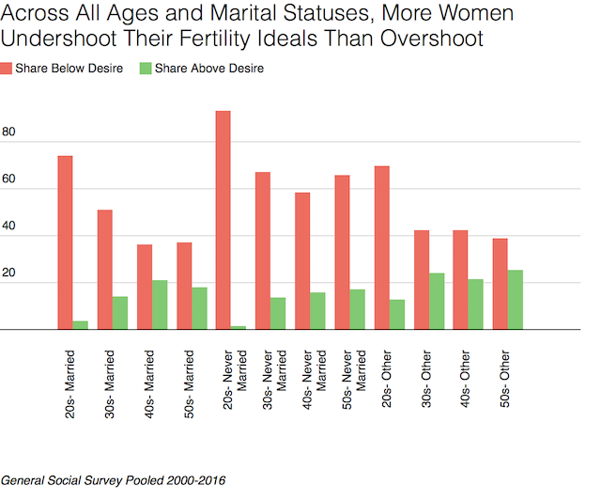
Women having far fewer children than we want

Slide 8
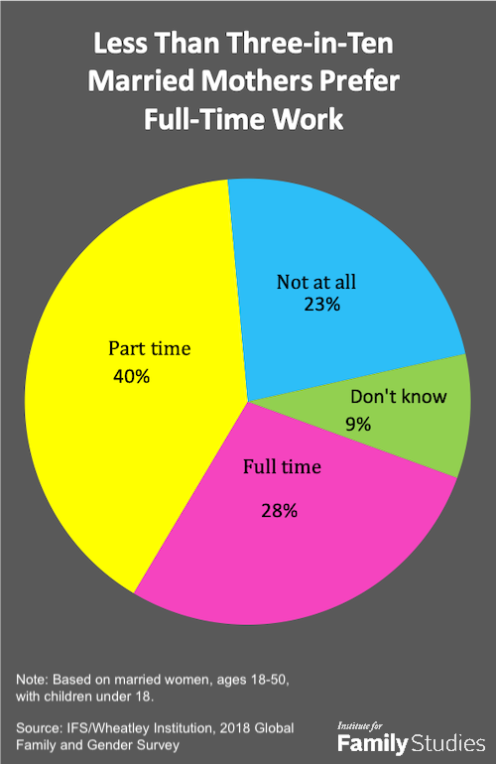
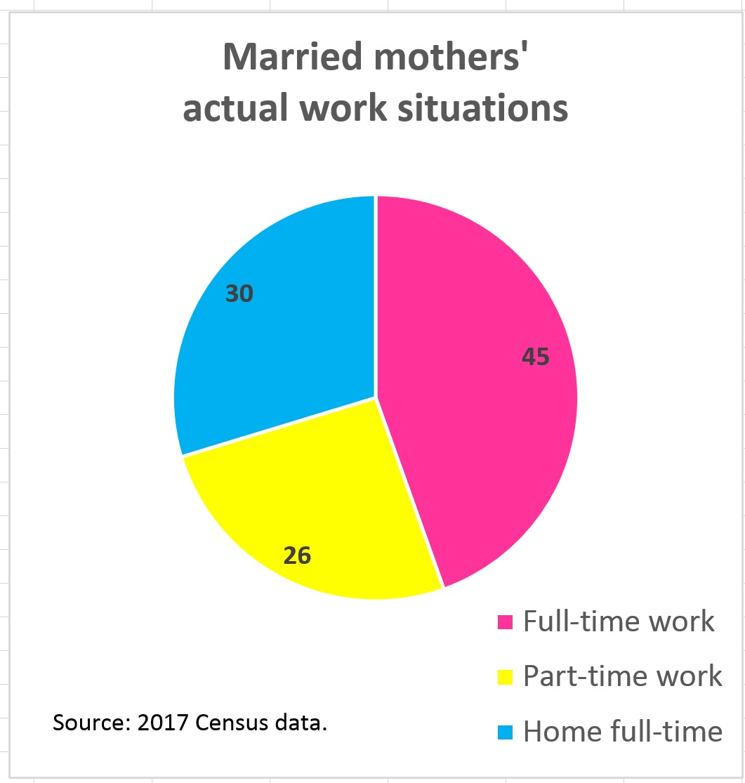
Mothers also working more than we want

Slide 9
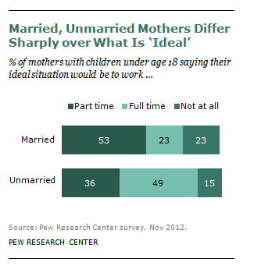
Marriage makes a big difference to women’s work preferences

Slide 10
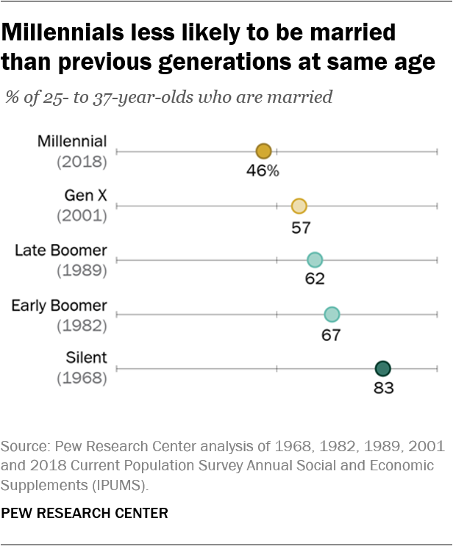
Marriage in major decline among young

Slide 11
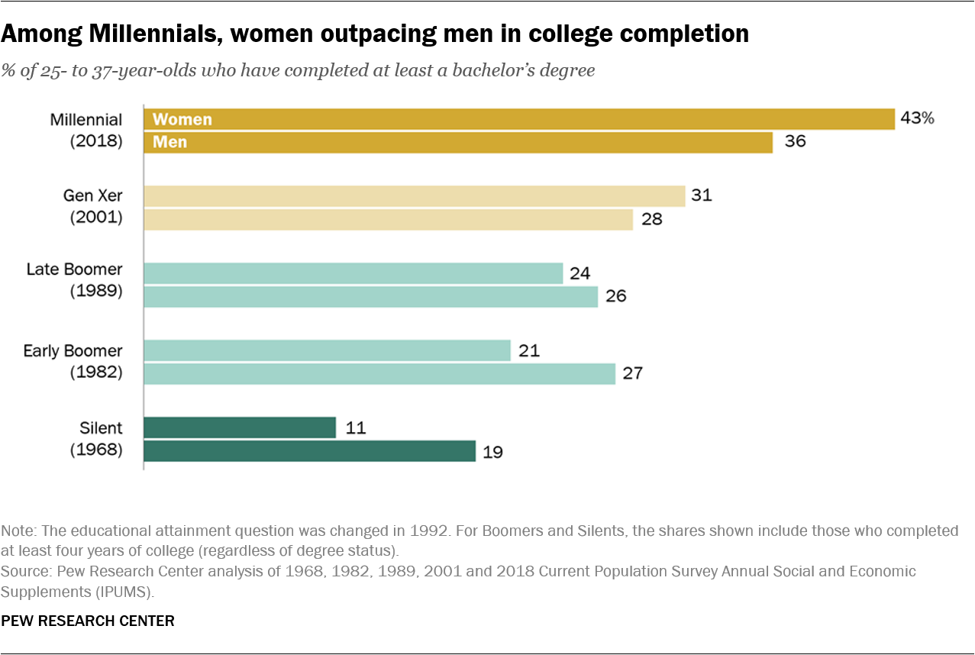
Women outstrip men in degrees

Slide 12
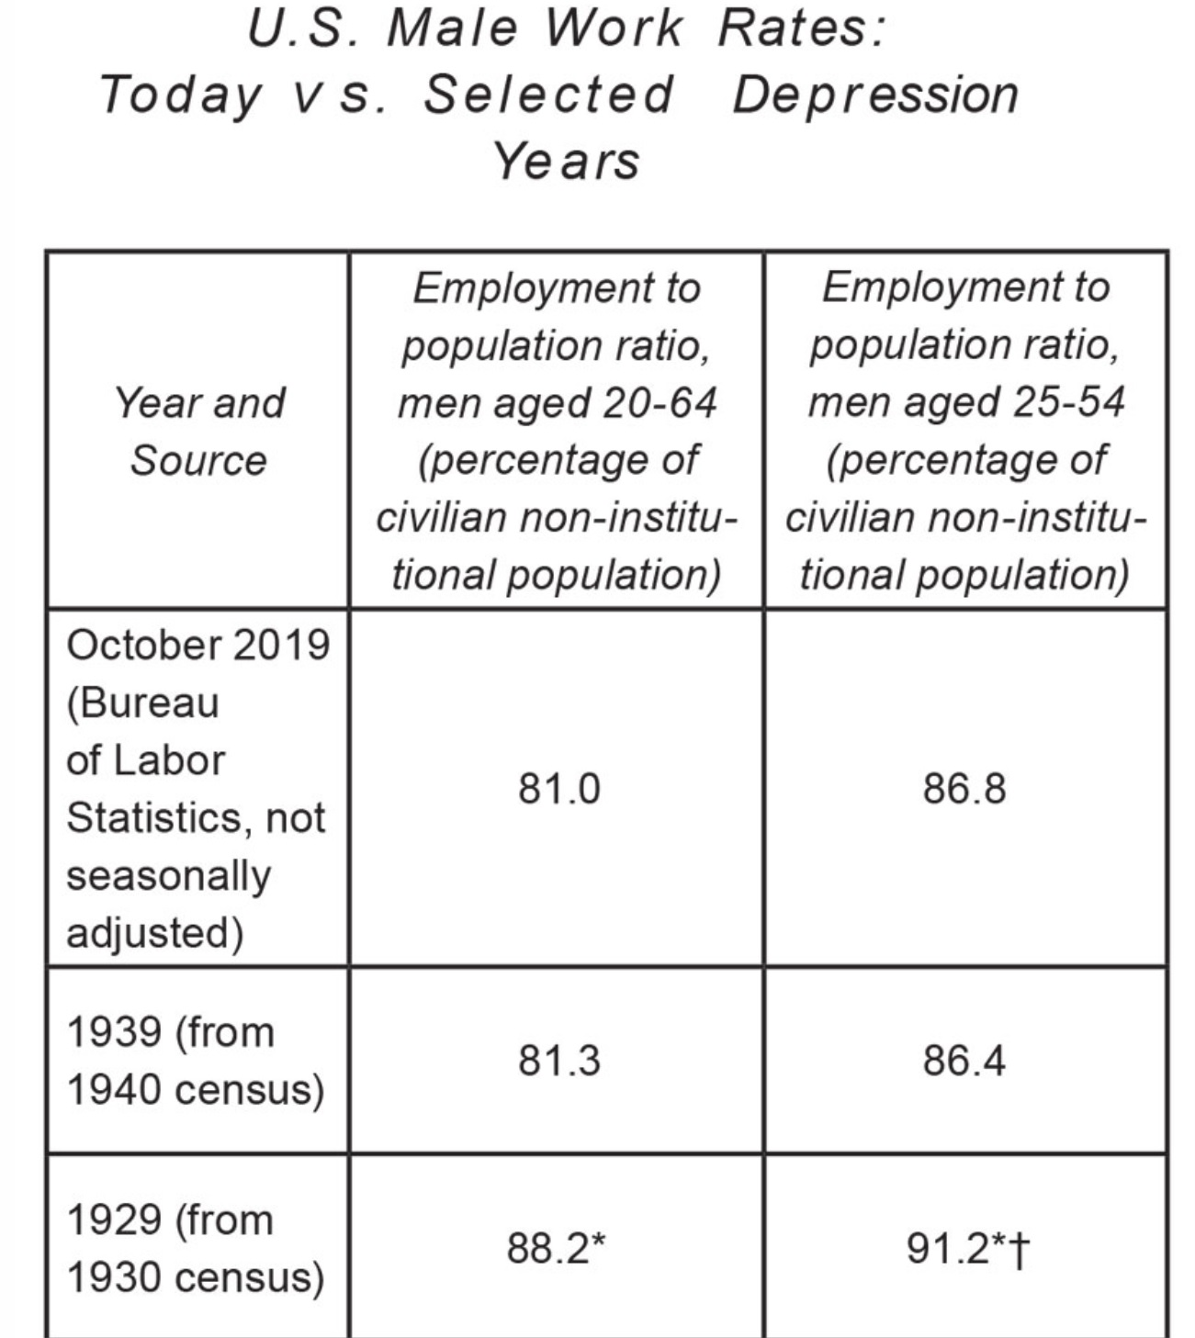
What’s going on? The man crisis

Slide 13
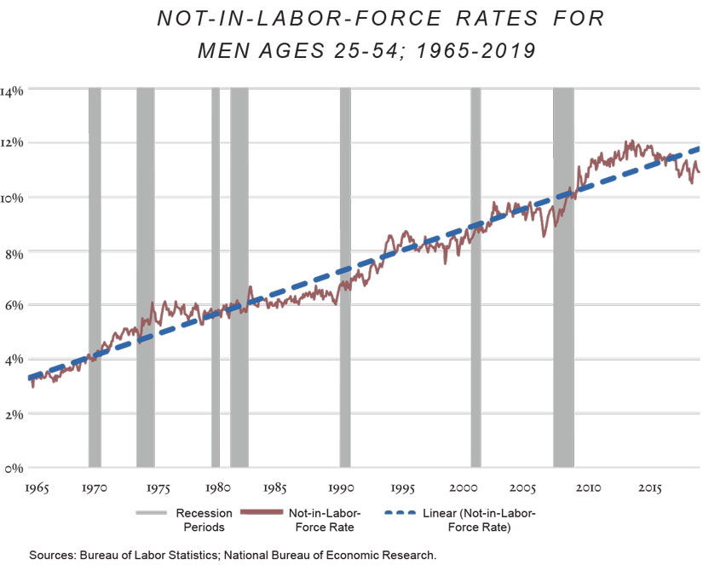
The decline of the working man

Slide 14
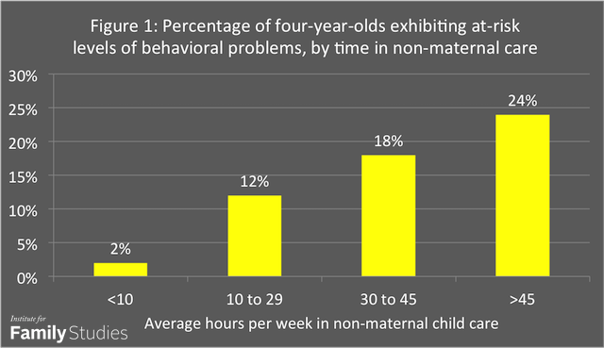
Children need their mothers

Slide 15
Parents increase language skills, reduce conflict. Nonparent care does the opposite.

Slide 16
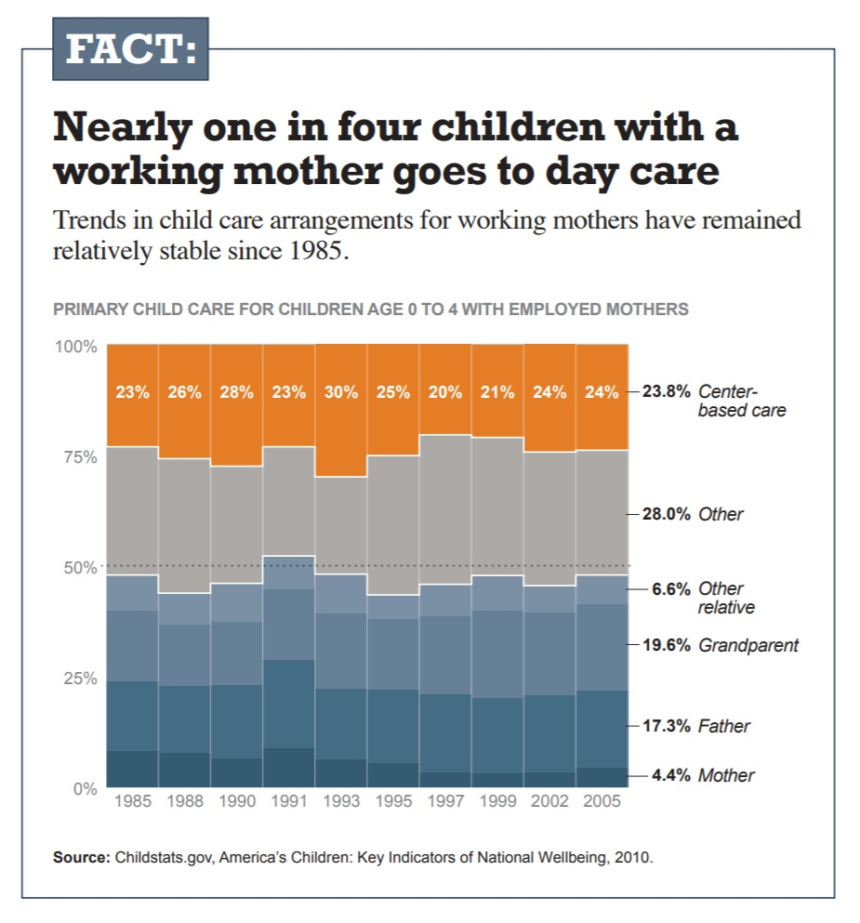
More working moms of young kids means more daycare; more daycare means more costs to society from emotionally hungry kids

Slide 17
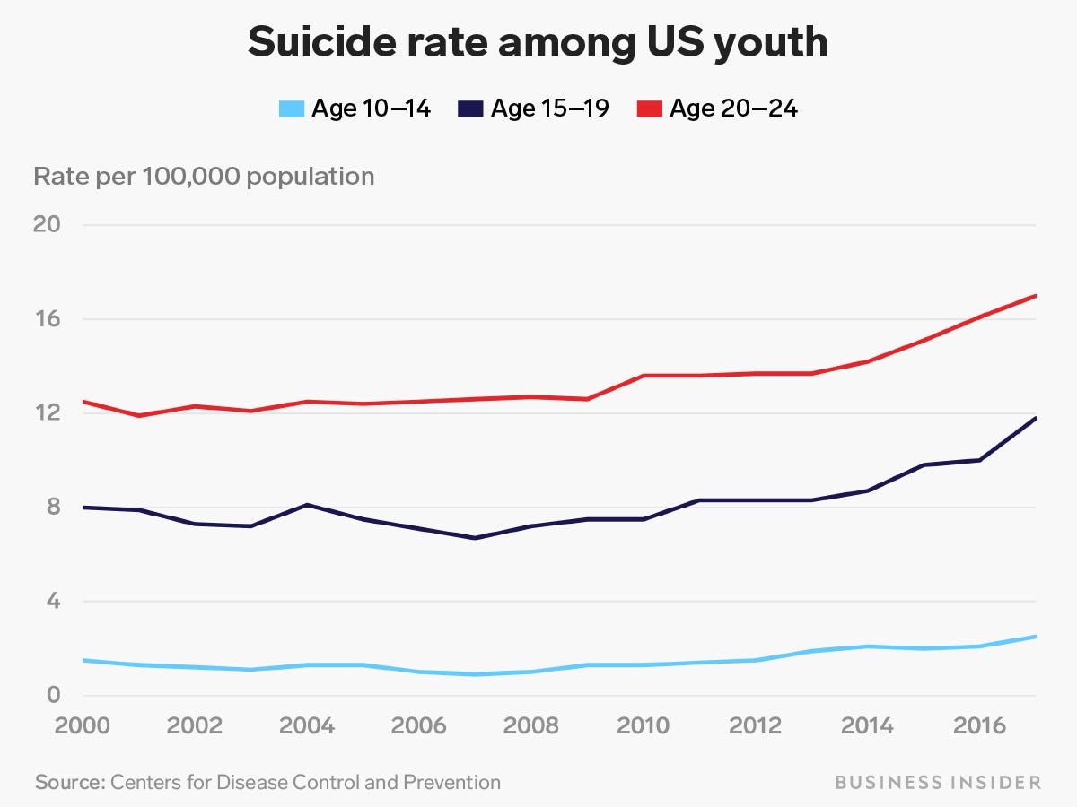

Slide 18
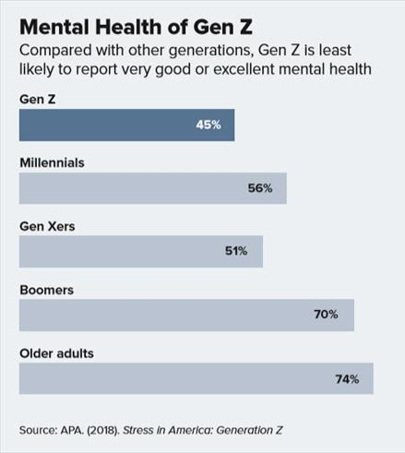

Slide 19
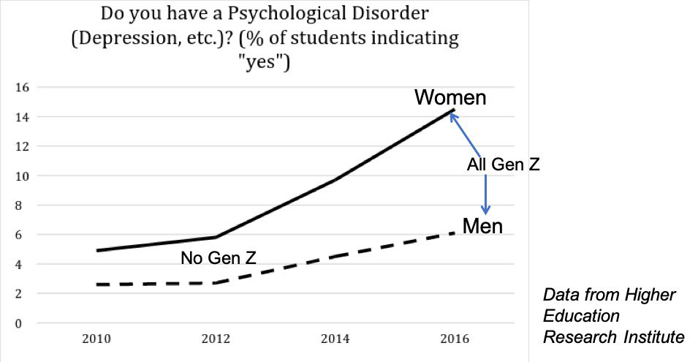

Slide 20
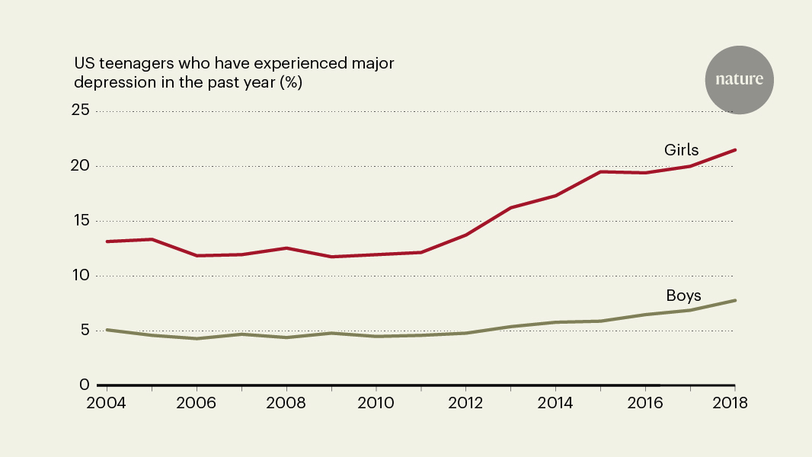

Slide 21
So what does all this mean?
It means more people in the cart, and fewer pushing it.

Slide 22
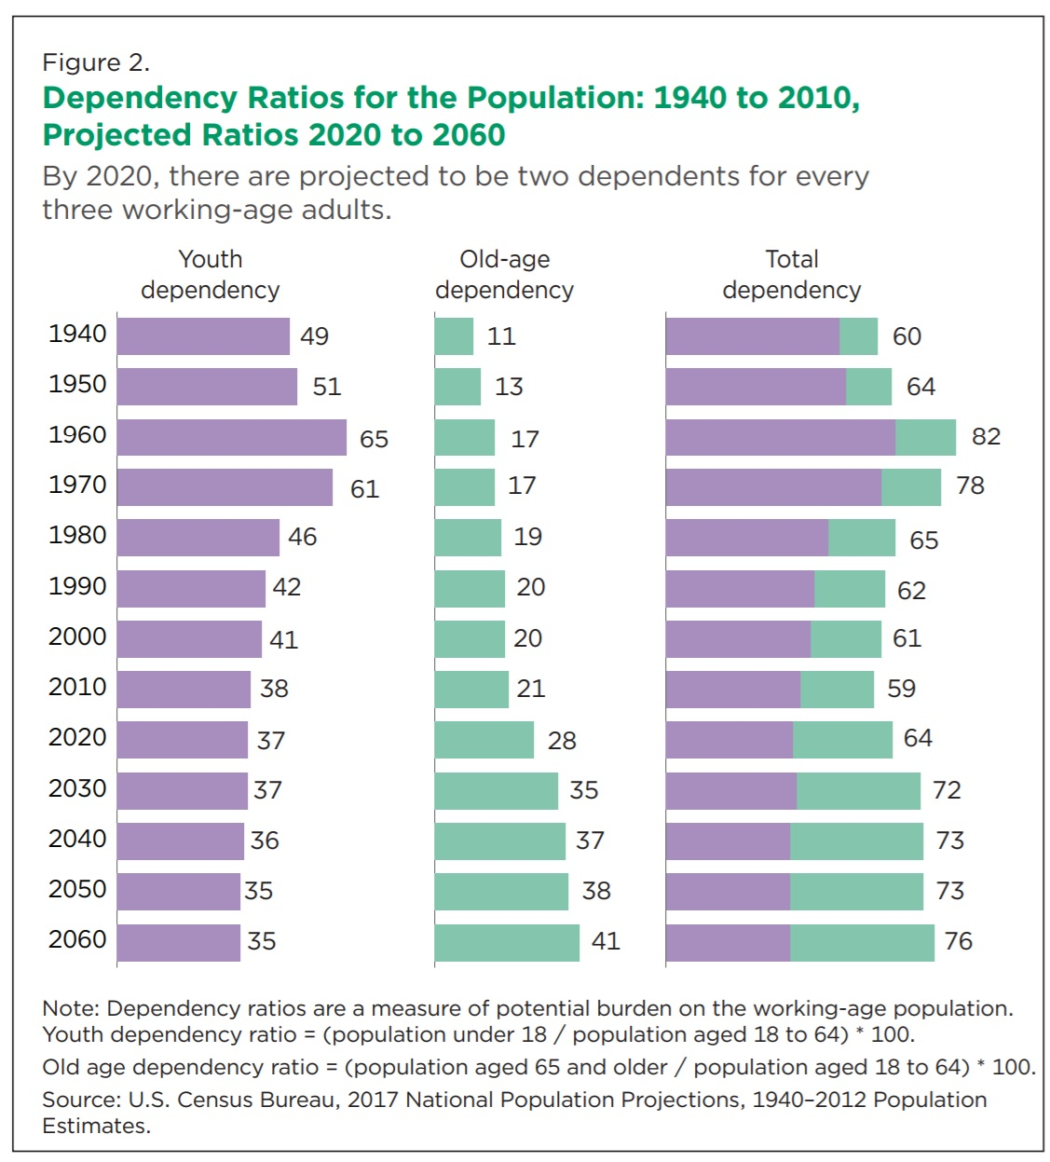
Census Data

Slide 23
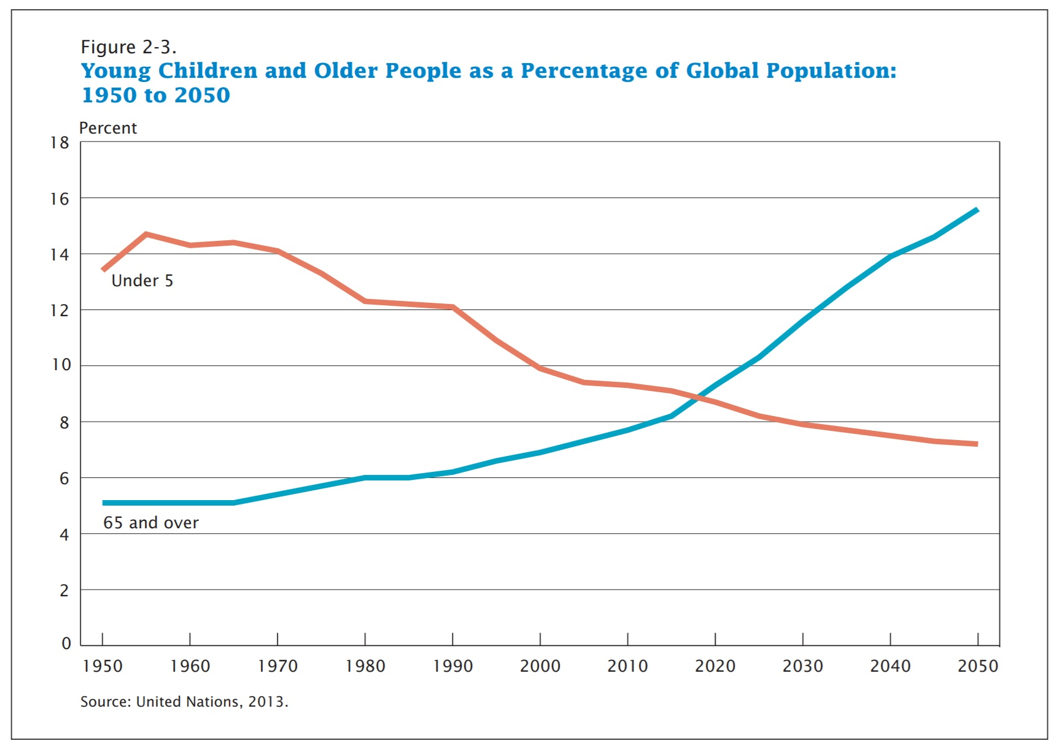

Slide 24
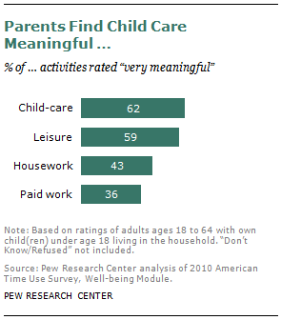
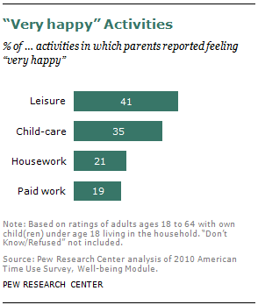
Parents love to spend time with their kids

