Slide 1
Why Public Schools Will Increase LGBT Indoctrination

Slide 2
“Black Lives Matter” coloring book in Madison, Wisconsin
Taught to kindergarteners through sixth grade.

Slide 3
Another page from the coloring book

Slide 4
‘Diverse Books’ From Scholastic for kids 8-12
A novel about a middle-school girl cast as Romeo in the school production of “Romeo and Juliet” and finds herself attracted to the also-female lead playing Juliet.
A new release from author Alex Gino, who demands the pronoun “they” and whose previous book, “George,” is described this way on Amazon: “When people look at George, they think they see a boy. But she knows she’s not a boy. She knows she’s a girl.”

Slide 5
Libraries top way to reach Americans culturally

Slide 6
Example curriculum directed by LGBT groups

Slide 7
This curricula is aimed for ages 3-5.

Slide 8
Notice the teacher script at the bottom.

Slide 9
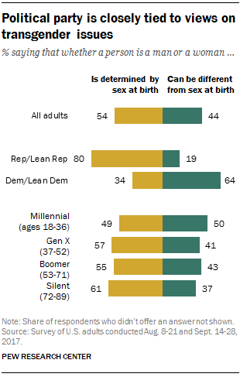
Youngest Americans most likely to support transgenderism
Ones most likely to have been taught it in school and in the media they consume

Slide 10
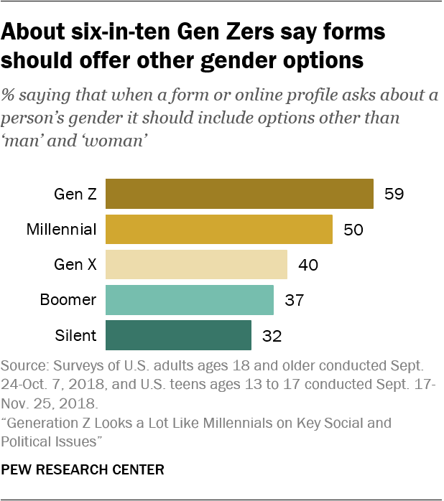
Two-thirds of kids ages 15-19 say use trans pronouns

