Slide 1
Entertaining Our Kids Into Losing Their Souls
Why and how parents can and should limit screen time.

Slide 2
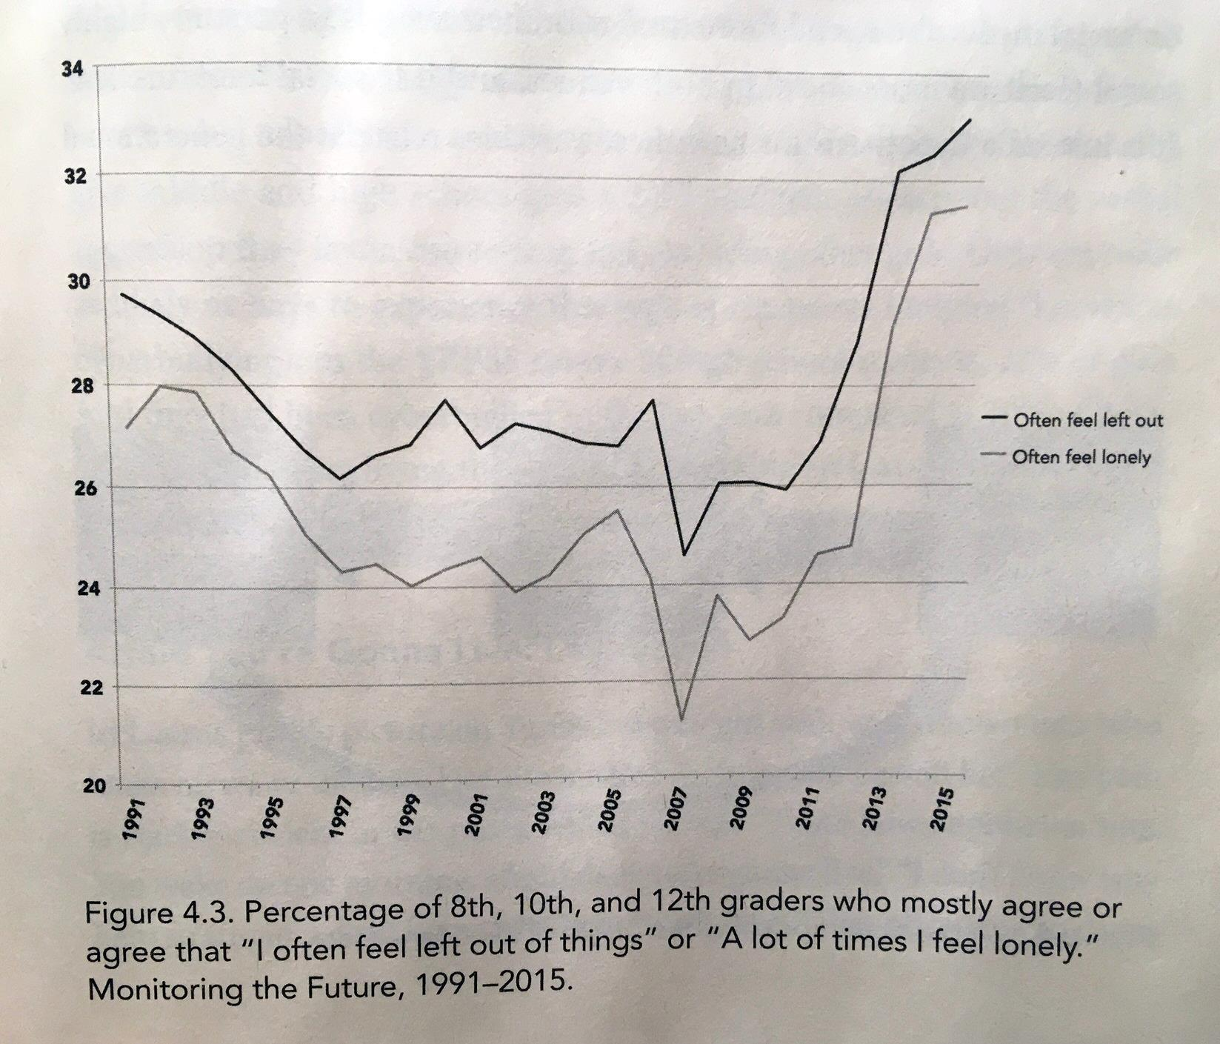
Depression and loneliness right when phones saturated society
Jean Twenge, “iGen,” 2017

Slide 3
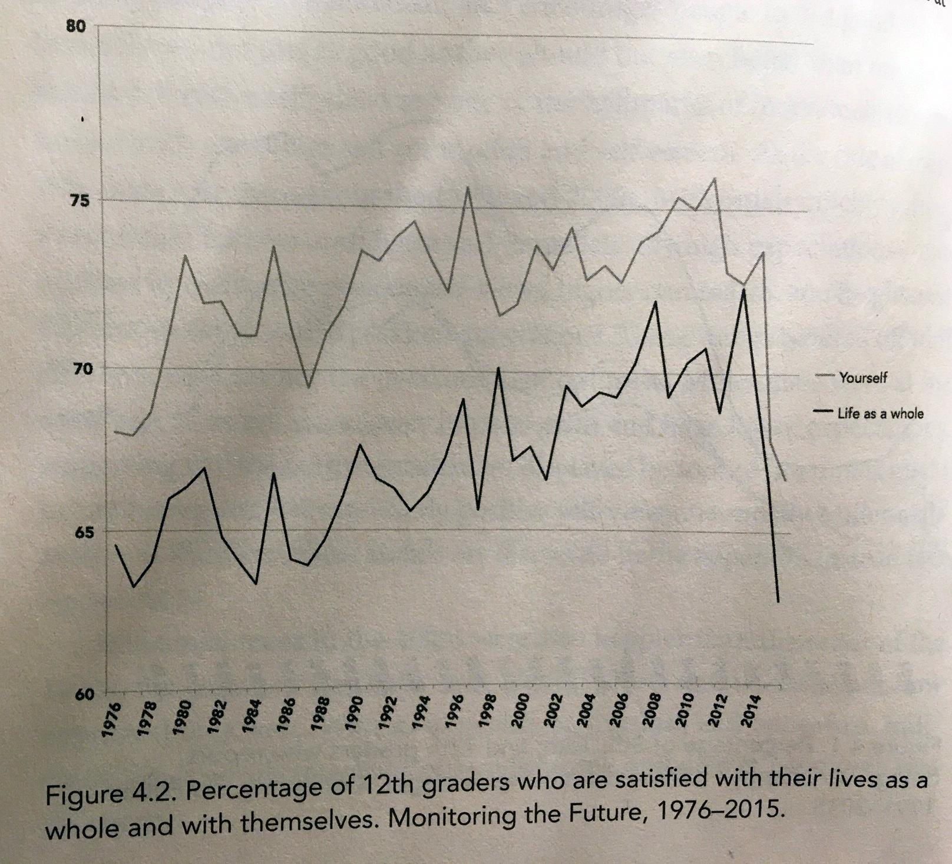
Life satisfaction takes a nosedive
Jean Twenge, “iGen,” 2017

Slide 4
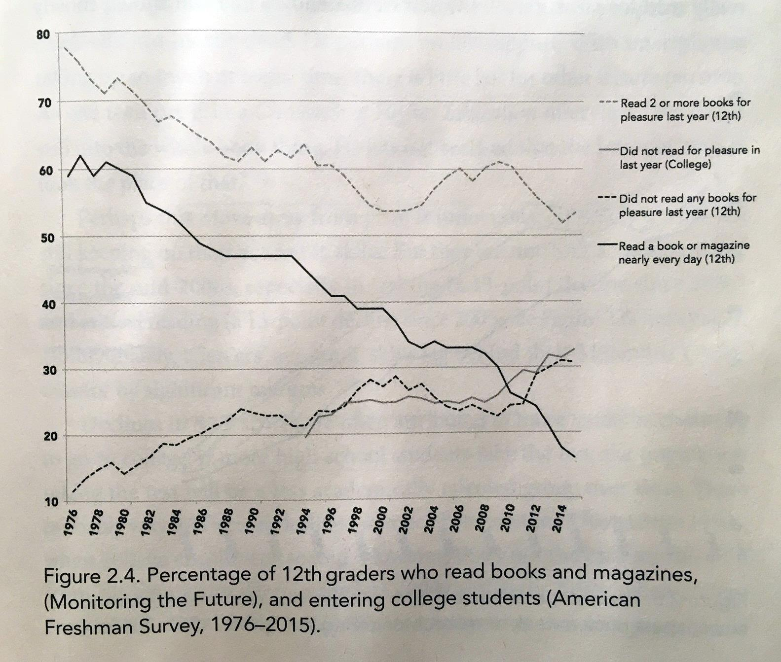
Sharp decline in reading
Jean Twenge, “iGen,” 2017

Slide 5
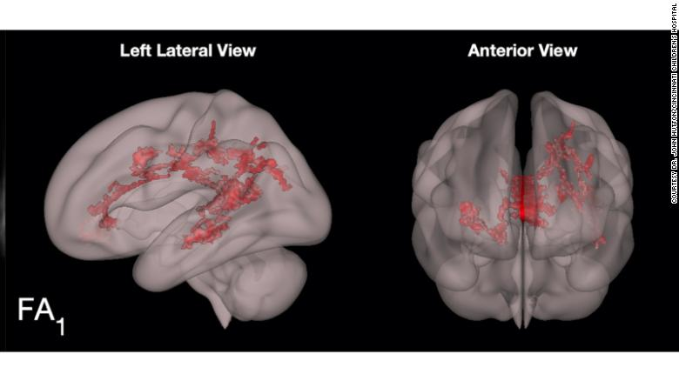
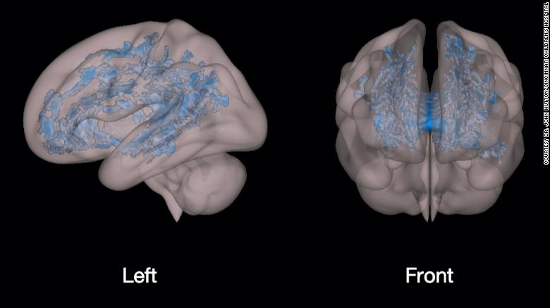
The red areas in this scan show a growth in organized white matter in the language and literacy areas of the child's brain, areas that will support learning in school.
The blue shows the massive underdevelopment and disorganization of white matter in a preschooler who is using a screen (television, tablets and smartphones, etc.)

